Slide 1
The European Child:Learning by doing the 3 C’s - Connect, Construct And Create
International learning/ training semiar
in Larsmo, Finland,
12.03.2018.-18.03.2018.

Slide 2
INTERNATIONAL LEARNING/TRAINING SEMINAR in Finland “CHILD OF NATURE”
MONDAY | TUESDAY | WEDNESDAY | THURSDAY | FRIDAY | SATURDAY
12th of March | 13th of March | 14th of March | 15th of March | 16th of March | 17th of March
10.00-14.00 Information about Risö skola Participation in classroom activities Lunch at school, offered 14.00 – Accommodation arrangements, free time DINNER IN JAKOBSTAD | 09.00-10.00 WELCOME CEREMONY 10.00-14.00 Workshops for teachers 1. KiVa-school in theory 2. KiVa-school in practice 3. Tablets in daily school work 4. Three steps of special education Lunch at school, offered 12.00-12.45 Meeting media 13.00 – 15.00 Discussions and conclusions 15.30 Transport to Jakobstad 18.30 DINNER at Steakhouse Ludvig | 09.00-12.00 Outdoor and environmental education in preschool “Skogsgläntan”, Visit to the Town hall Lunch at school, offered 12.00 – 15.00 Observing woodwork and needlework lessons, project “Grandparents at school” Teacher´s meeting 15.00-17.00 Finnish traditions, sauna and swimming DINNER 17.00-19.00 Transport to Jakobstad | 09.00-12.00 Visit to the local community center Bjärgas, with guided tour and information about the open air museum and the school project "Time travel” 12.00-14.00 Lunch at school, offered Presentations and discussions, classroom observations, active learning in participating schools 14.00 Transport to Jakobstad Visits the hospital 19.00 Festive dinner Restaurant Epoque | 09.00-14.00 Visit to Risö preschool, -presentation about outdoor education, “Skogsmulle” -special education in preschool -classroom observations Lunch at Risö skola, offered 14.00 Transport to Jakobstad Free time 19.00 Possibility to attend the local Teacher´s associations Winter party in Jakobstad | 09.00-12.00 Meeting and summary Discussions and planning the meeting in GBR Lunch in Jakobstad at own cost Departure

Slide 3
OTHERS ACTIVITYS
Four nature trips:
Autumn Trip: Orienteering games.
Winter Trip: Designing bird feeders and putting in natural environment.
Spring Trip: Planting tree.
Summer Trip: Recycling activities.

Slide 4
Other issues
Creating and leading E-twinning project (Bulgaria)
Approbation/ testing of the experience of „Child of Nature” in each country till June, 2018
Creating the teaching material "CHILD OF NATURE», „Nature Scrapbook” (Finland, Bulgaria)

Slide 5
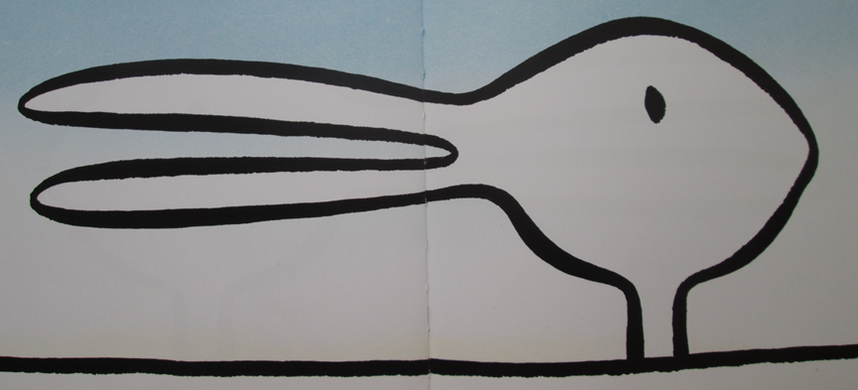
Notes:
Uz skaitu trīs (1,2,3) dalībnieki korī visi kopā pasaka, ko viņi redz.
Sagaidām, ka citi teiks ‘’pīle’’ un citi ‘’zaķis’’ vai ‘’trusis’’, tātad nebūs viendabīgs “koris.” Kas te notika? Attēls taču ir viens? Vadītāji rāda youtube grāmatas PPP un lasa grāmatu latviešu valodā. Mēs visi skatāmies uz vienu attēlu, bet saskatām tajā dažādas lietas. Lai kopīgi izvirzītu mērķus un kopīgiem spēkiem to sasniegtu, svarīgi ir ne tikai skatīties vienā virzienā, bet arī redzēt ja ne gluži vienu un to pašu, tad vismaz kaut ko līdzīgu.

Slide 6
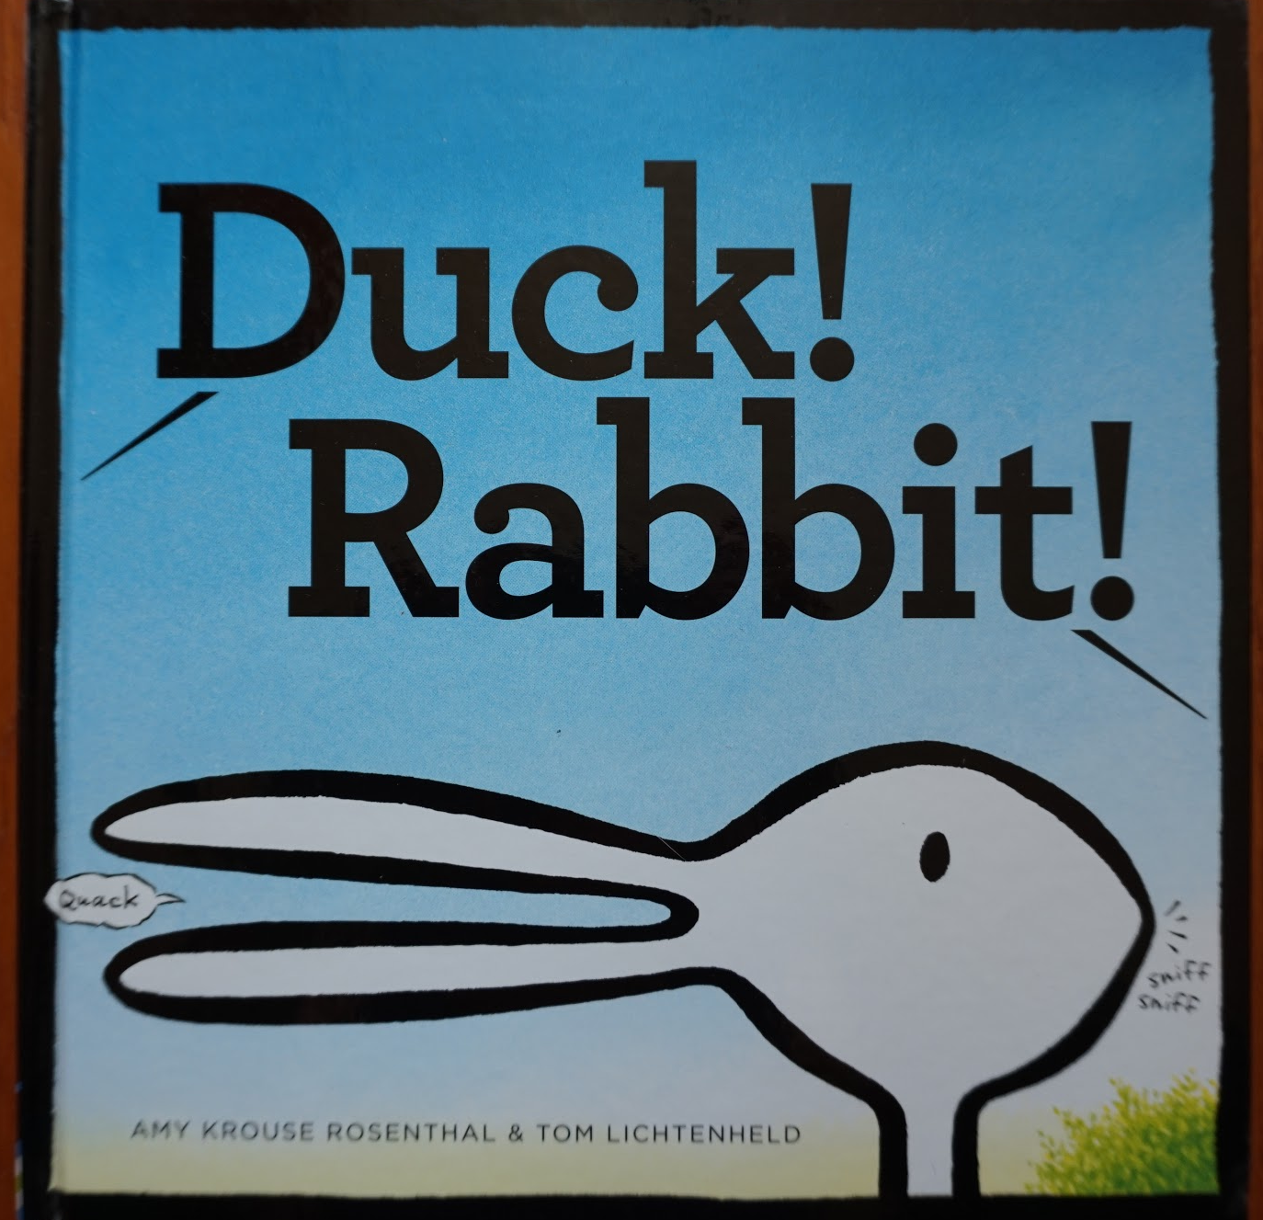
Notes:
Amy Krouse Rosenthal un Tom Lichtenheld ‘’Duck! Rabbit!’’

Slide 7
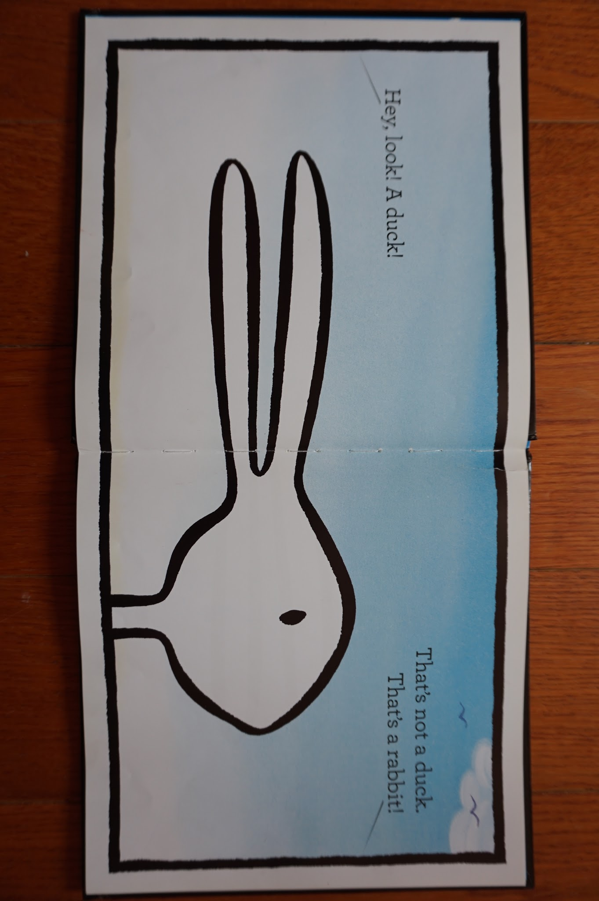

Slide 8
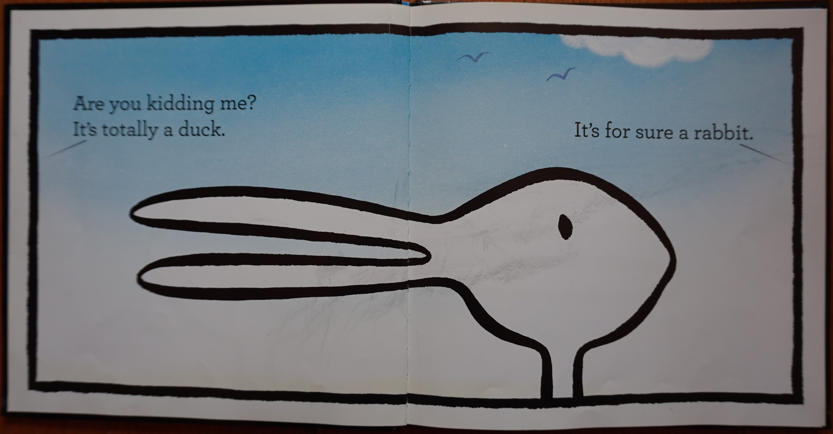

Slide 9
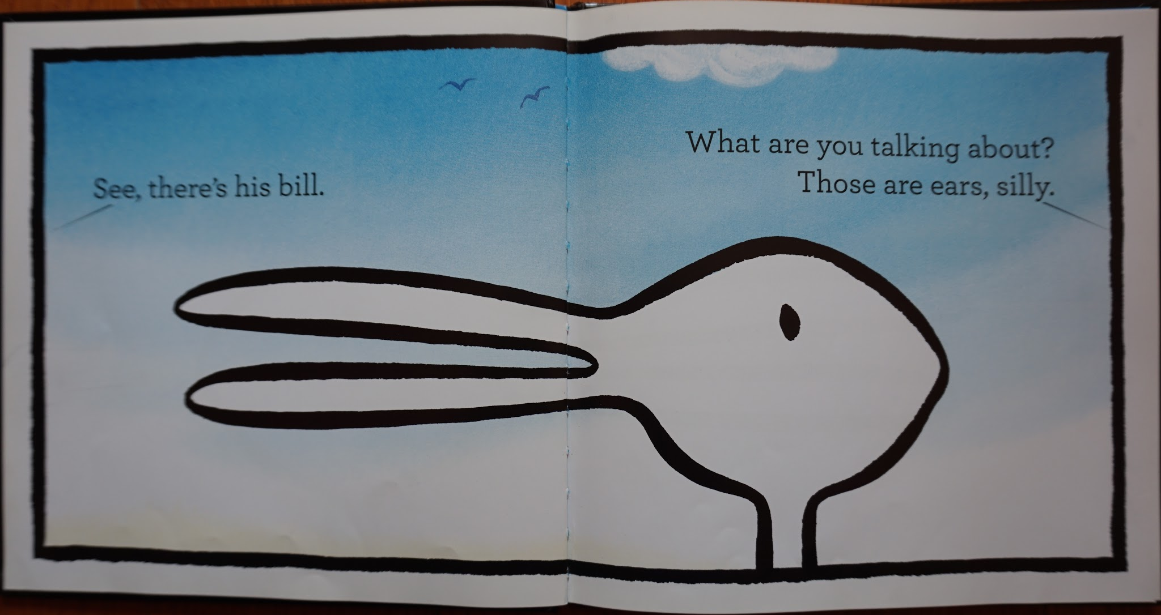
.

Slide 10
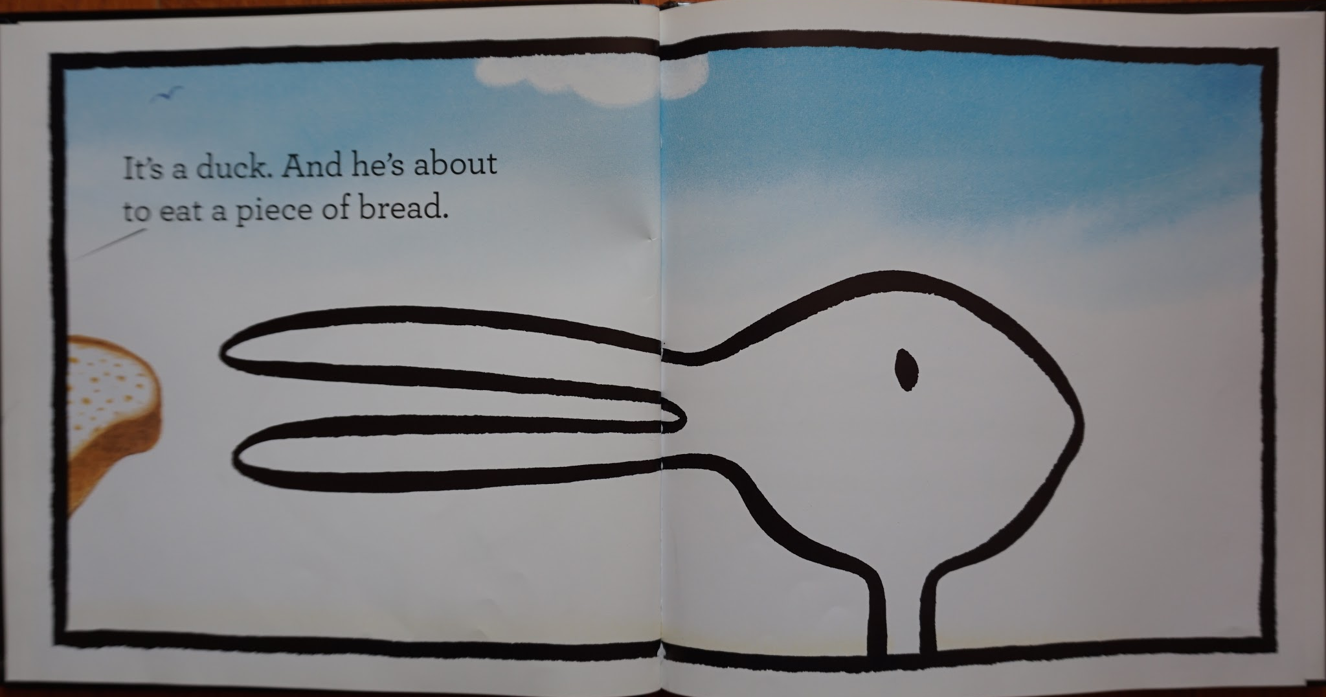

Slide 11
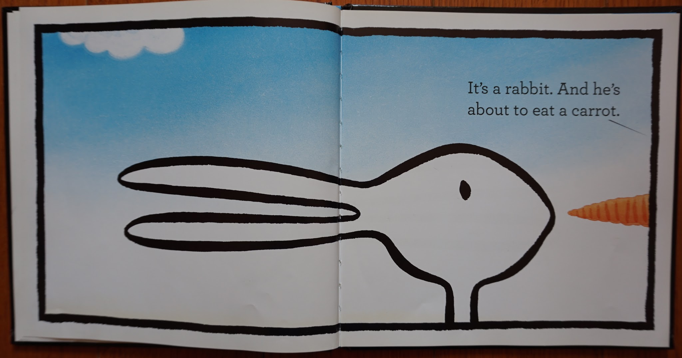

Slide 12
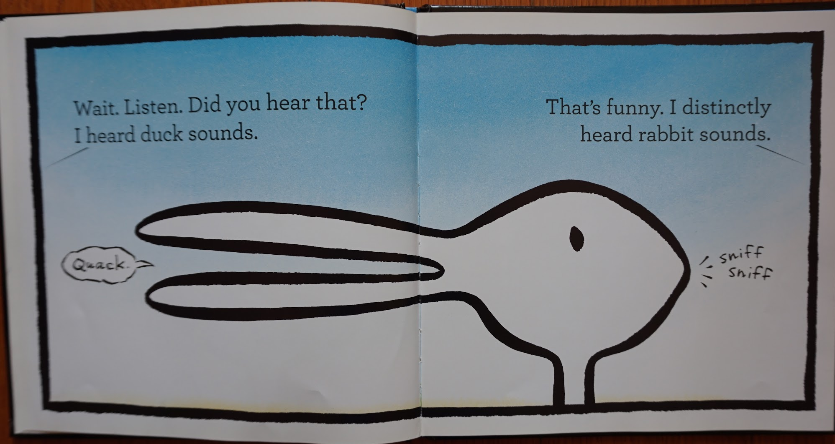
.

Slide 13
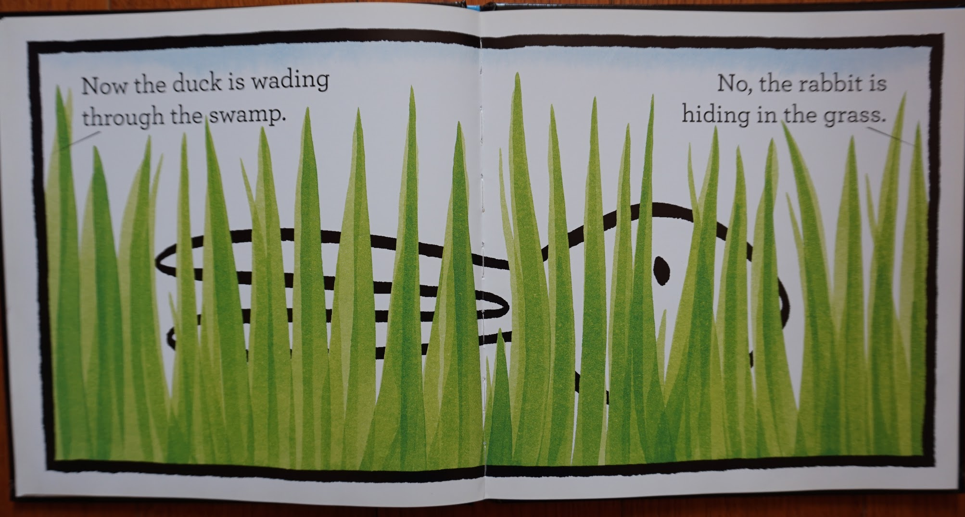
.

Slide 14
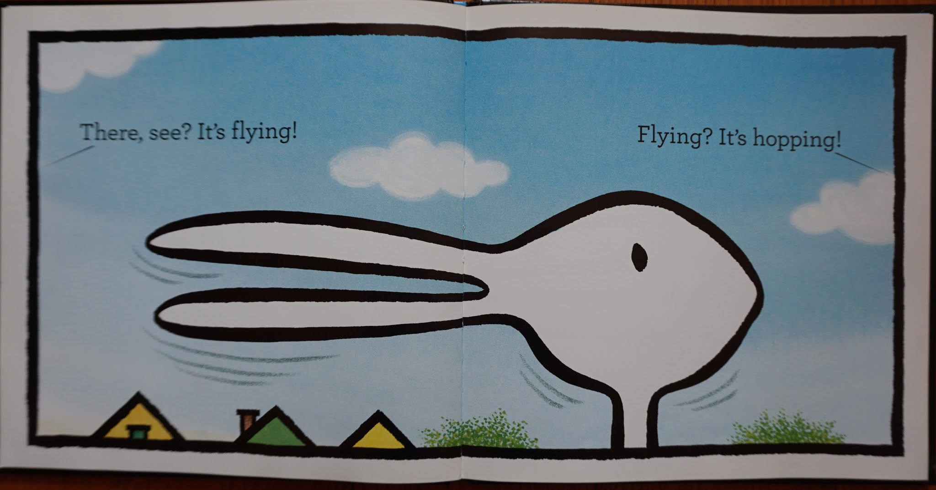

Slide 15
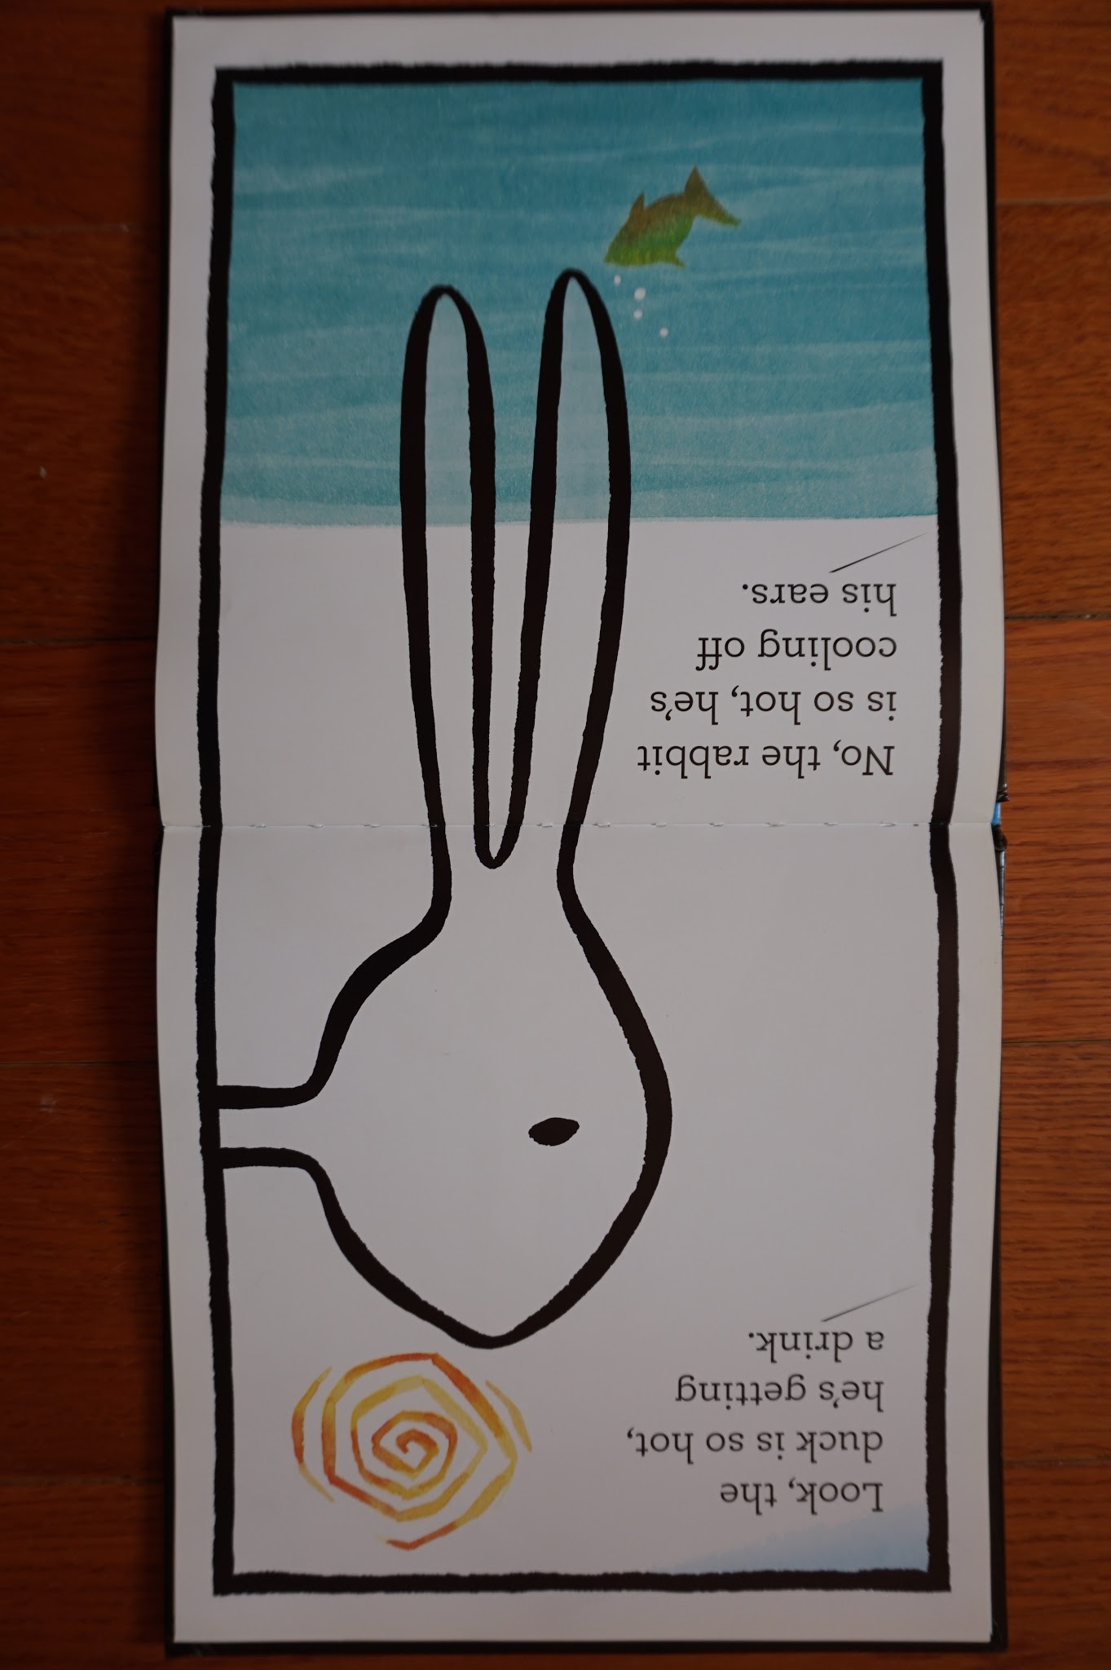

Slide 16
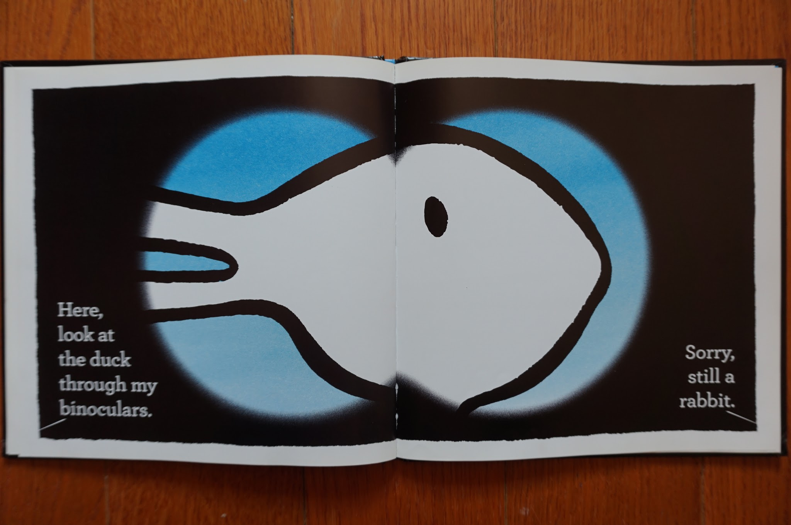

Slide 17
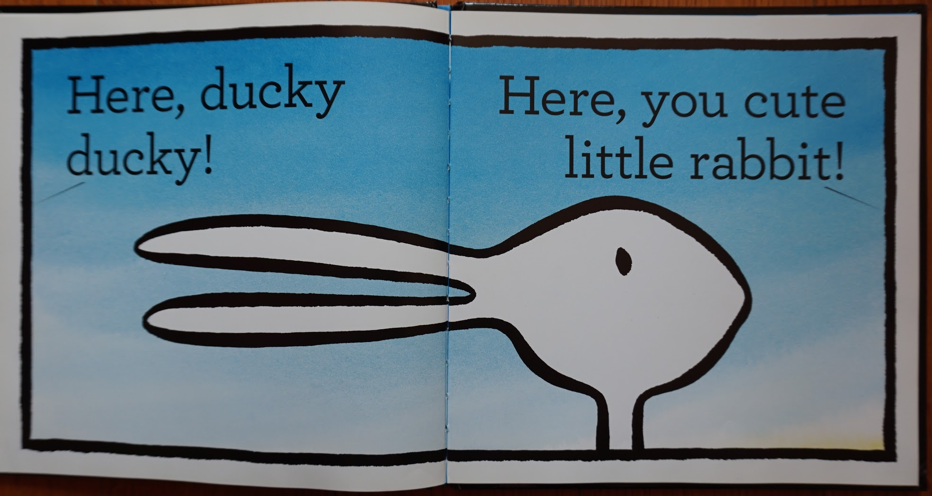

Slide 18
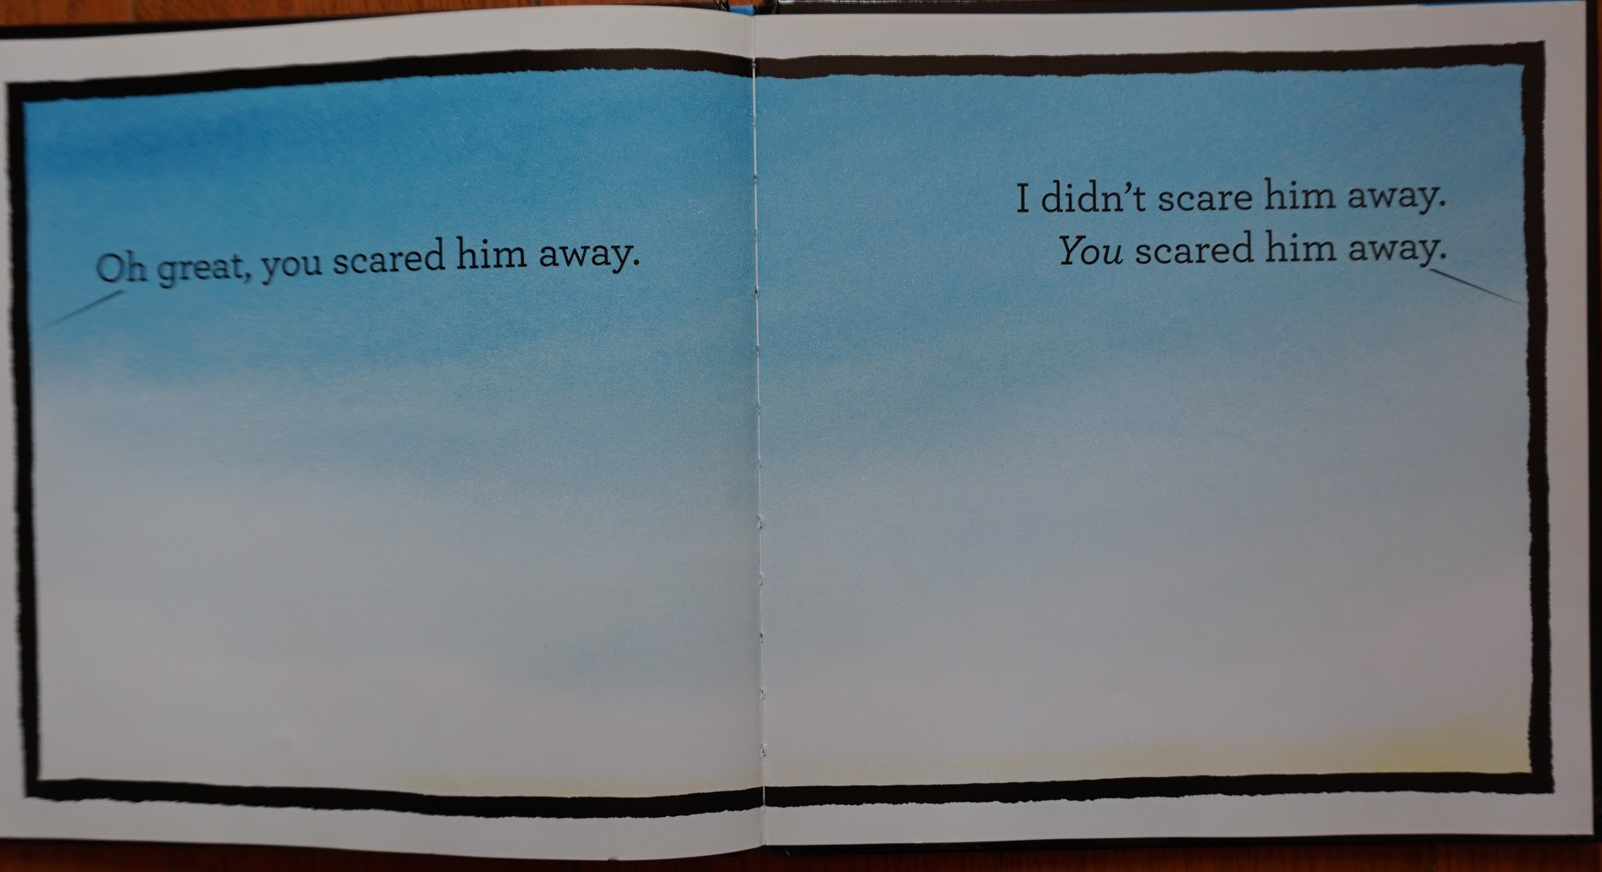

Slide 19
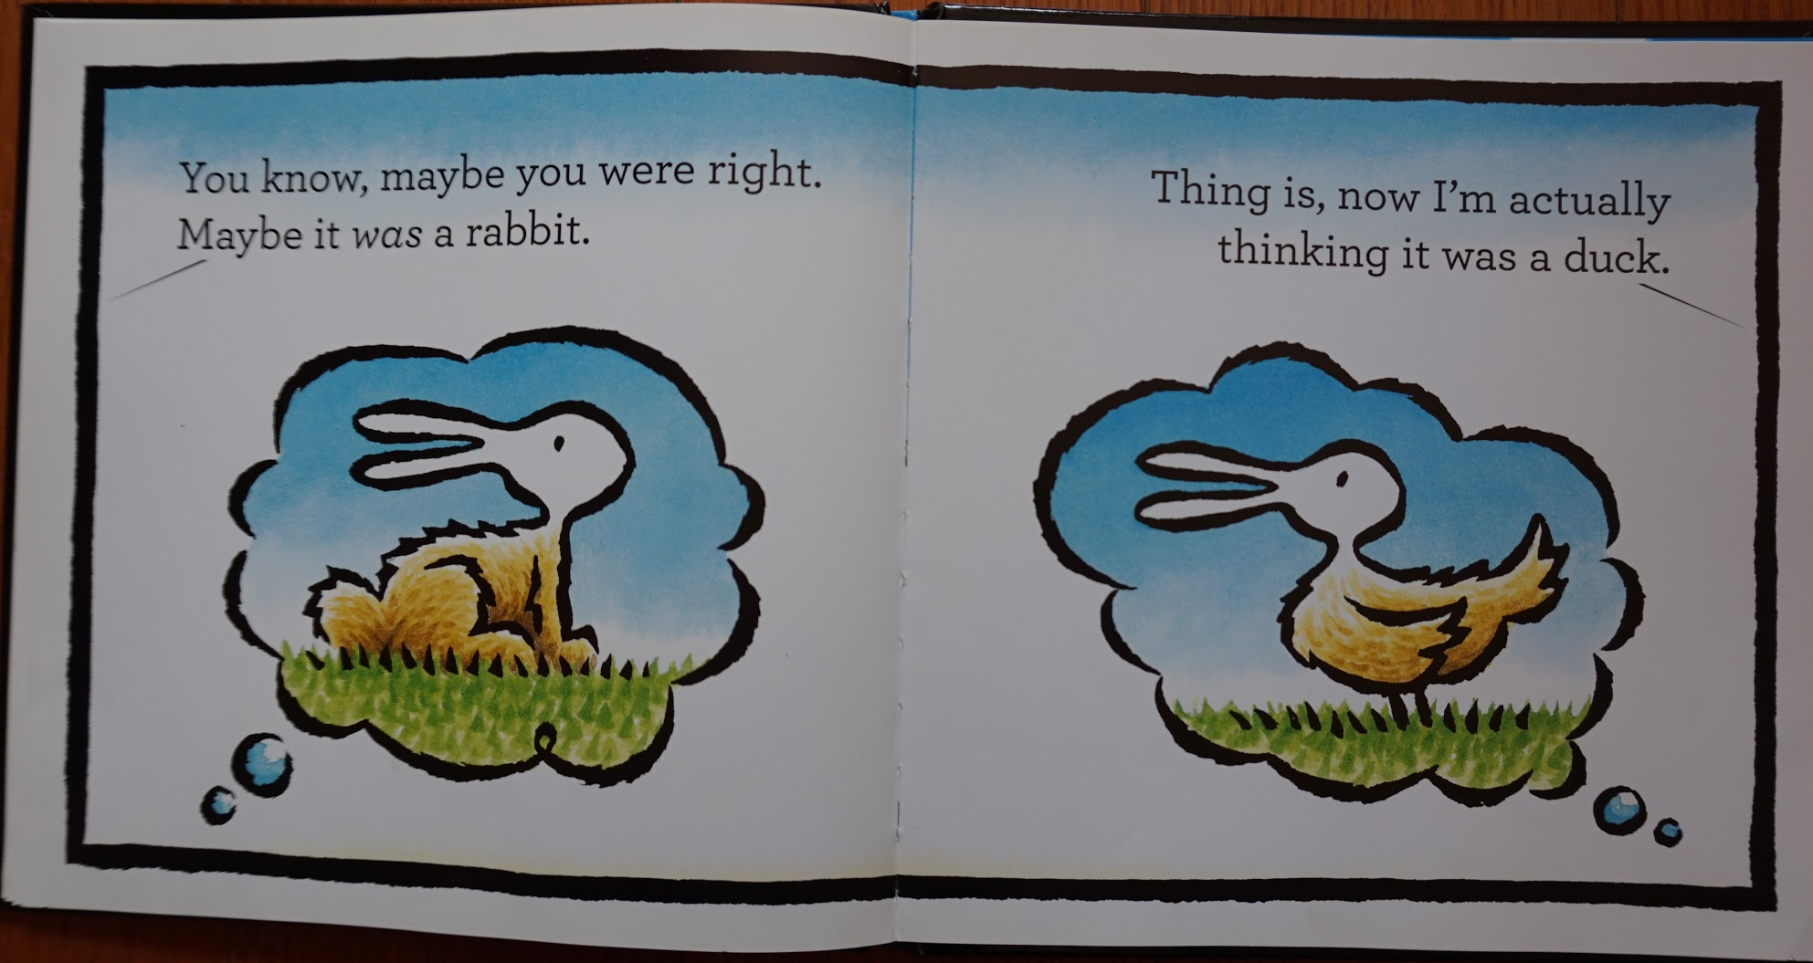
.

Slide 20
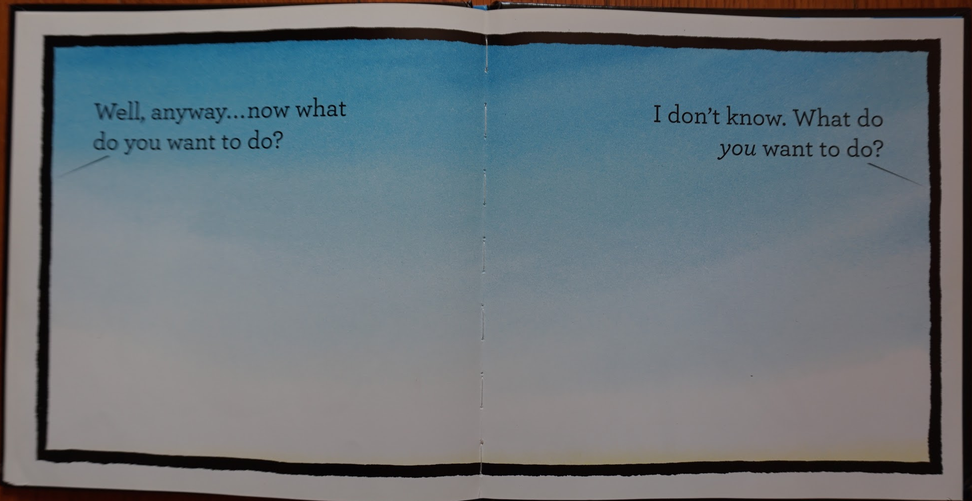

Slide 21
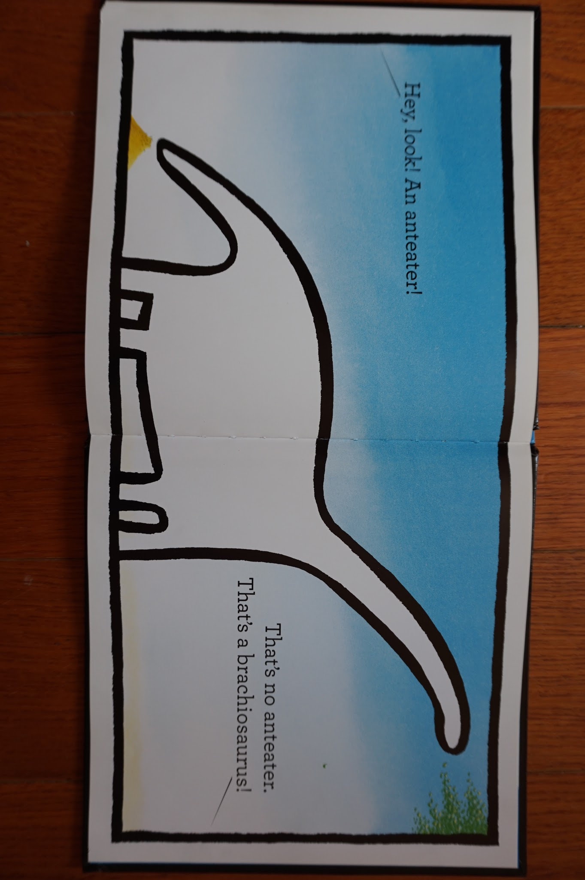

Slide 22
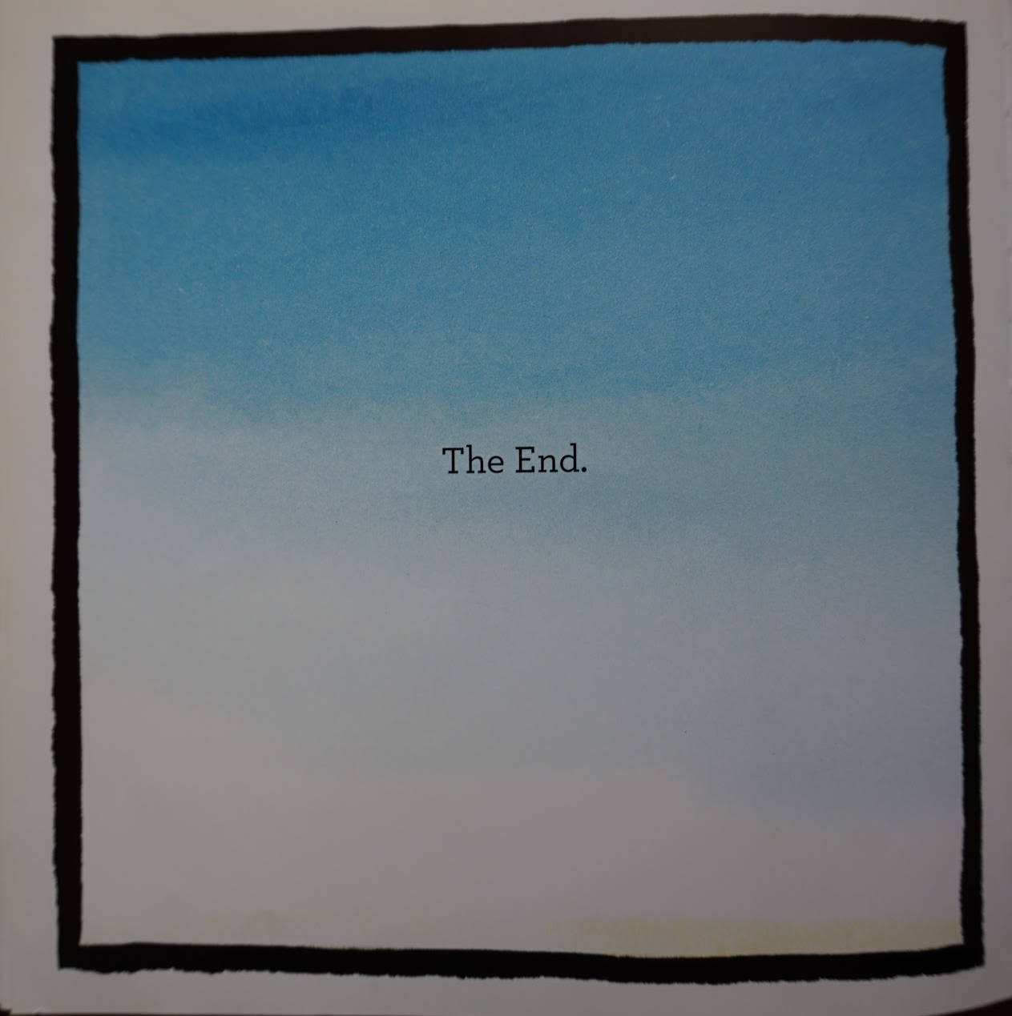
What is the main idea from this story?

Slide 23
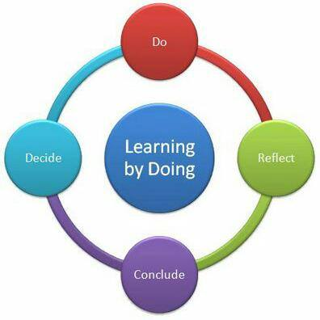
TEACHING AND LEARNING ON THE BASIS OF CONSTRUCTIVISM AS A METHOD RELATED TO / CLOSE WITH THE THEORY FOR ACTIVE EDUCATION
Assoc. Professor Chrissoula Nedyalkova,Ph.D Faculty of Social Sciences Prof. Assen Zlatarov University - Burgas, Bulgaria
Methodological material
«Guide-Active learning»

Slide 24
In the «Guide-Active learning» material we need to explain the teachers how they can
- apply innovative teaching/ learning methods.
- create learner centred enviroment.
- improve children and children skills, to share experience.
- develop children' learning skills like critical thinking and problem solving, communications and collaboration, creativity and innovation skills.
- apply teaching/learning methods of constructivism and connectivism.

Slide 25
THIS MATERIAL WILL GIVE IDEAS HOW
To create an environment and encourage the child for an active participation.
2. To enable children to gain experience in natural environment and gain natural awareness, flexibility, adaptability, initiative and self-direction, productivity and accountability skills.
3. Teachers will be able to encourage children to observe and connect the new knowledge with their previous one and construct, create their own knowledge.

Slide 26
If teachers use this material, children will be able
1. To learn best when they are allowed to construct a personal understanding based on experience and discuss these experiences.
2. To develop skills and confidence so they can analyze the world around them. Solve real-world problems.
3. To take responsibility for their own learning, they become explorers.
4. Children will be able to be more active than a teacher in a learning process.
5. To be active and develop their competences and learning skills.
6. To have ability to choose variety of activities and communication.

Slide 27
To create climate of democracy in the children's group we need
To enable children to make decisions that are important to the whole group.
To enable children to solve real problems by searching solutions and negotiating.
To enable children to learn to respect uniqueness and appreciate common features.

Slide 28
we will look for answers
How to get expected results of the children if in the group they are very different: why, active, upset, slow, sensitive, competitive, with special needs..... ?
2. What to do that children want to do something different than teacher has planned them to do? (to draw flowers whole day)
3. What the environment should be for children to they can develop their ability like thinking skills, problems solving skills, communication, plan, analyze.....

Slide 29
Thank you for your attention!
Questions!

