Slide 1

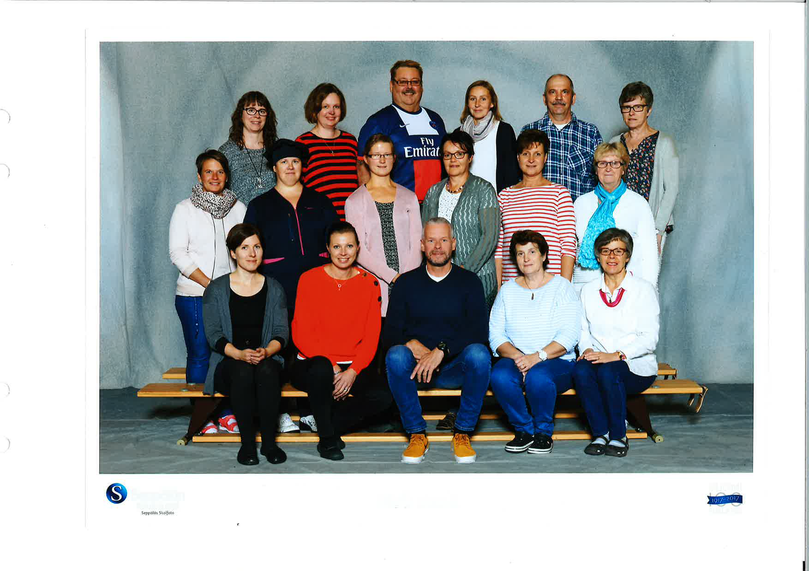

Slide 2
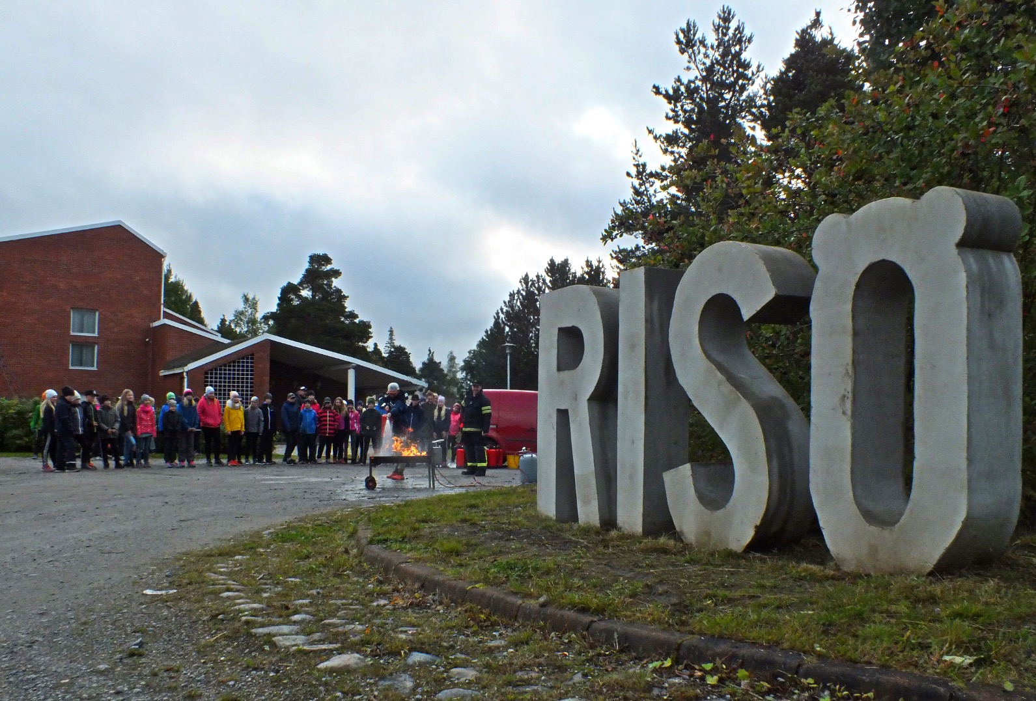

Slide 3
Preschool unit (37 pupils, 6 years of age, 3 teachers and two assistants)
Elementary school (136 pupils 7-13 years, 10 teachers and 3 assistants)
We belong to the Swedish-talking minority in Fınland. Finnish is also tought as language, beginning from preschool and throughout the school-system. We teach English from 4th grade. The school focuses on ICT, reading comprehension and ongoing teachers´ education for competences in differentiation in the subjects we teach.

Slide 4
Experienced teachers and school staff
Outdoor education in preschool
For the older pupils outdoor education is usually arranged in the form of trips and excursions. We provide students to investigate local environments biogeographically, observe actual changes in nature, investigate cultural-social environment and recycling , study relationships between man and nature, understand human beings as a part of nature.
Pupils solve problems based on their own age level.

Slide 5
Pre-primary education as part of the ECEC is the systematic education and instruction provided in the year preceding the start of compulsory education. Pre-primary education is organised in day-care centres and schools. Providing a place in pre-primary education free of charge for all children is a statutory duty for municipalities. Participation became compulsory in August 2015. Nearly all 6-year-olds were, however, enrolled already when pre-primary education was voluntary.

