Slide 1
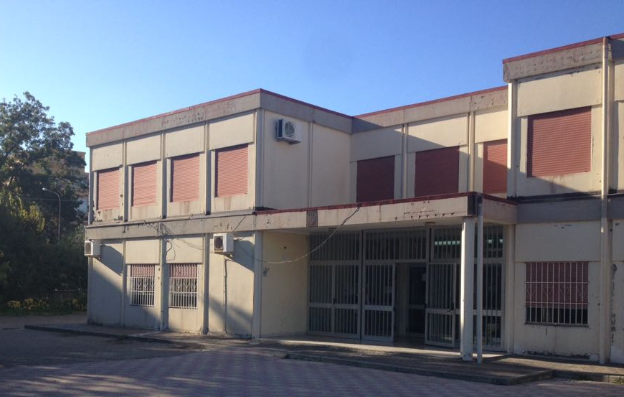
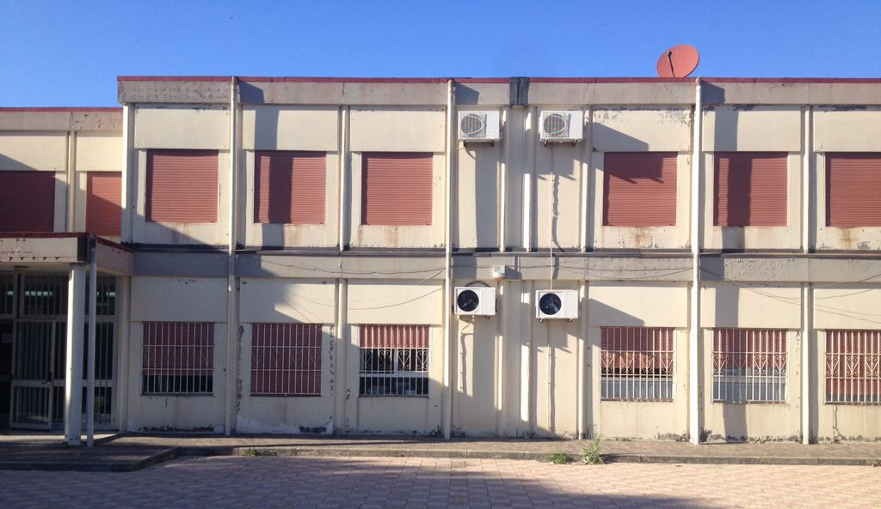
Istituto Comprensivo «MILITI» Barcellona P.G. (ME)

Slide 2
Our Schools
Kindergarten: Il Girasole, Nasari, S. Venera, Portosalvo
10 classes: 200 children
20 teachers and 5 special needs teachers
From Monday to Friday ( h. 08.15/16,15)
Primary school: Militi, Ettore Maiorana, S. Venera 1 e 2, Nasari, Portosalvo
30 classes: 542 children
From Monday to Friday ( h. 08,10/13,35)
Secondary school: Portosalvo
3 classes: 48 children
Secondary school: from Monday to Friday (h. 08,10/13,45)

Slide 3
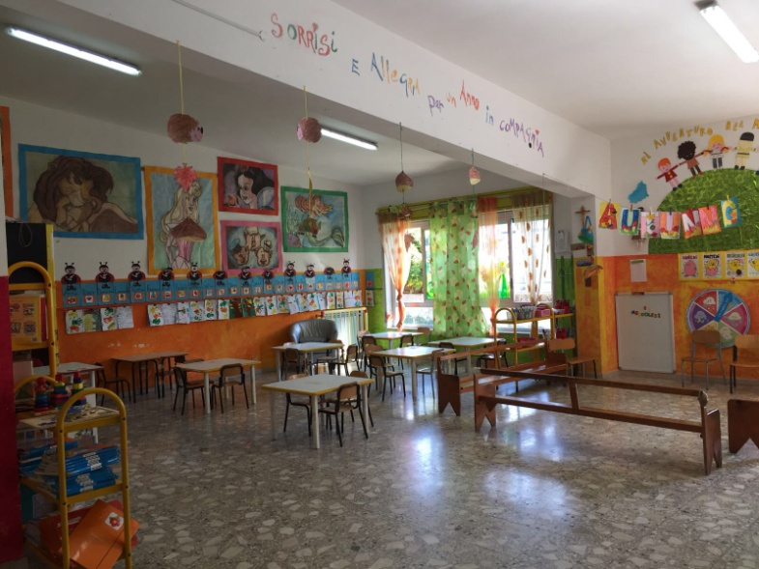
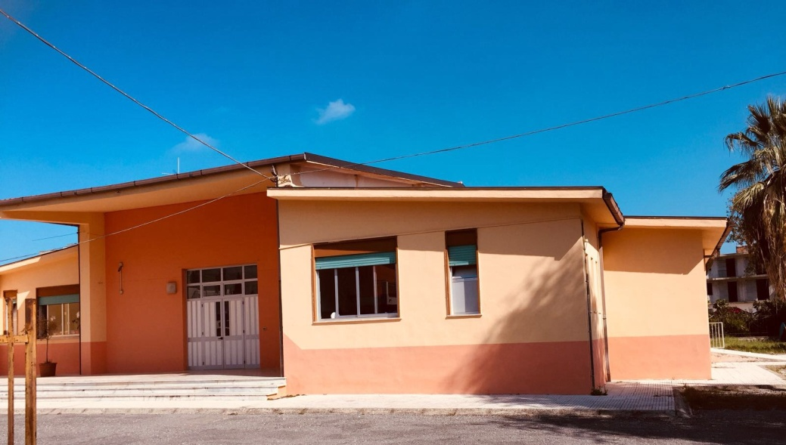
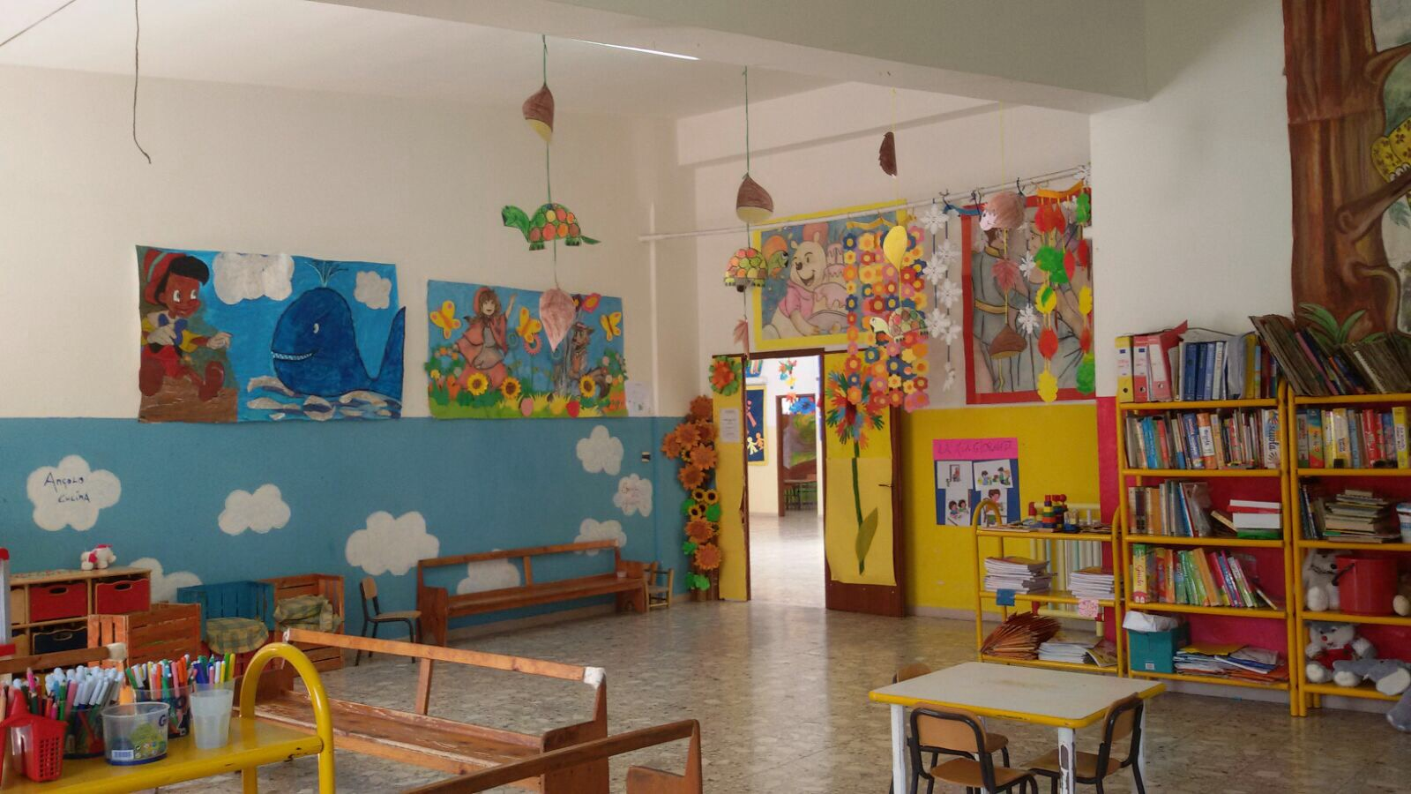
Kindergarten
“GIRASOLE”

Slide 4
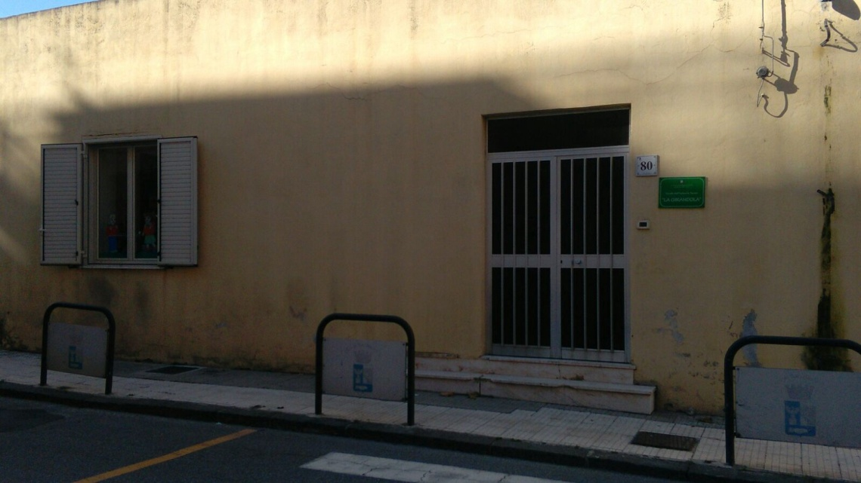
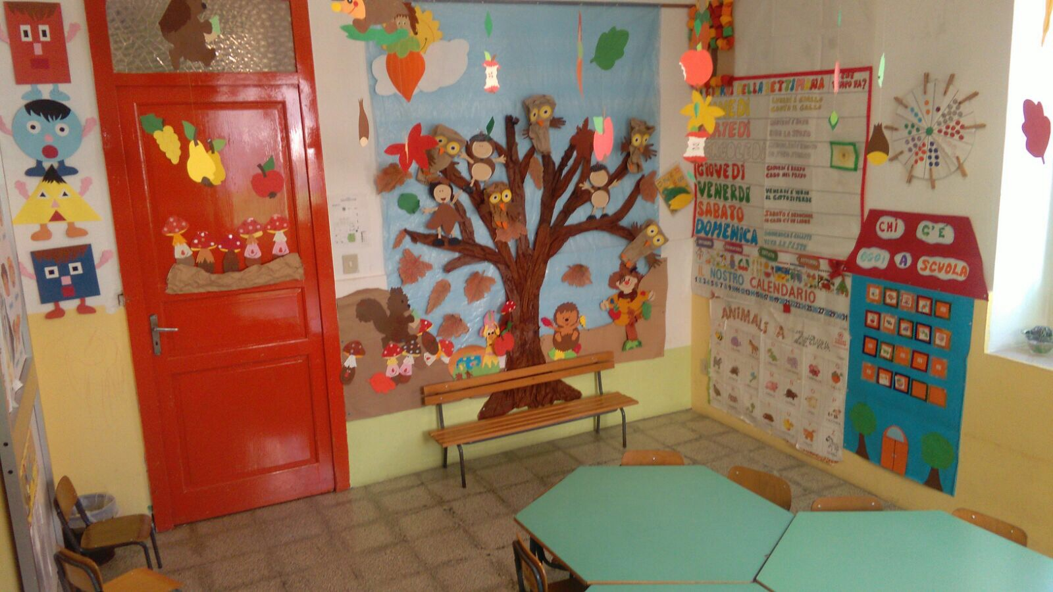
Kindergarten
“NASARI”

Slide 5
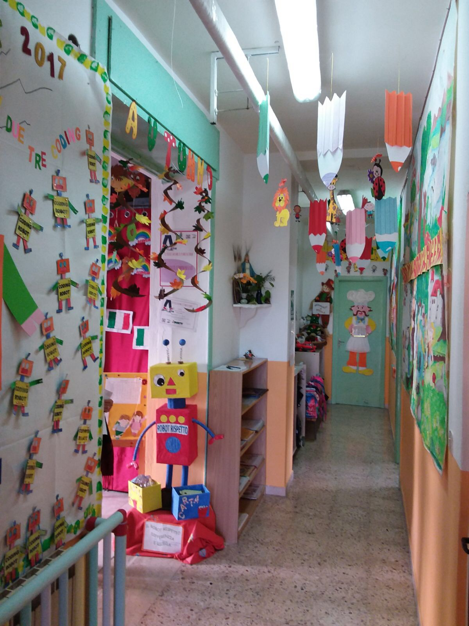
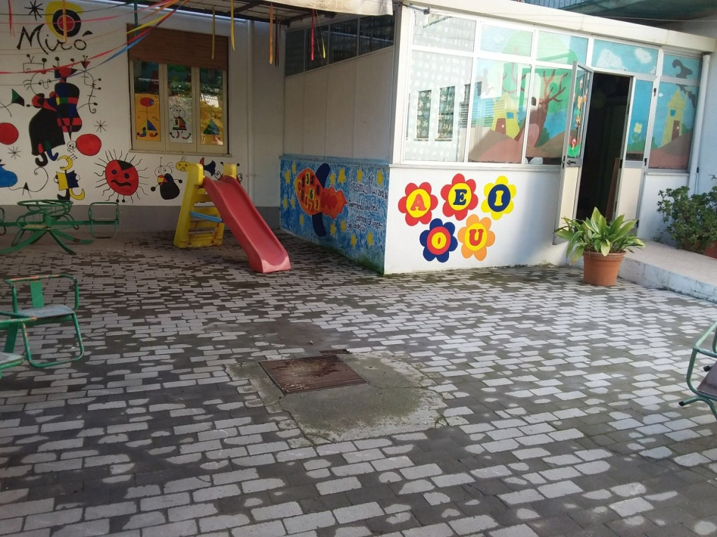
Kindergarten
“PORTOSALVO”

Slide 6
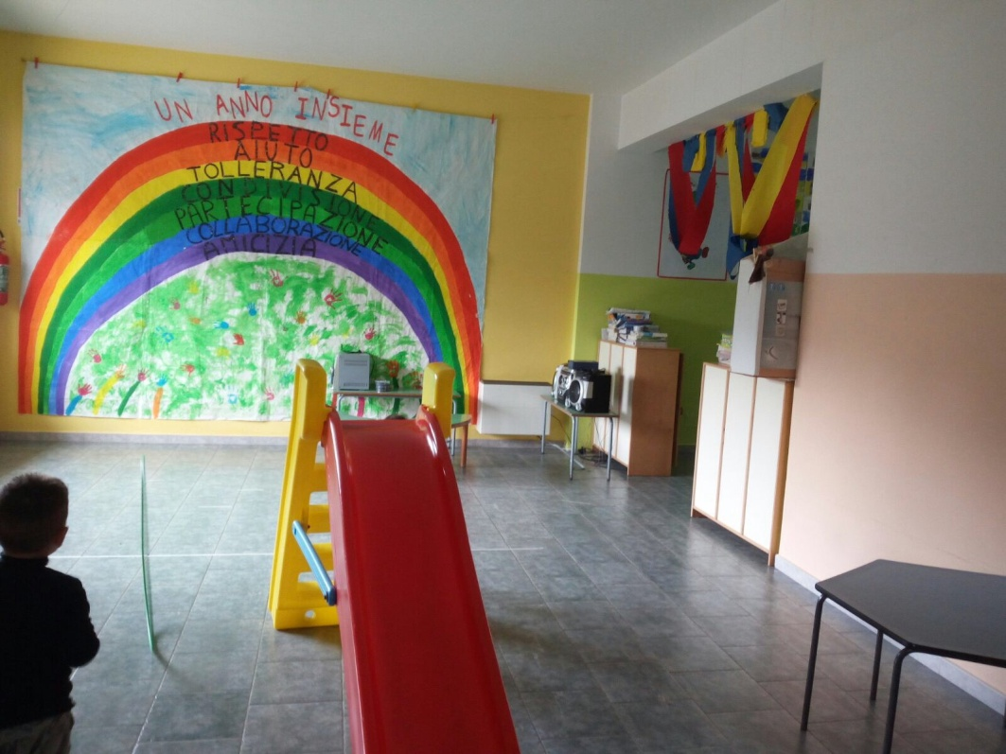
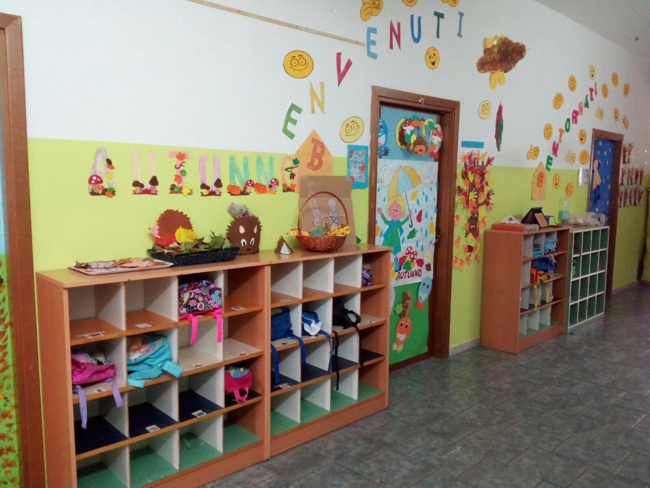
Kindergarten
“S. VENERA”

Slide 7
Our town is Barcellona Pozzo di Gotto in the Province of Messina.
Sicily is the largest Italian region.
Trinacria is the ancient name for Sicily and also it’s symbol. It is composed of the head of the Gorgon , a mythological figure, whose hair is entwined by serpents with ears of corn, from which radiate the three legs bent at the knee.

Slide 8
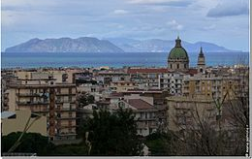
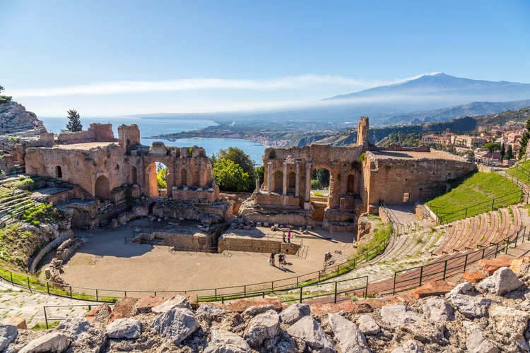
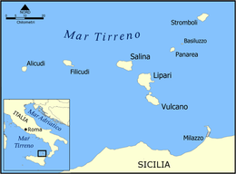
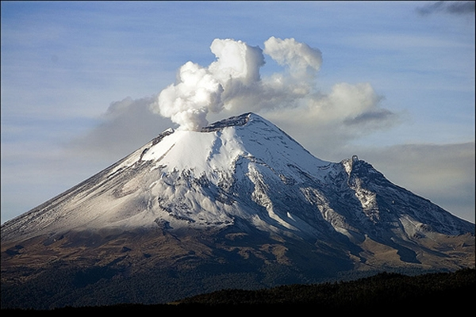
Barcellona Pozzo di Gotto is a Sicilian town, consisting of about 41, 900 inhabitants, located in the province of Messina.
This Tyrrhenian town lies in front of the Aeolian Islands (Vulcano, Lipari, Salina, Panarea, Stromboli, Alicudi, Filicudi).
Near the beautiful city of Taormina and in a 2 hours ride by car you can reach the Etna Vulcano.
.

Slide 9
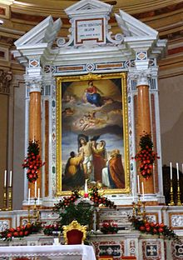
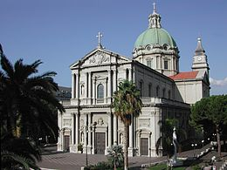
WHAT YOU CAN SEE
St. Sebastiano Basilica: It was inaugurated in 1936 by the Archbishop of Messina Monsignor Angelo Paino. Named after our patron saint Sebastiano, whose feast is on 20th of January.

Slide 10
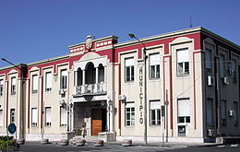
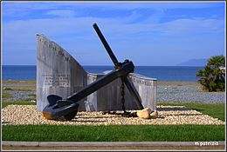
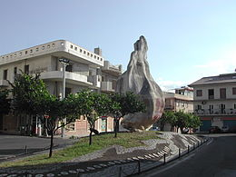
Municipality
Calderà beach
Orange seed Monument (1989) by Emilio Isgrò , a famous and creative artist born in Barcellona P.G.

Slide 11
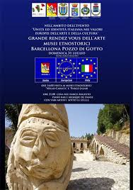
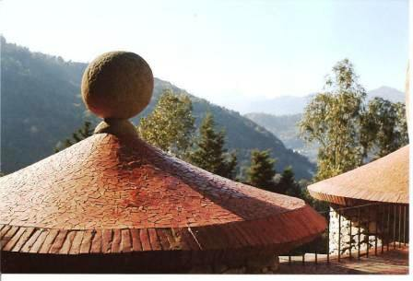
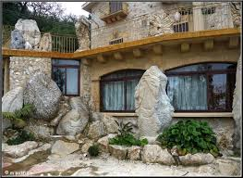
Parco Jalari Museum: sculputured rock museum

Slide 12
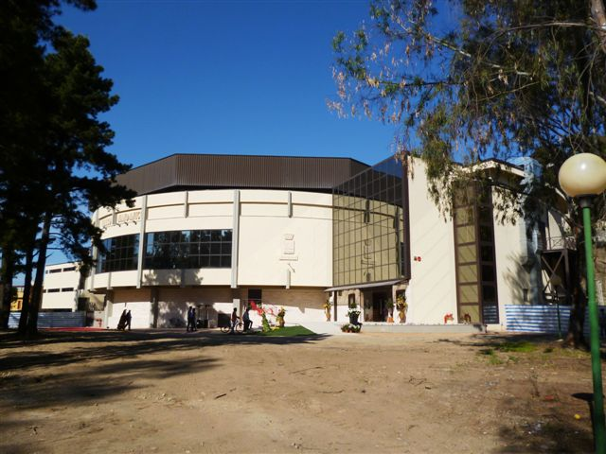
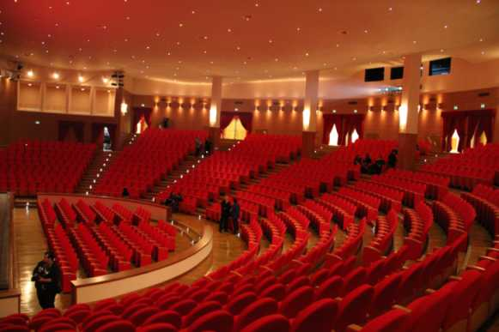
THE NEW «PLACIDO MANDANICI» THEATRE

Slide 13
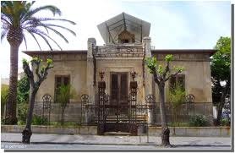
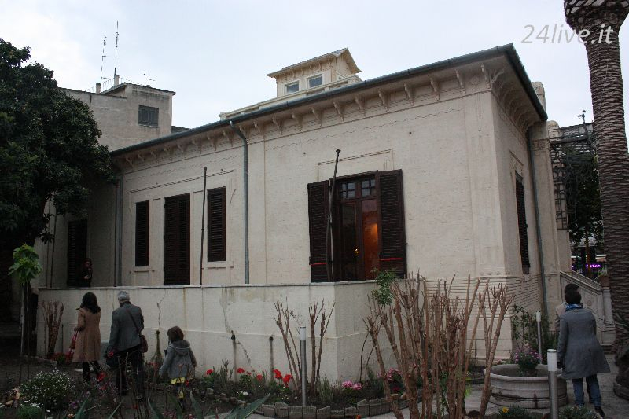
VILLA LIBERTY «FOTI-ARCODACI»
Built by Baron Foti around 1920 and known as "Villa Arcodaci" from the name of its last owner, the villa is one of the most important examples of Art Nouveau in Sicily.
before
now

Slide 14
Sicily's pastries and desserts (dolci) are famous for their richness, and stuffed with ingredients like marzipan and ricotta. Among the treats are cannoli (thin tubes stuffed with ricotta, chocolate or candied fruit). In the Sicilian heat welcome specialities are the area's fine ice cream and the refreshing drink granita di limone (ice and lemon slush) or caffè con panna.
SICILIAN DELIGHTS
Ice cream and granita with brioche

