Slide 1
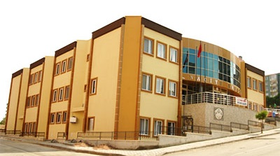
NACİYE KABAKÇI PRESCHOOL
(BALIKESİR)

Slide 2
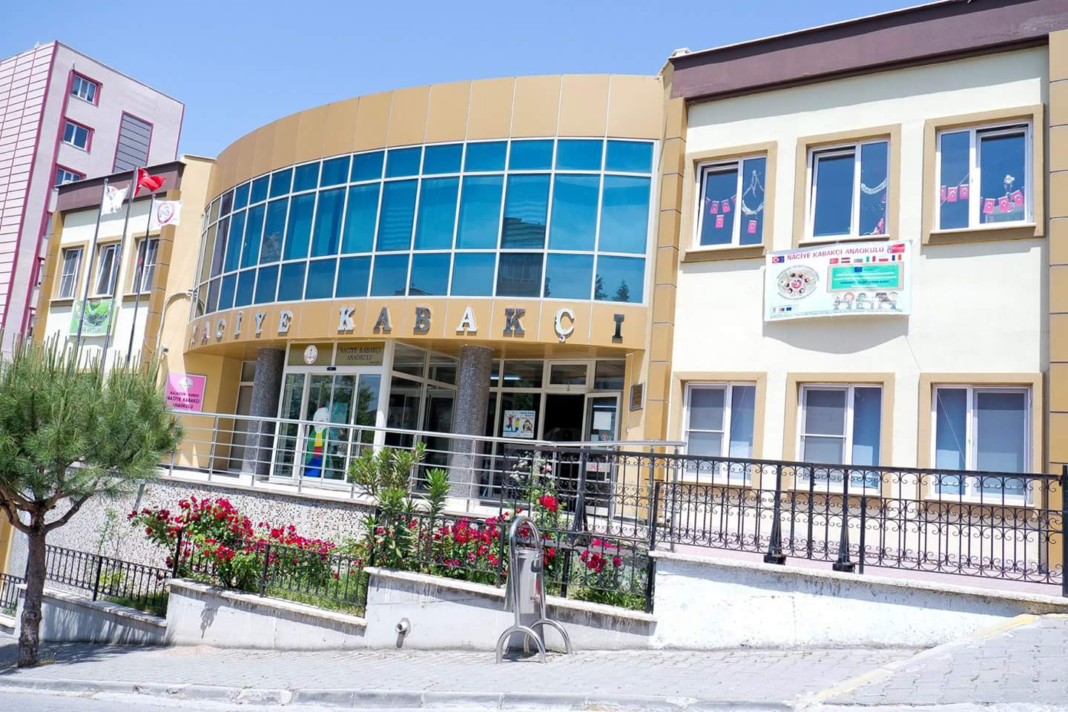

Slide 3
EDUCATION PHILOPSHY OF NACİYE KABAKÇI PRESCHOOL :
I hear and forget,
I see and remember,
I do and understand.

Slide 4
BACKGROUND AND EXPERIENCE OF NACİYE KABAKÇI PRESCHOOL:
Naciye Kabakçı Preschool started to provide preschool education service in 2009. Naciye Kabakçı Preschool has 12 classes,1 intelligence games library, 1 dream room, 1 science room, 1 music room 1 indoor playground, 1 planetarium ,1 greenhouse area, 1 farm house, 1 exhibition hall. Naciye Kabakçı Preschool has 17 preschool teachers, a music teacher, an english teacher, a gymnastics teacher, a school principal, a deputy principal, 8 assistant staff and 380 children aged 3-6.

Slide 5
TEACHING/LEARNING ACTIVITIES AT NACIYE KABAKÇI PRESCHOOL
KITCHEN ACTIVITIES
SCIENCE ACTIVITIES
Science Room Activities
Planetarium Activities
3.ART ACTIVITIES
4.INTELLIGINCE GAMES
5.SPORT ACTIVITIES
6.OUTDOOR ACTIVITIES
7.VALUES EDUCATION

Slide 6
KITCHEN ACTIVITIES
WE aim to develop social skills and life skills as you work together to create something. These activities provide hands-on experiences. Cooking can help young kids learn and practice some basic math concepts and build language skills. And the experience of creating meals with you can help build their self-confidence and lay the foundation for healthy eating habits.

Slide 7
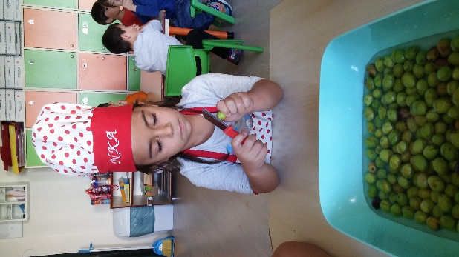
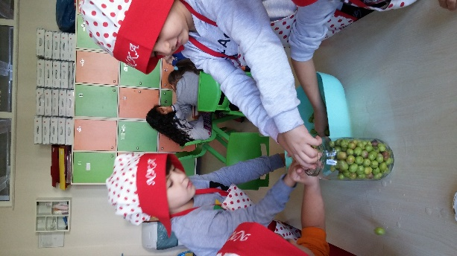
PREPARING OLIVE

Slide 8
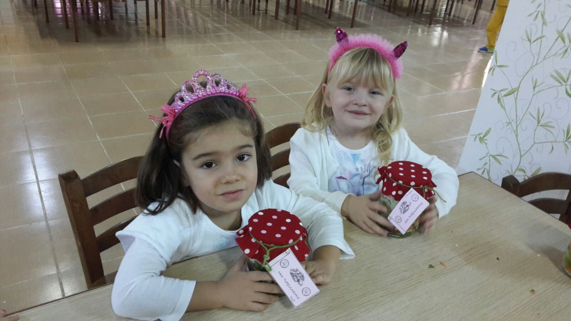
MAKING PICKLE

Slide 9
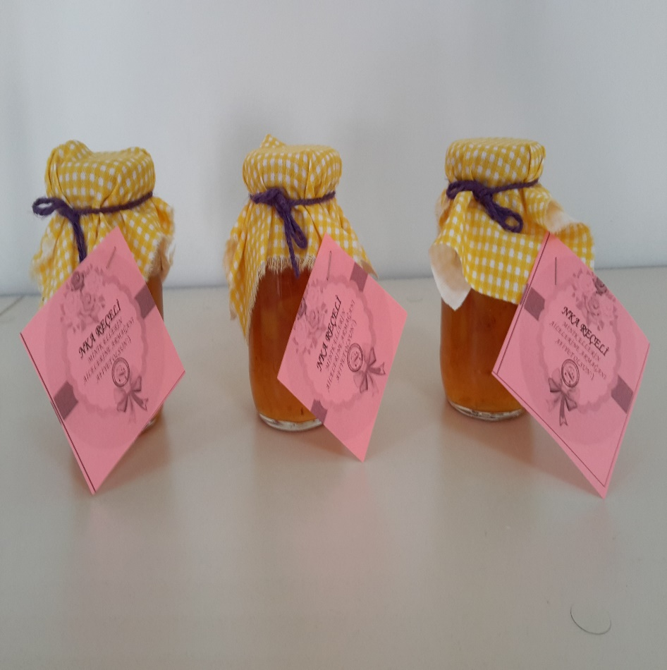
MAKING JAM

Slide 10
SCIENCE ACTIVITIES
Preschool children are naturally wonderful at asking questions about the world around them, and these science activities give answers and view the world scientifically.

Slide 11
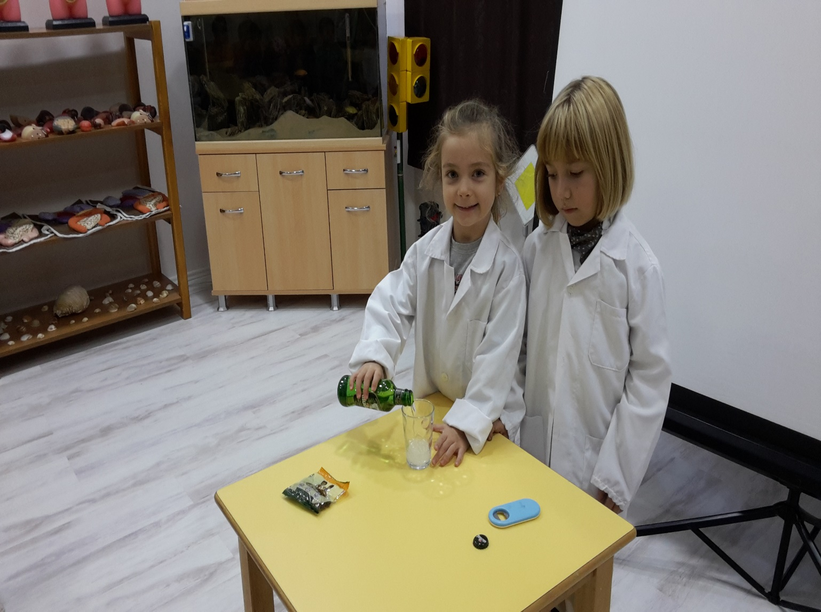
SCIENCE ACTIVITIES

Slide 12
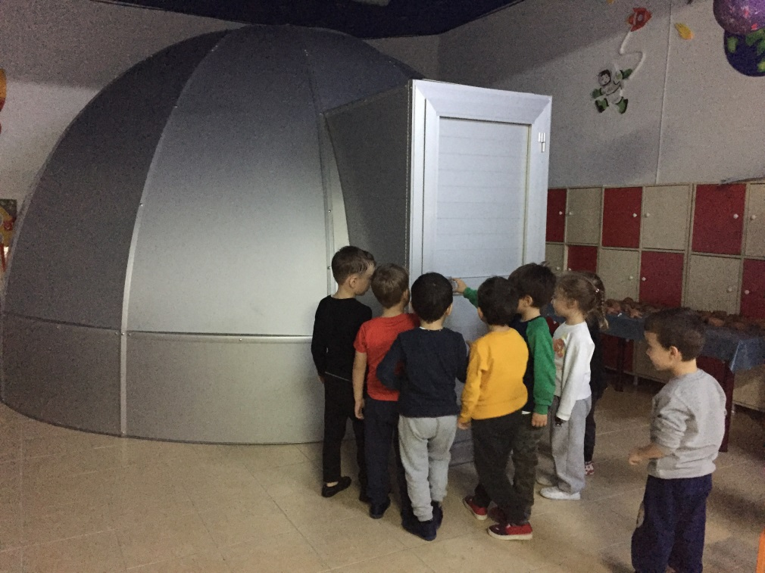
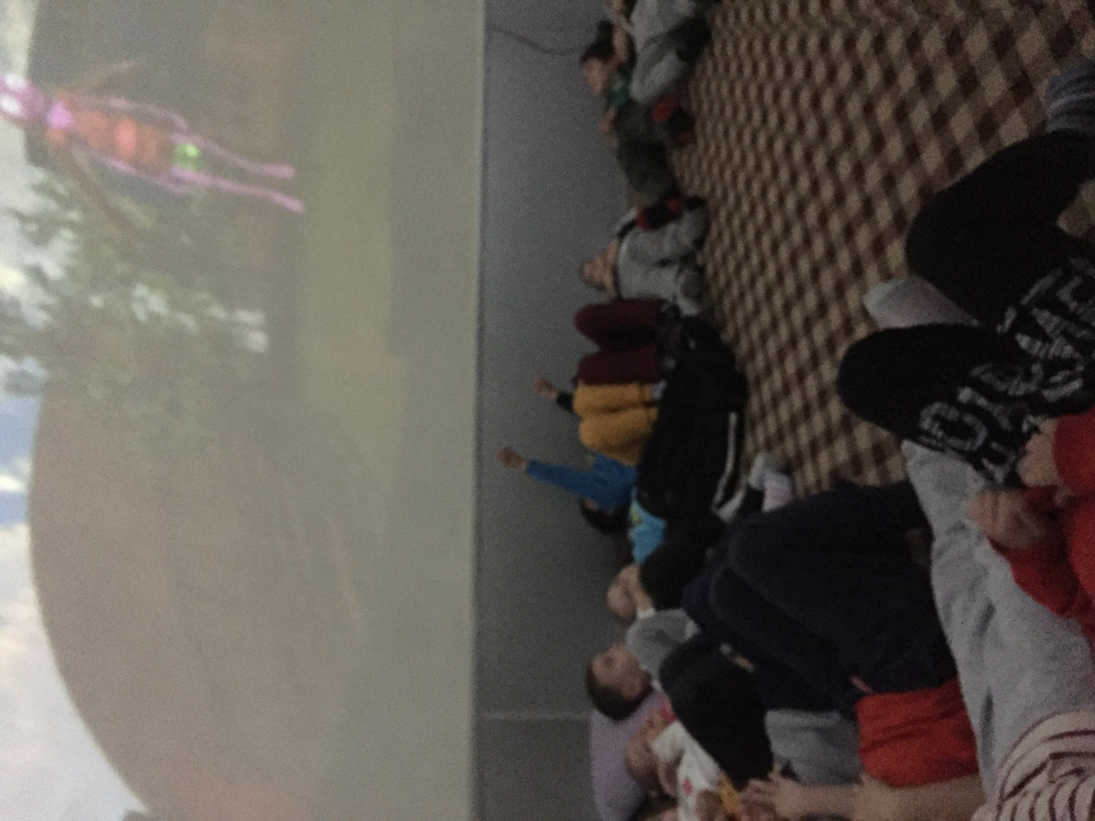
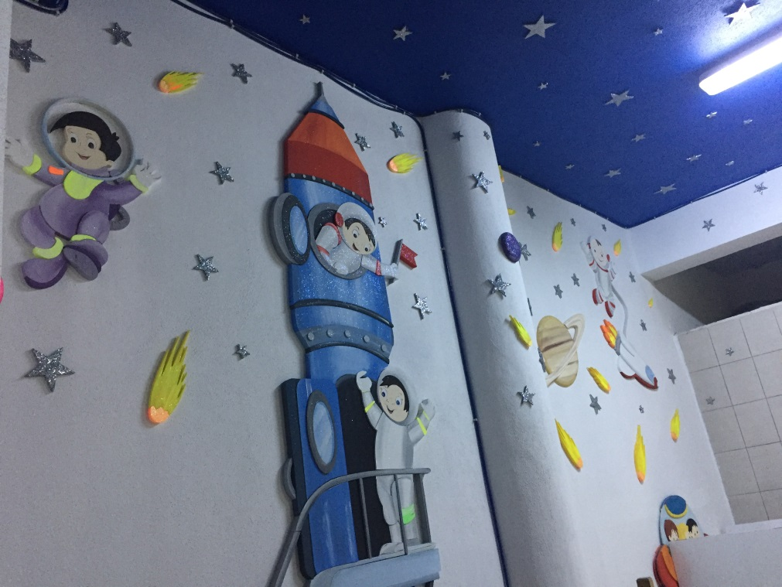
PLANETARIUM ACTIVITIES

Slide 13
ART ACTIVITIES
We aim to develop creativity of children with art activities. Art encourages fine motor skills, neural development, and problem-solving abilities . Children learns to express feelings, with or without words.

Slide 14
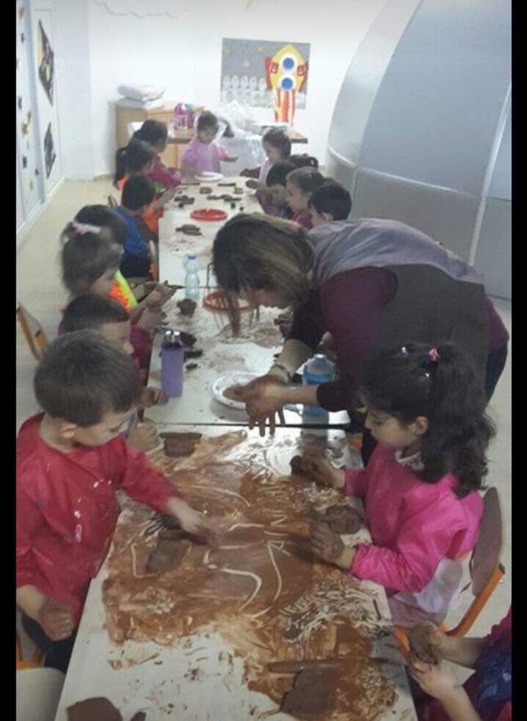
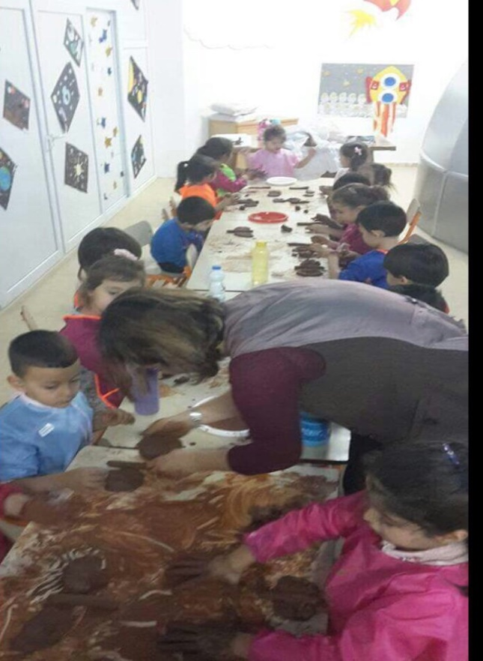
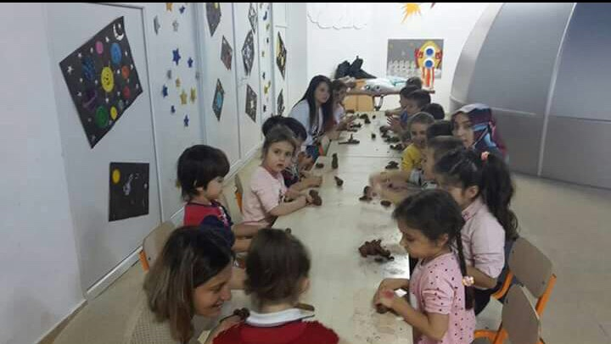
ART STUDIO

Slide 15
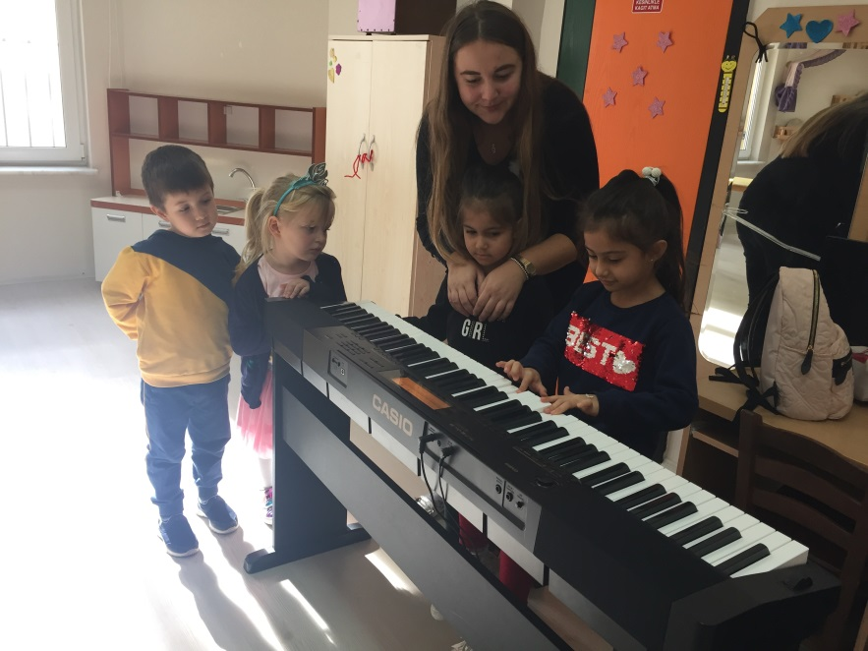
MUSIC STUDIO

Slide 16
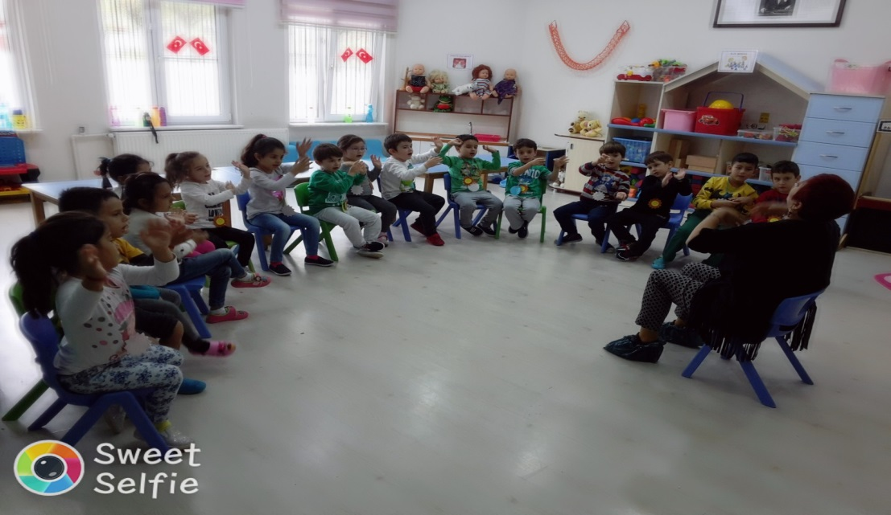
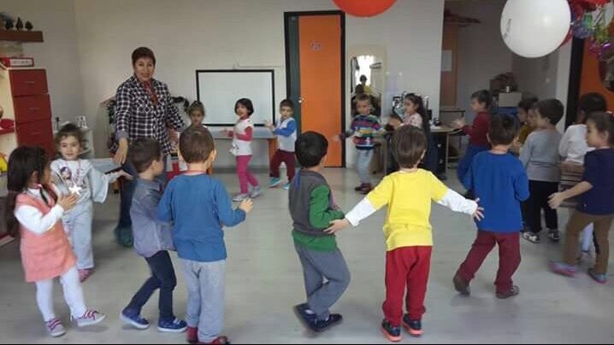
Drama Studıo

Slide 17
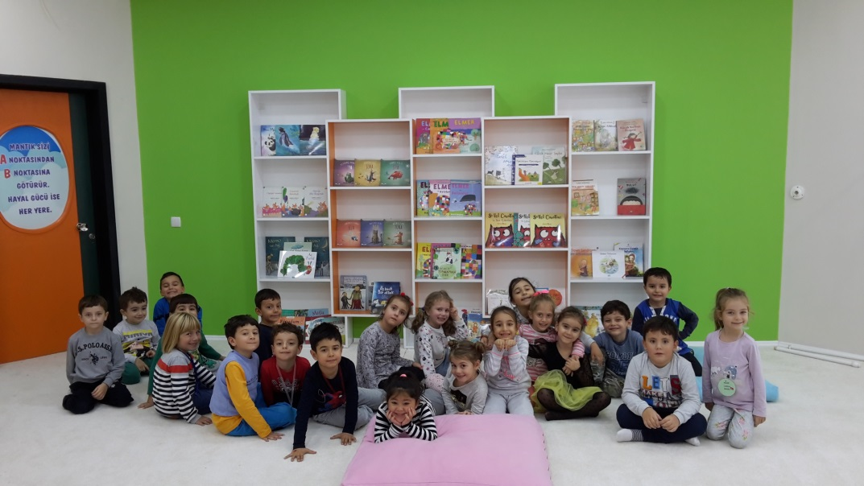
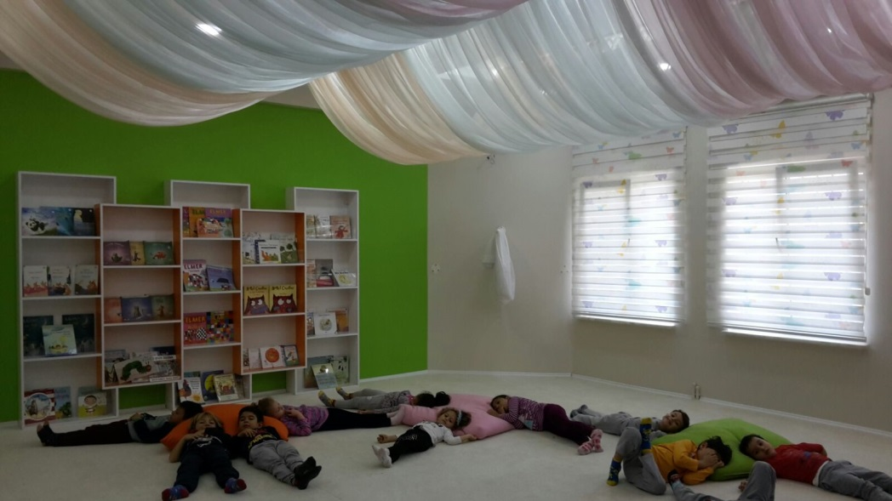
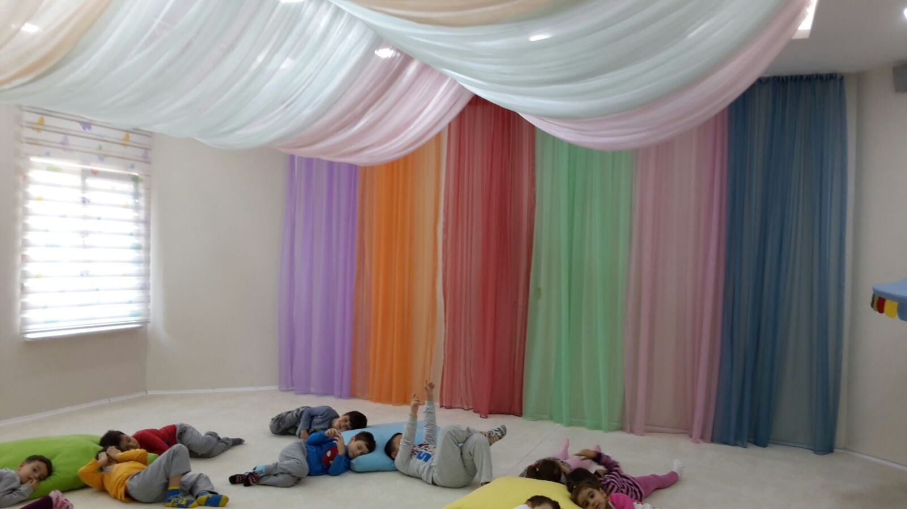
DREAM ROOM

Slide 18
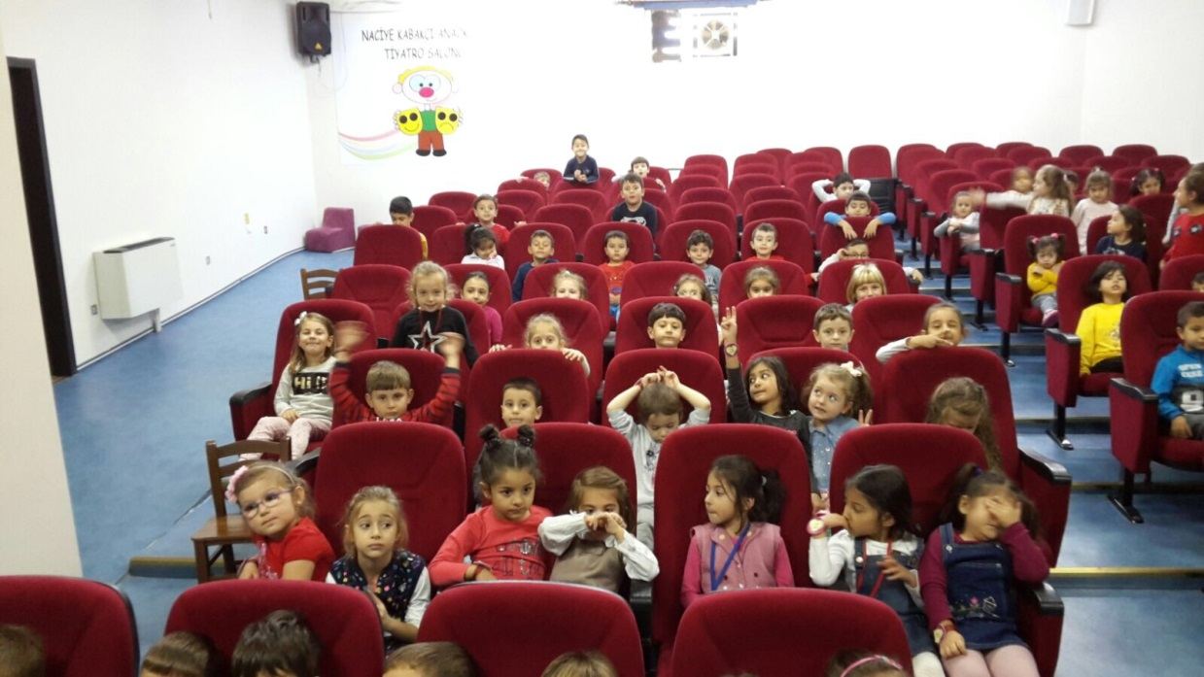
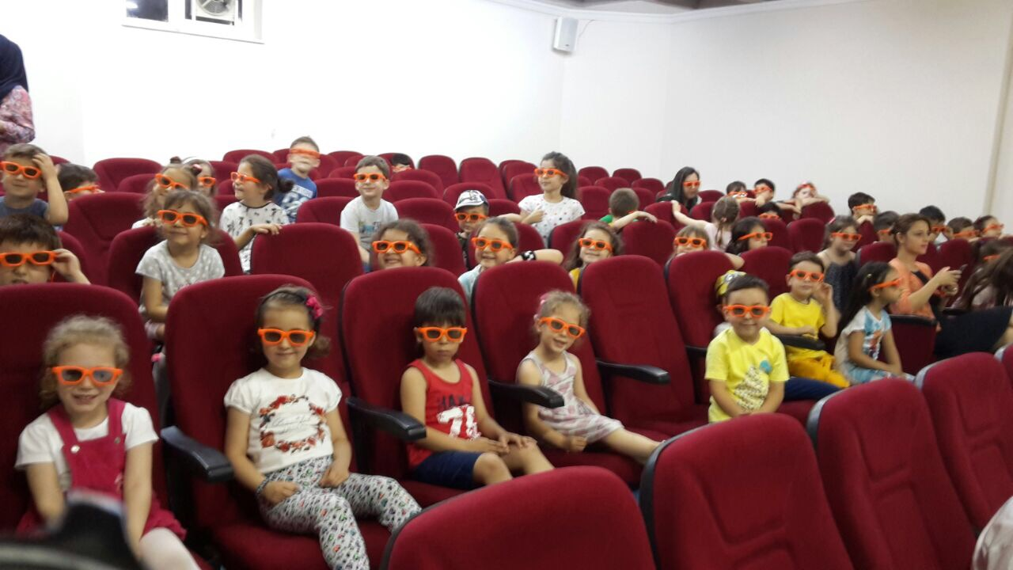
THEATRE HALL

Slide 19
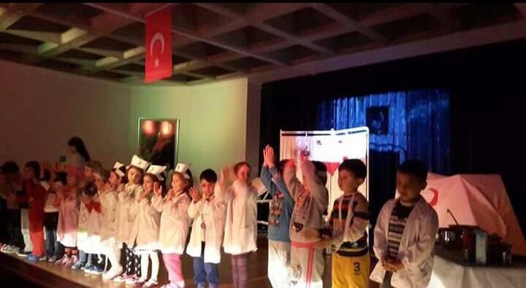

Slide 20
INTELLIGENT GAMES
We aim to stimulate children’s cognitive functions. Intelligent games boost memory, reasoning skills, and executive functions of children.
Intelligent games increase attention, train visual memory, help to keep focus, increase short-term memory of the children.

Slide 21
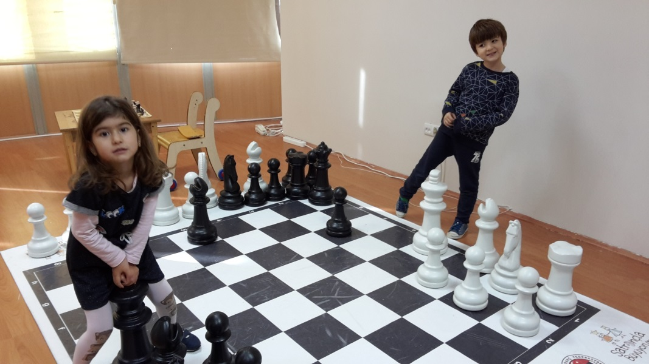
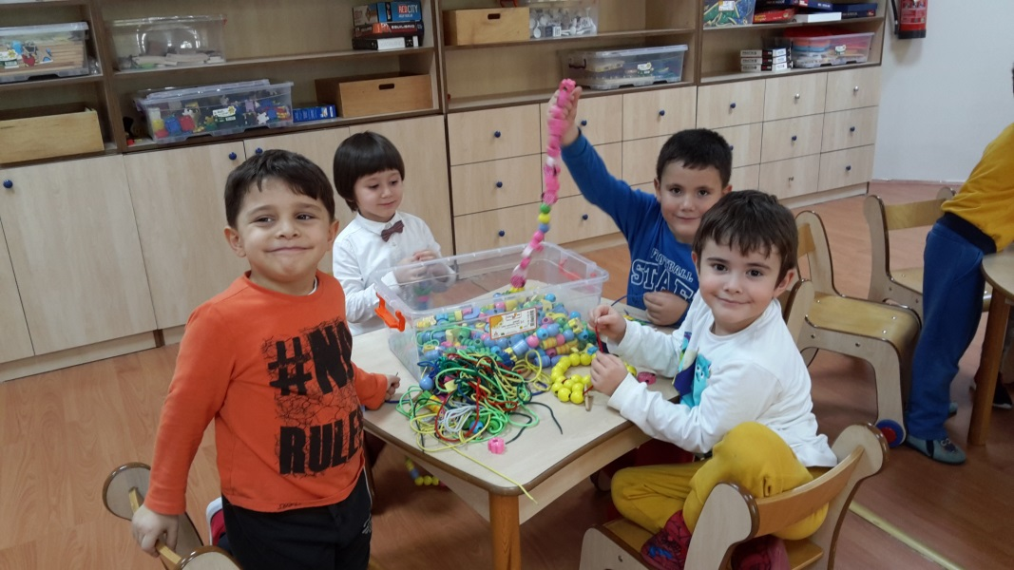
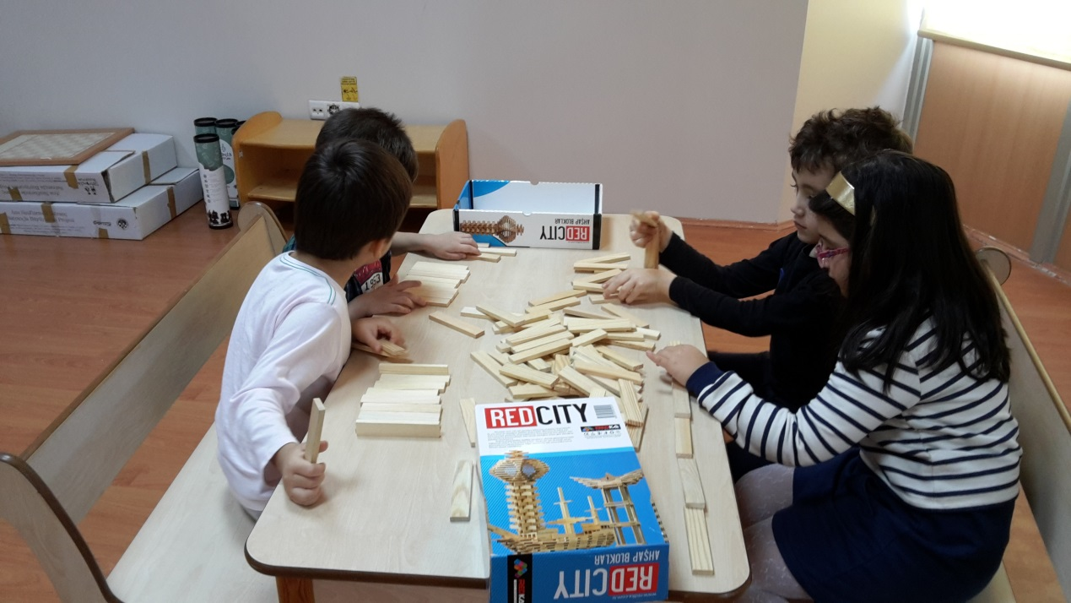

Slide 22
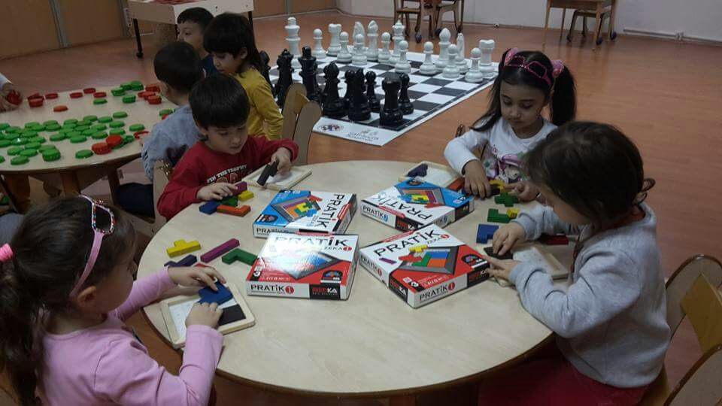
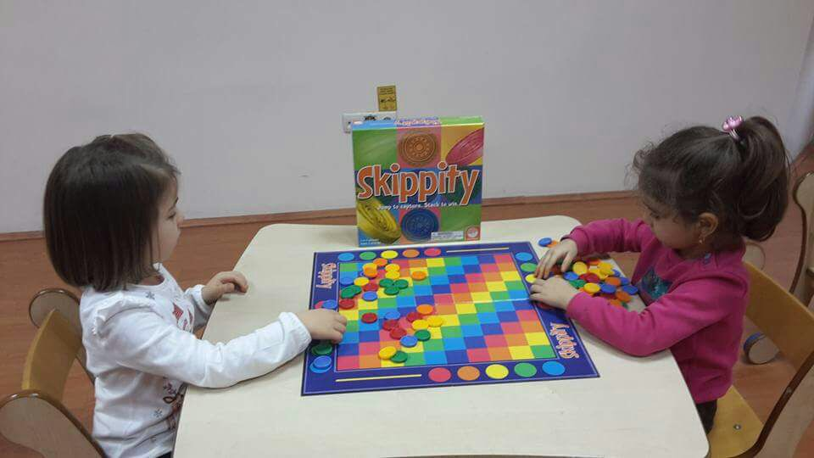
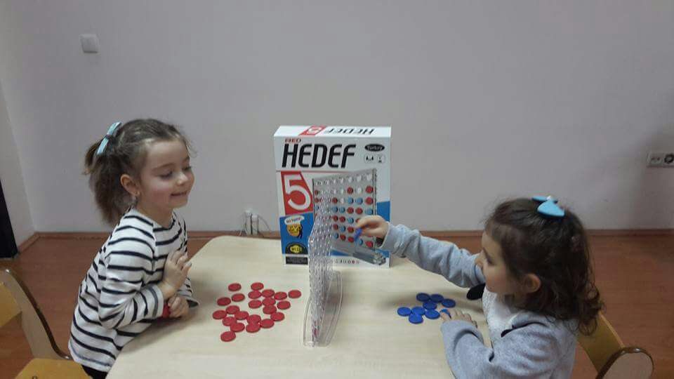

Slide 23
SPORT ACTIVITIES
We aim to increase muscular strength of chıldren
Improving learning,
Aiding in healthy growth and development,
Building self-esteem

Slide 24
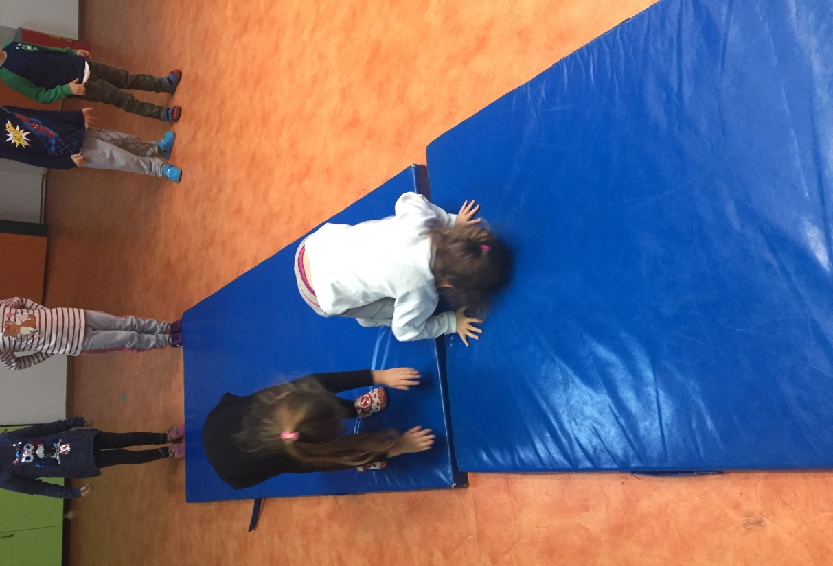
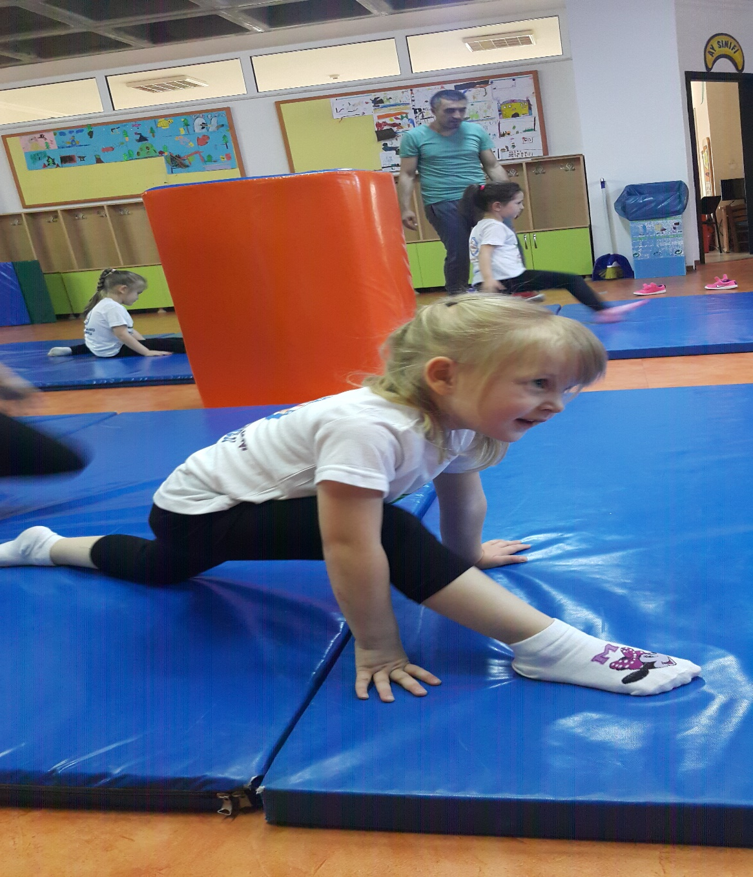
GYMNASTICS

Slide 25
OUTDOOR ACTIVITIES

Slide 26
We have greenhouse area in our school garden. Children can view plant types and lifecycles of plants.

Slide 27
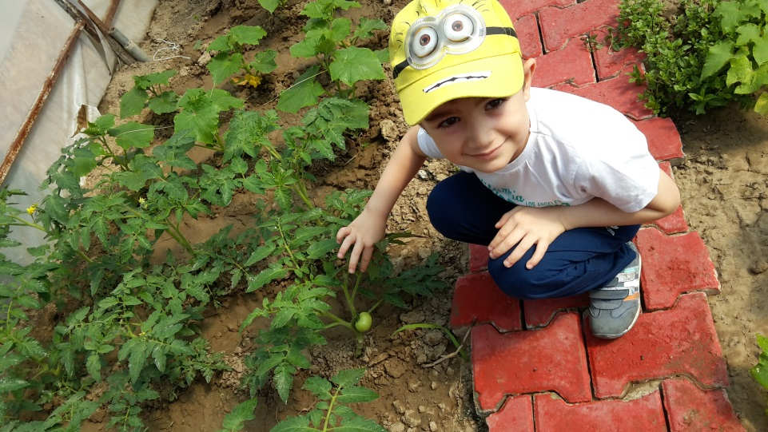
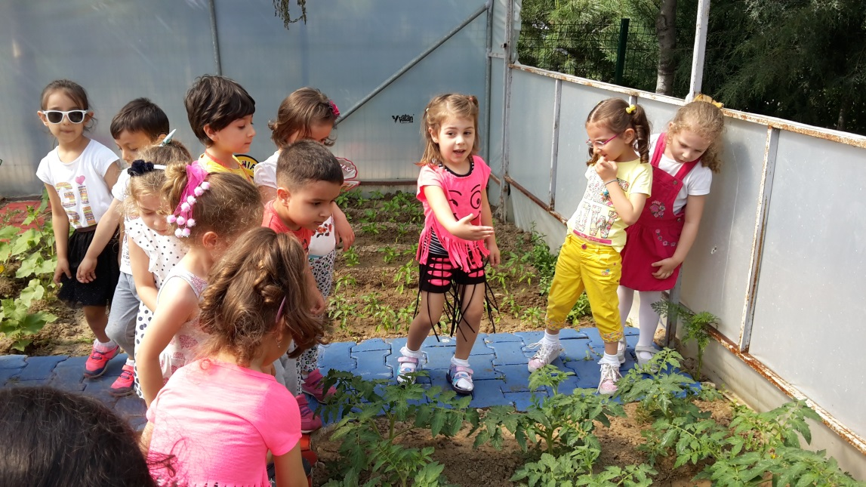
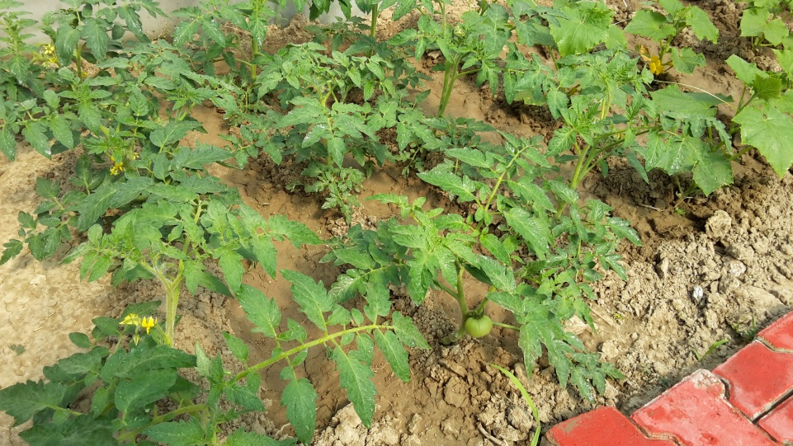
Greenhouse Area
Children learn by doing in greeanhouse area.

Slide 28
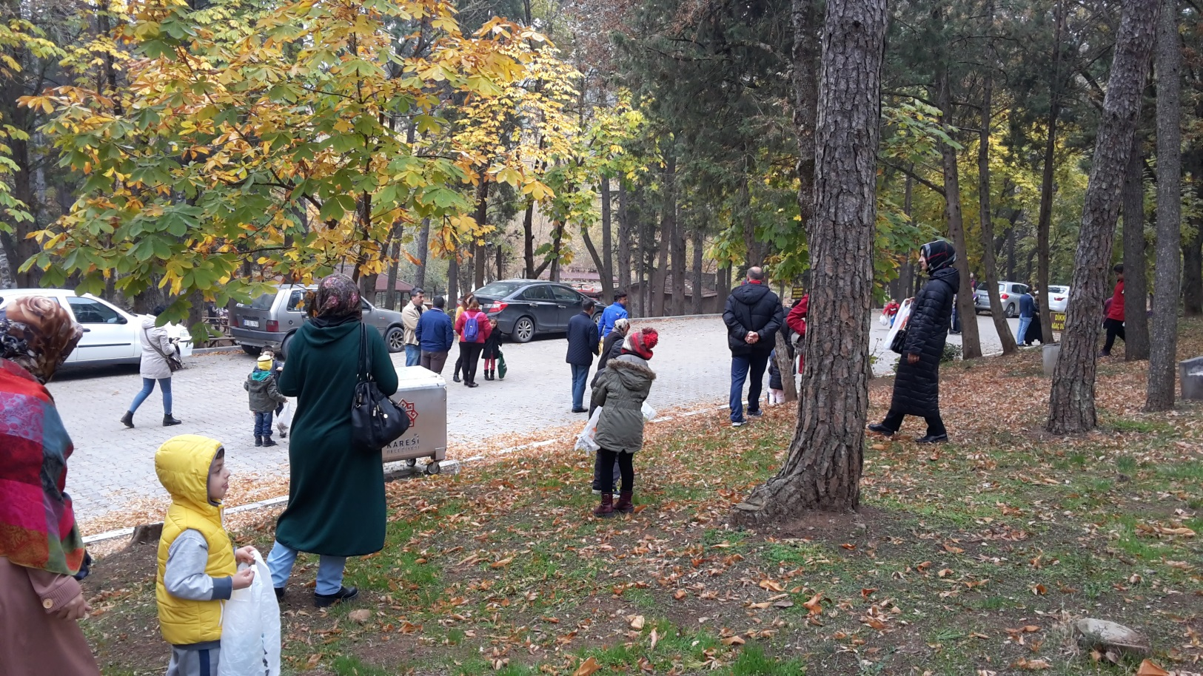
Nature Trip

Slide 29
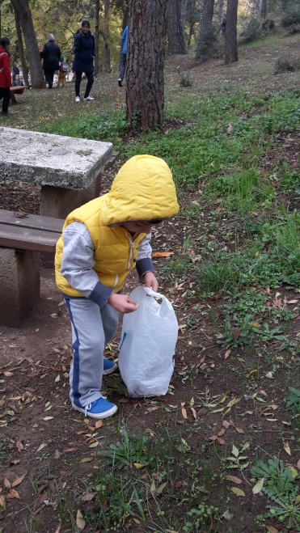
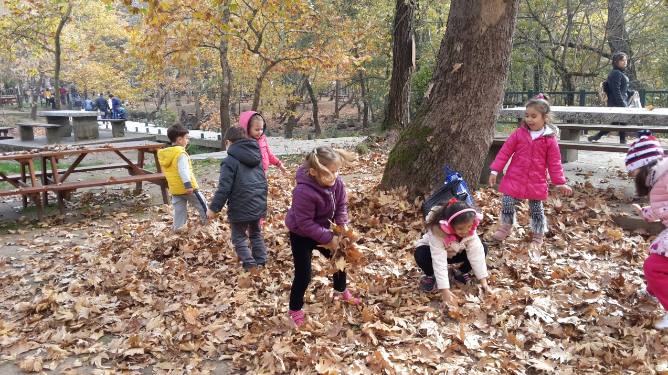
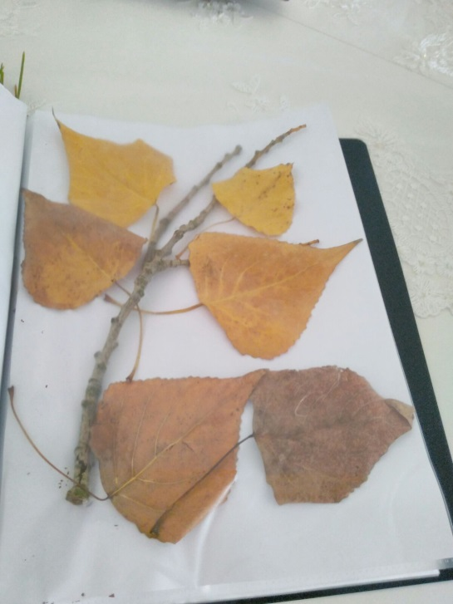
Chıld of Nature

Slide 30
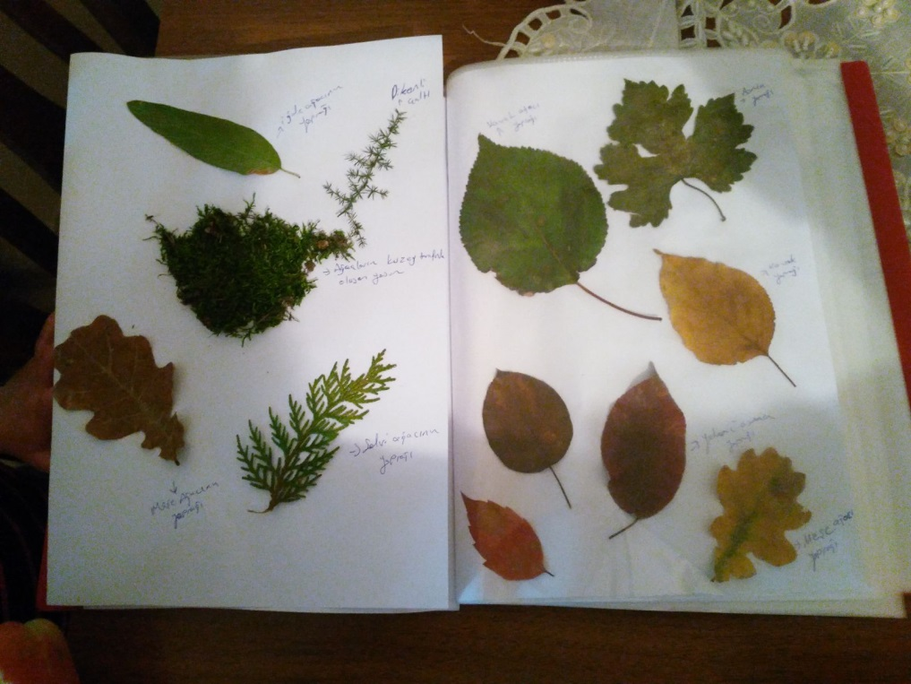
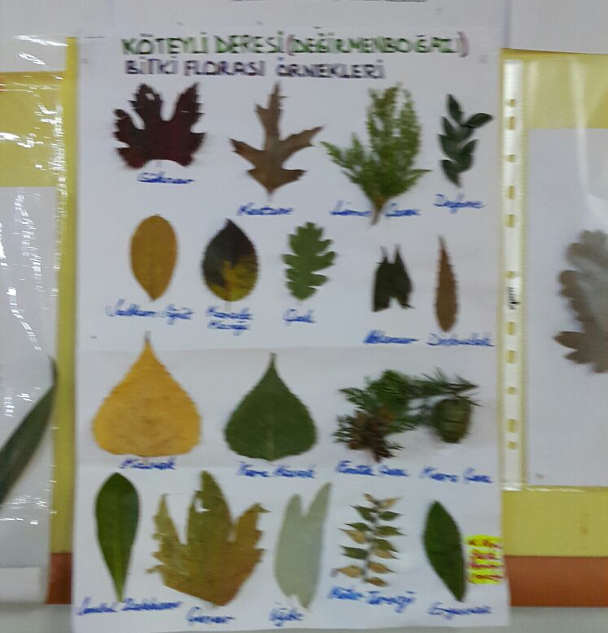
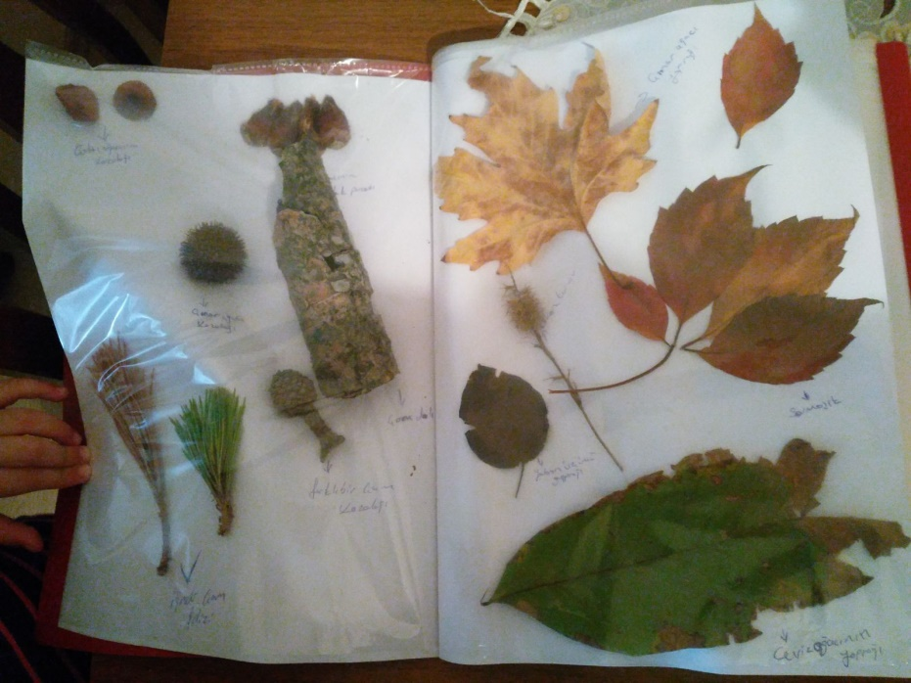
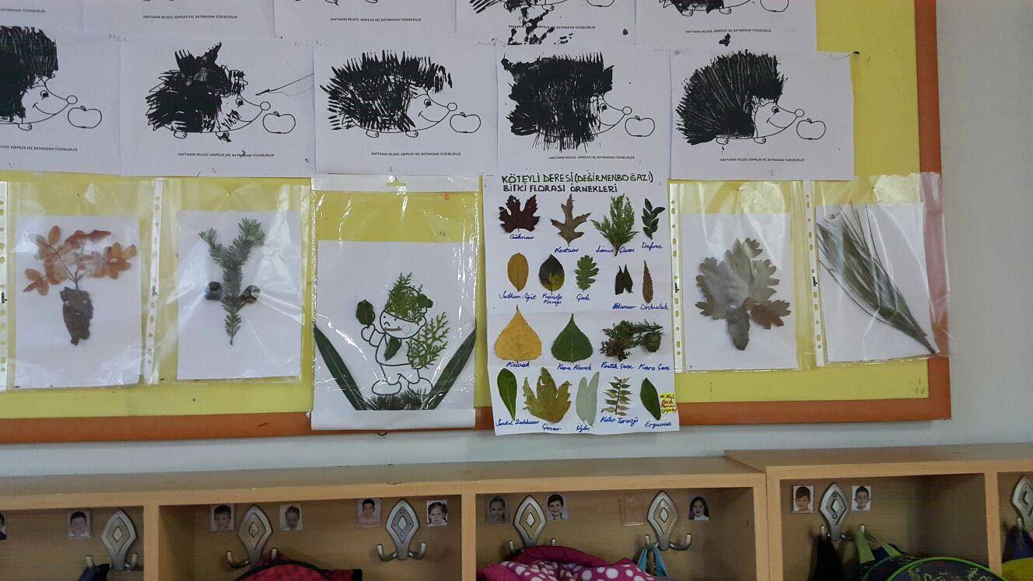

Slide 31
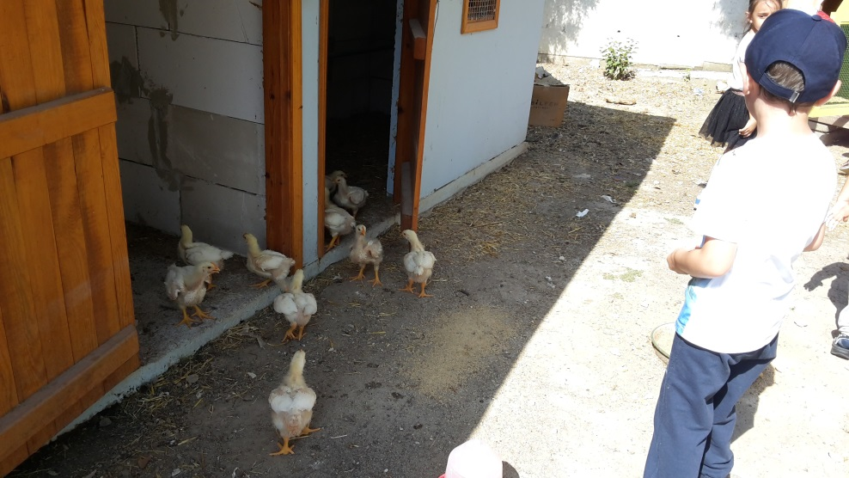
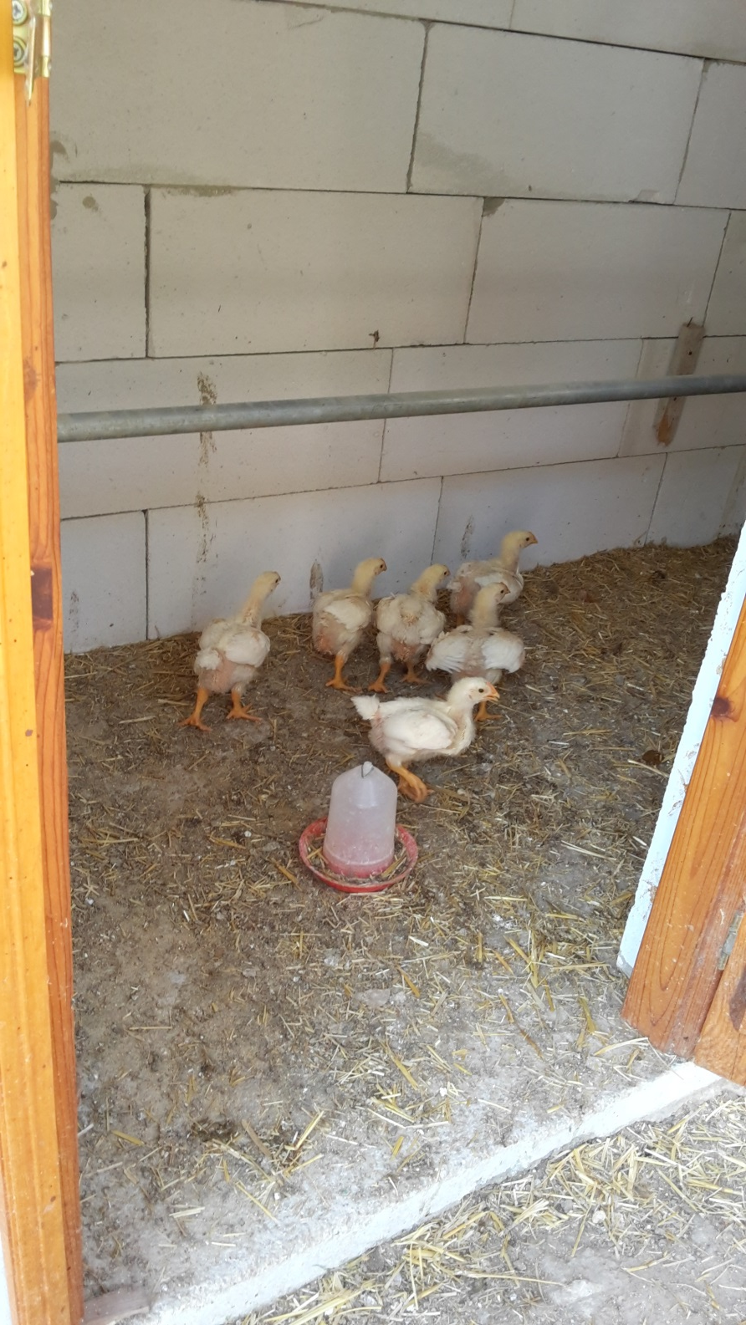
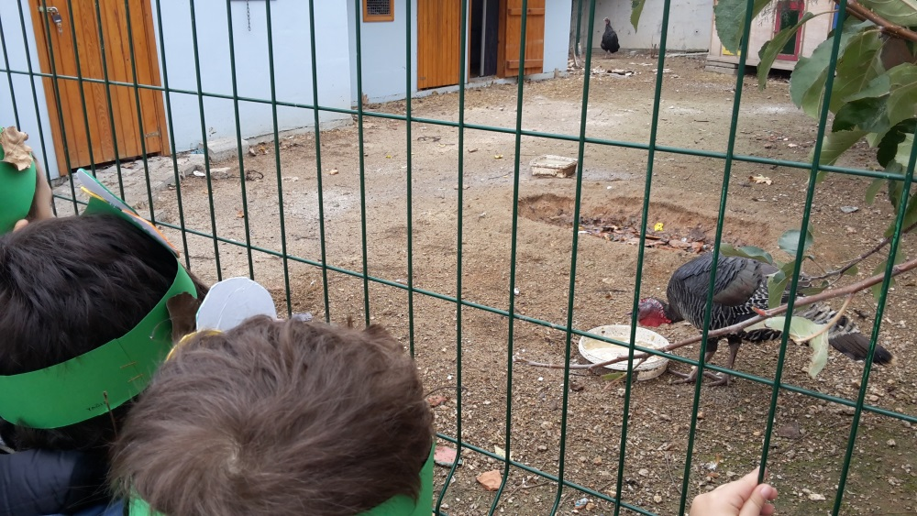
ANIMAL SHELTER

Slide 32
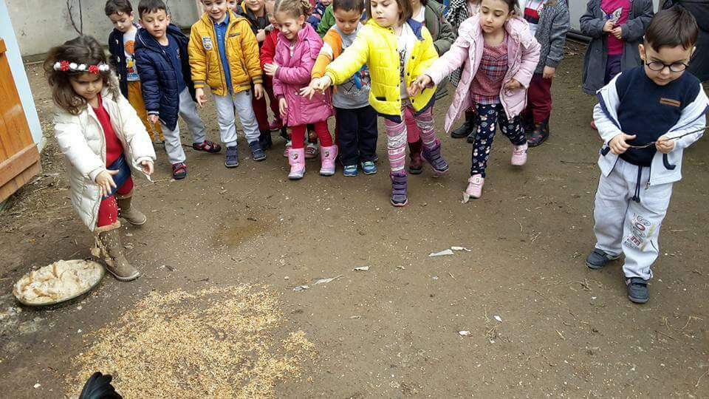
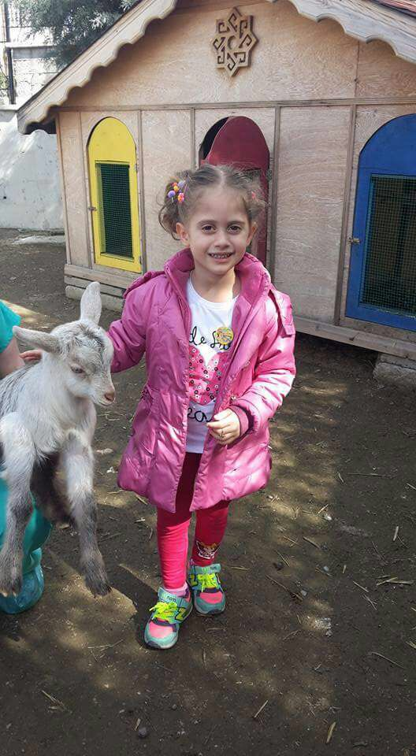
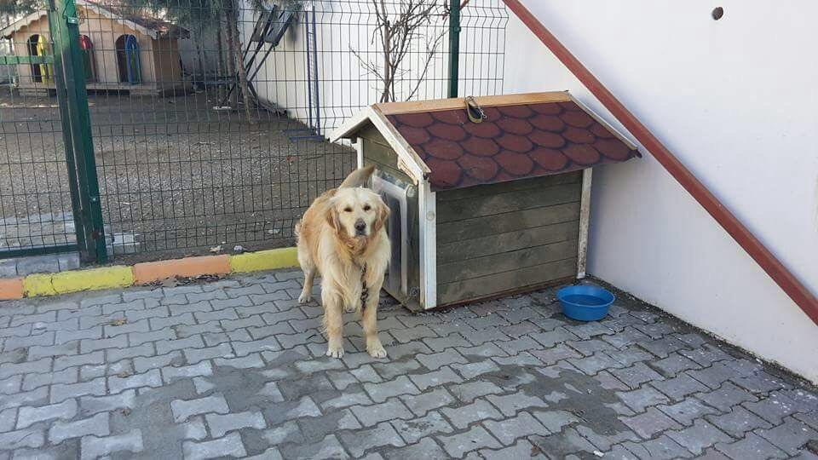

Slide 33
VALUES EDUCATION
‘’Education without values make man a more clever devil.” – CS Lewis

Slide 34
Values Education provides to children showing respect to others, showing tolerance and understanding to others.

Slide 35
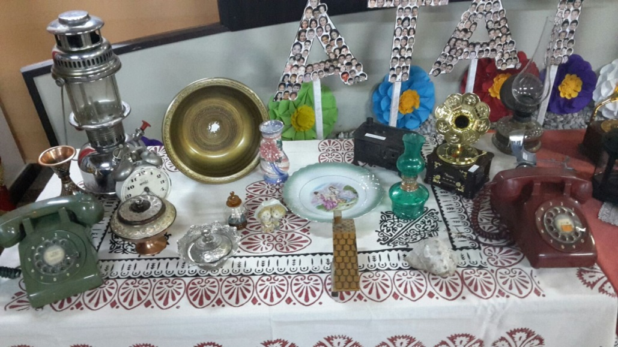
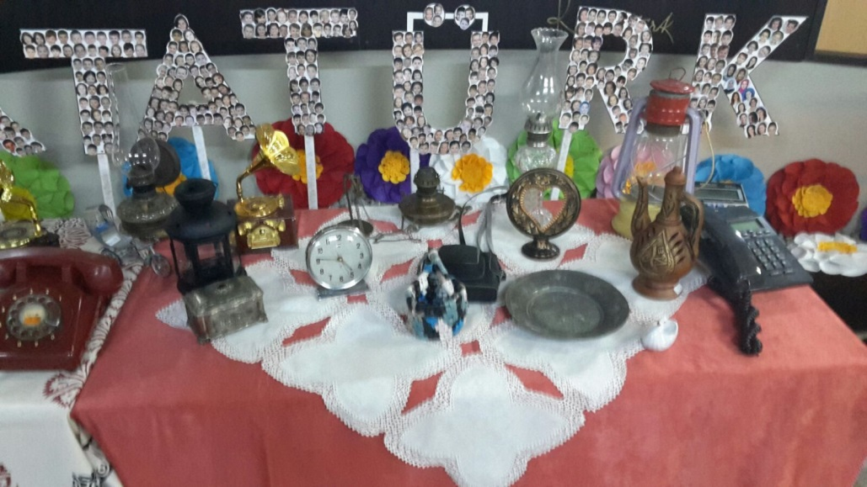
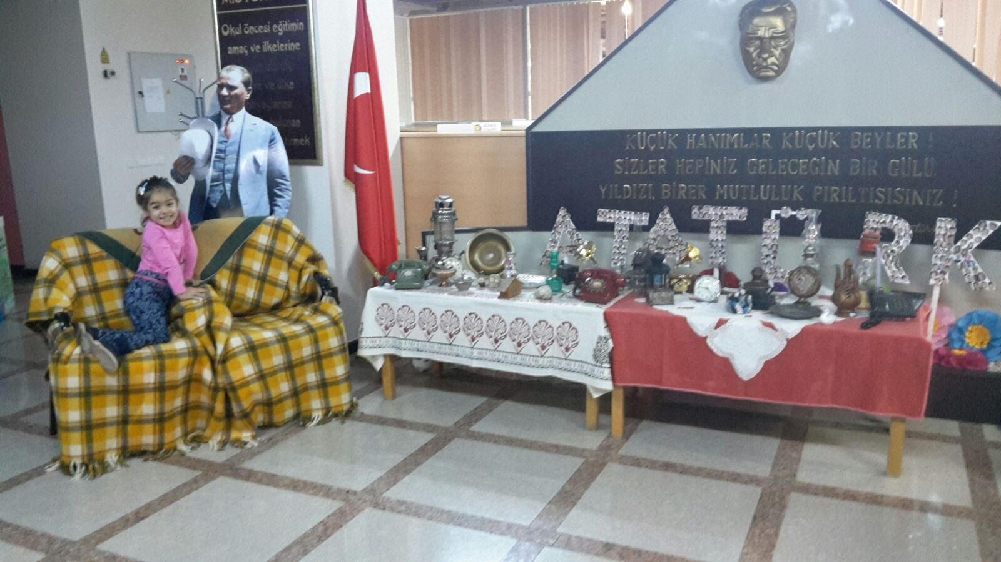
Respect to elderly
Children invited their grandparents to school. They prepared exhibition with old times

