Slide 1

ERASMUSPLUS 2017
“The european child: learning by doing
The 3 c’S – CONNECT, CONSTRUCT AND CREATE”
It’s important for a child to create and build, possibly having fun while doing it, has been explained in the last hundred years by a host of illustrious pedagogues,
including Maria Montessori:
“Education…. is not acquired through listening to words,
but through the child’s experiences in the environment”

Slide 2

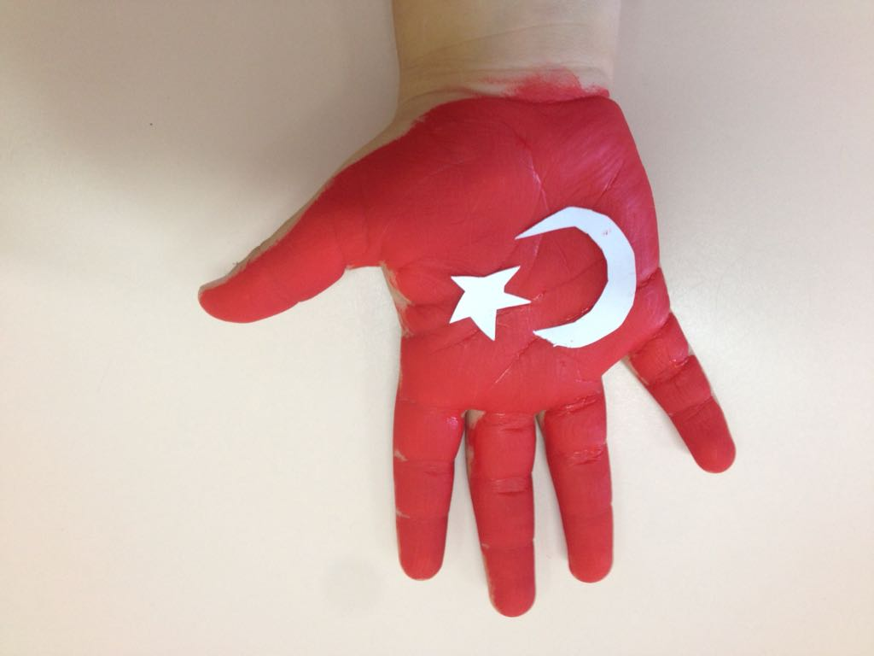
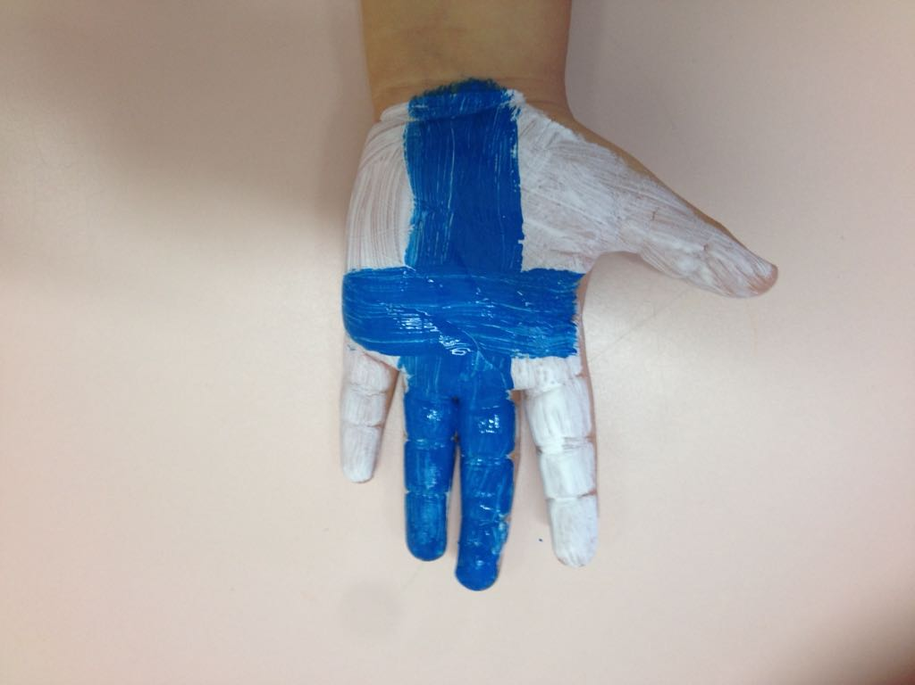
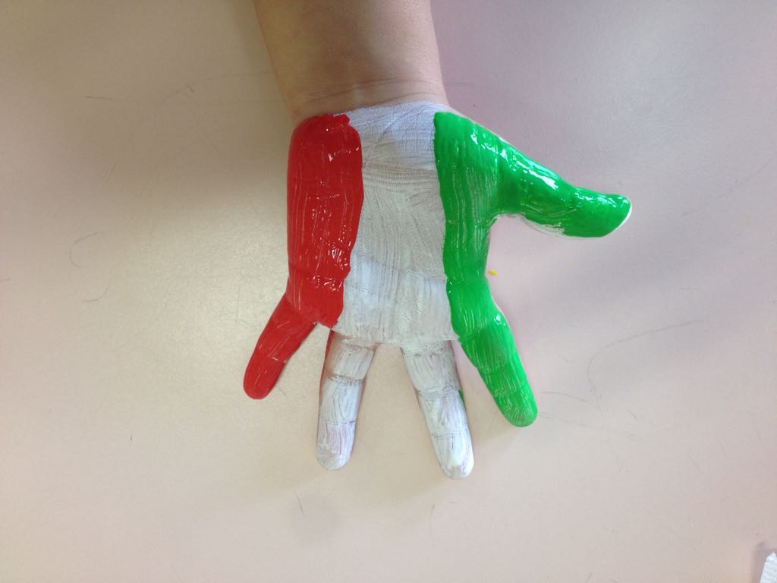
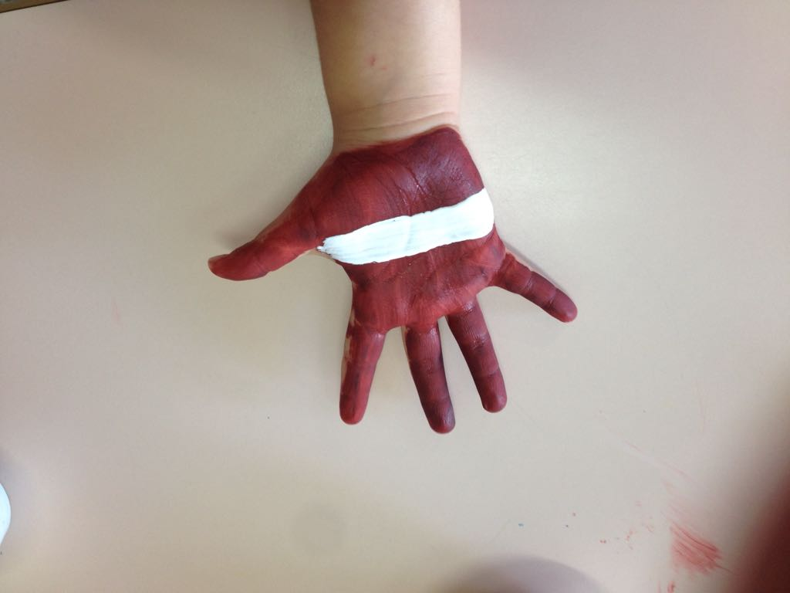
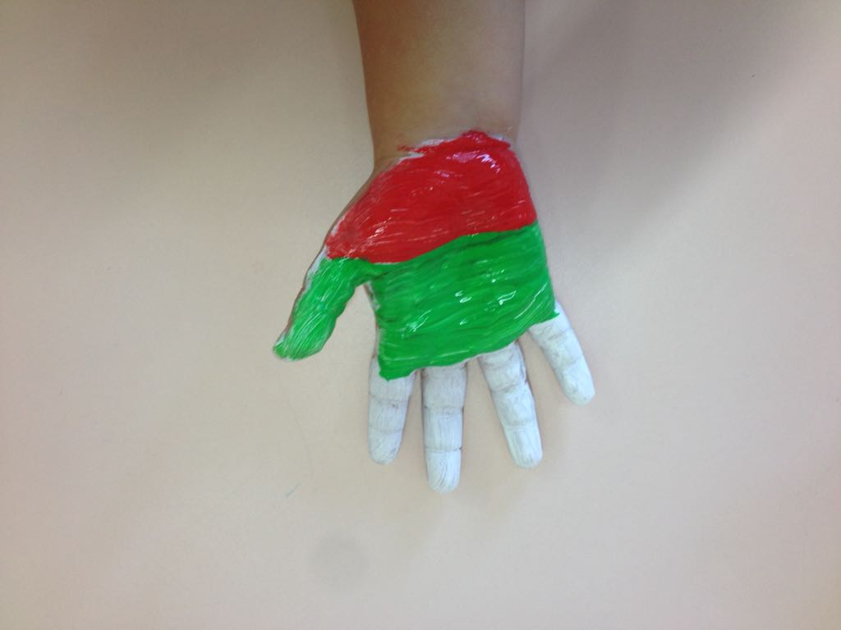
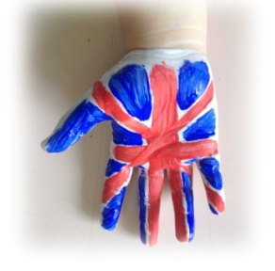
OUR
PARTNERS

Slide 3

In this project we will focus on Social Constructivism or Learner Centered Theories. Constructivism is a theory of knowledge, not a didactic method, which tries to explain the general way in which people learn. The constructivist didactic that stems from these theories changes the meaning of learning, the role of the teacher, his relationship with the pupil and of the pupils among themselves. The teacher: teaches,suggests but at the same time allows children to experiment and to ask questions.
CHILDREN LEARN THROUGH:
The construction of Knowledge
SOCIALIZATION
The Freedom to think, to ask questions, to refect and interact with ideas and objects in order to build meanings.
And so the teacher is a Facilitator:
raises major questions
organizes group work
(cooperative-learning).

Slide 4
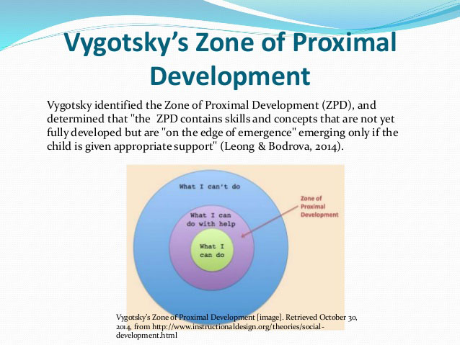
COOPERATIVE-LEARNING
Learning is not only an individual reconstruction, but above all a social factor.

Slide 5
LEARNING
It is the product of an active construction done by a person;
It is closely linked to the concrete situation in which it takes place;
It stems from social collaboration and interpersonal communication;
It is influenced by affective, emotional and relational types of situations.
How children learn…
CHILDREN ARE STUDENTS AND ACTIVE THINKERS
Piaget, 1970)
CHILDREN LEARN EFFECTIVELY THROUGH SOCIAL INTERACTION
vygotsky, 1962
CHILDREN LEARN EFFECTIVELY THROUGH SCAFFOLDING WITH ADULTS
Bruner, 1983
SCAFFOLDING INDICATES THE HELP GIVEN BY ONE PERSON TO ANOTHER TO PERFORM A TASK.

Slide 6
INNOVATIVE DIDACTIC THEORIES
1) LEARNING BY DOING (Constructivism and Active learning)
DEFINITION | OBJECTIVES | FINALITY
Learning through: doing working actions | Learning objectives are configured in the form of «Know how to do»,rather than «knowing»; in this way the child becomes aware of why it is necessary To know something and how knowledge can be used. It will have to be a goal able to motivate and induce him to put into action his own previous knowledge creating an ideal situation for the integration of new knowledge. | Improve the strategy of learning, where learning is not merely memorization, but above all Understanding and doing.
RIFERIMENTI | http://www.edscuola.it/archivio/didattica/leanrning.html

