Slide 1
I’m an Artist activities of Naciye Kabakçı Preschool

Slide 3
CANDY PRINT
Children get their own watercolors from their closets. They apply the candy printing technique using the colors they want as the teacher tells and demonstrates

Slide 4
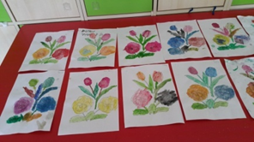
CANDY PRINTS

Slide 5
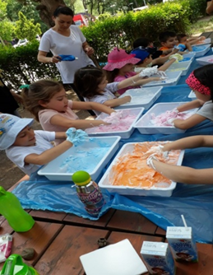
Coloring The Shaving Foam
The teacher distributes the basket to the children. Foam is sprayed into the dishes. Foam is colored with colored fingers according to children's wishes. Children with colored foam play freely and figure numbers, etc. the concepts they lea-The kids draw the same shapes at the same time.Children follow the formation of new colors by mixing colors. The consepts they learn are repeated on the foam.

Slide 6
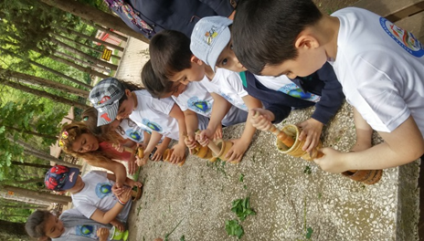
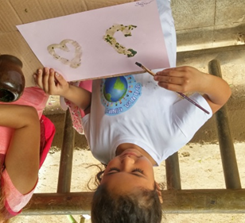
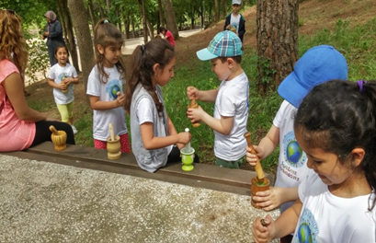
Colour of the nature(Natural Paint Production)
Students collects plants. Teacher gives information about how they press the plants.Students produce their own paint.
.
.

Slide 7
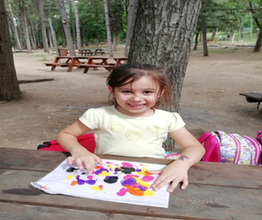
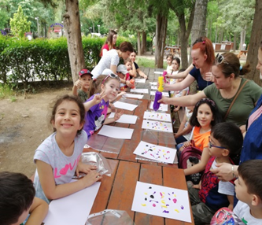
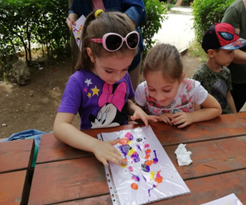
Finger Painting Technique
The fingers of various colors on the A4 paper are dripped onto the paper. Put the paper dripped into the plastic bag. It prints on the paper over the color with the index finger. It allows all colors to be mixed with each other and the patterns that come out of the paper are interpreted by the children.

Slide 8
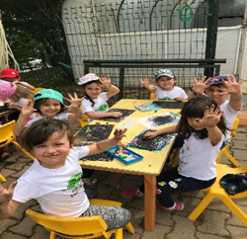
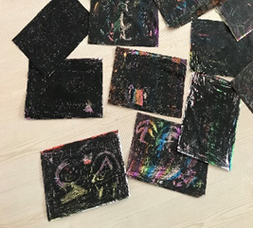
Magical Coloring
Students first completely color A4 paper using the colors they wish. After the entire page has been painted, students paint all of their papers with black crayons. They draw pictures that they wish and imagine with the help of toothpicks onto the picture sheets which are black.

Slide 9
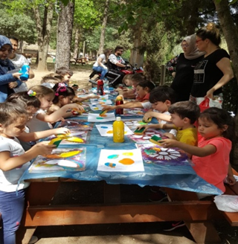
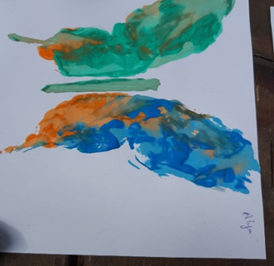
Outdoor School Activity
Teacher guides to children and they complete their studies. The studies are left to dry.

Slide 10
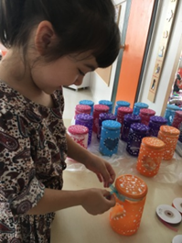
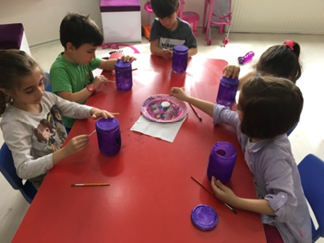
Jar Painting
Children stick a heart paper on a glass jar. Children paint the jar using acrylic paint with the help of the sponge. When the painting process is finished, children remove heart paper. Then print with ear pads, get a spotted look. After all the work is done, the jars are left to dry. Finally children decorates the jars with the ribbons.

Slide 11
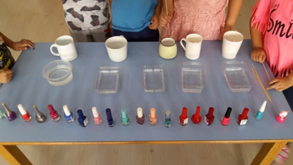
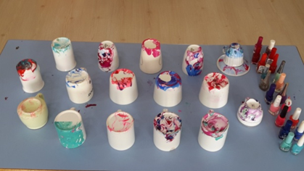
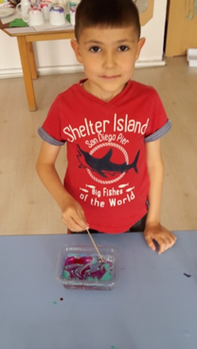
Painting the cup with Ebru technique
Children drop the nail polish into the water as he/she desires .Then they give shape with the help of wooden skewer and put the glass into the container filled with the water and see the patter in the glass.
.

Slide 12
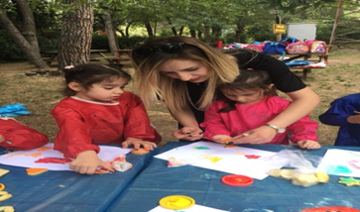
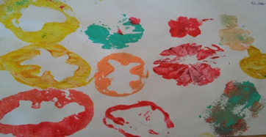
Printing Practice
They learn by doing and living. When they mix colors, they get different colors.
They learn to use tools and tools in different ways. Creativity develops.

Slide 13
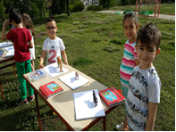
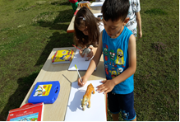
Drawing picture using shadow painting technique.
Students sit at a spot where the sun's rays cast shadows over the object to be scratched. Students put the animal figure on the paper.Students draw a shadow around the paper with a pencil and then ask them to paint as they want.

Slide 14
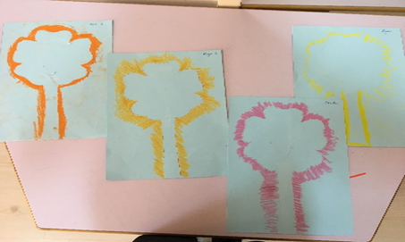
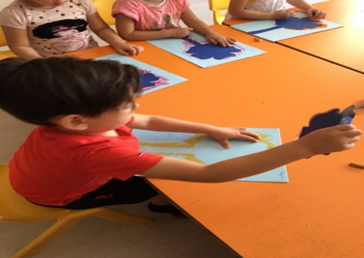
Shape Removal Technique
Each student gets an A4 paper and a flower pattern. With the help of the teacher, the children stick the flower patterns in the middle of A4 paper. They start to paint around the flower pattern using the color pastel they want. The activity continues until you paint the entire pattern. When painting finishes, pulls out the pattern and removes it from a4.

Slide 15
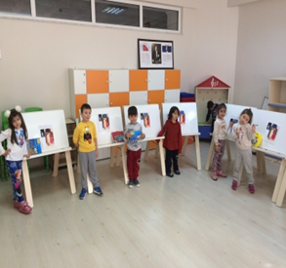
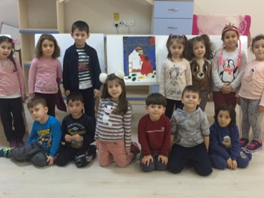
The Square Brush Technique
The students follow the teachers. They make the pictures. They make pictures by matching between the picture and the canvas. Cooperate to complete the image

Slide 16
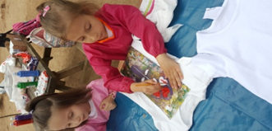
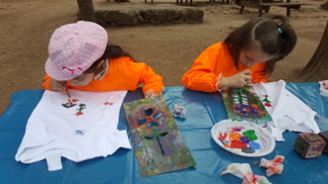
We are painting our T-shirts
The children take their t-shirts, their own bruises and choose what they want from the various patterns that the teacher has presented or make original paintings.
.

Slide 17
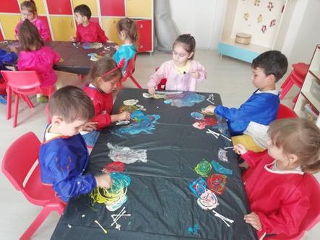
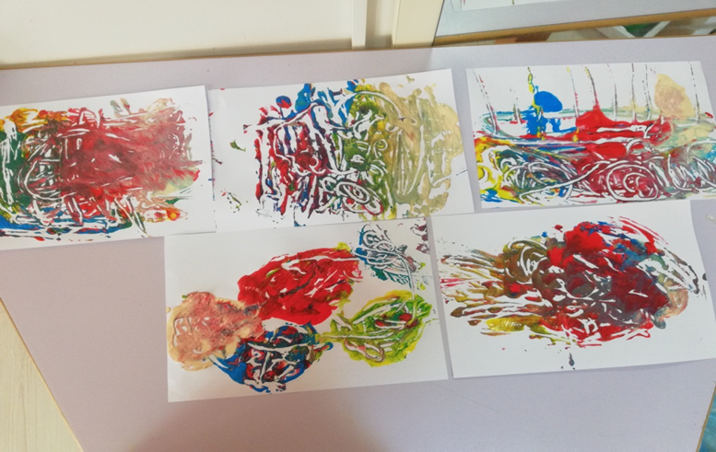
We are painting with ear pudding
During the planning stage of the event, the children picked up the finger paint in the desired color and prepared the materials. They spread the colors on top of the garbage bag. They use ear pads to paint as they want. The pictures are printed on paper in teacher guidance.

Slide 18
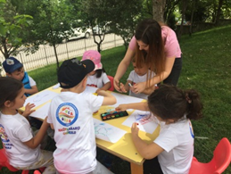
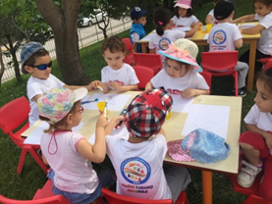
We're painting with the Spray Technique
The students will research the figures they want during the planning stage of the activity. Then they get their own toothbrushes. Then the students apply the technique of spraying the picture papers distributed to them by their teachers with the colors they want and the frequency they want.

