Slide 2
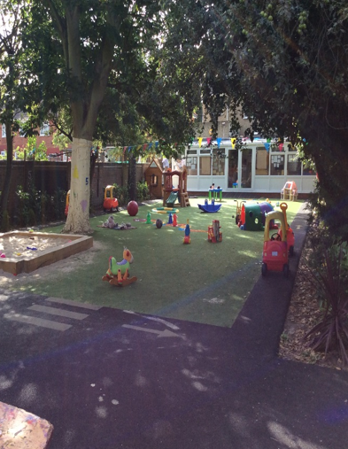
Arts at Tendercubs
Learning by doing

Slide 3
Arts at Tendercubs

Slide 4
Wassily Kandinsky –Shapes and Colours
Time period:
-16th December 1866 – 13th December 1944
-often referred to as the artist to invent abstract art
-he tried to connect:
Colours and meanings/associations (peaceful, supernatural, deep)
Colours and shapes (blue-circle)
Colours and colours (the effect of dark red can be enhanced with light blue)
Important & famous works:
-Colour Study. Squares with concentric circles
-Yellow-Red-Blue
-Composition VII
http://www.wassilykandinsky.net/images/works/370.jpg, https://learnodo-newtonic.com/wp-content/uploads/2016/07/Yellow-Red-Blue-1925-Kandinsky-Wassily.jpg , https://learnodo-newtonic.com/wp-content/uploads/2016/07/Composition-VII-1913-Kandinsky-Wassily.jpg

Slide 5
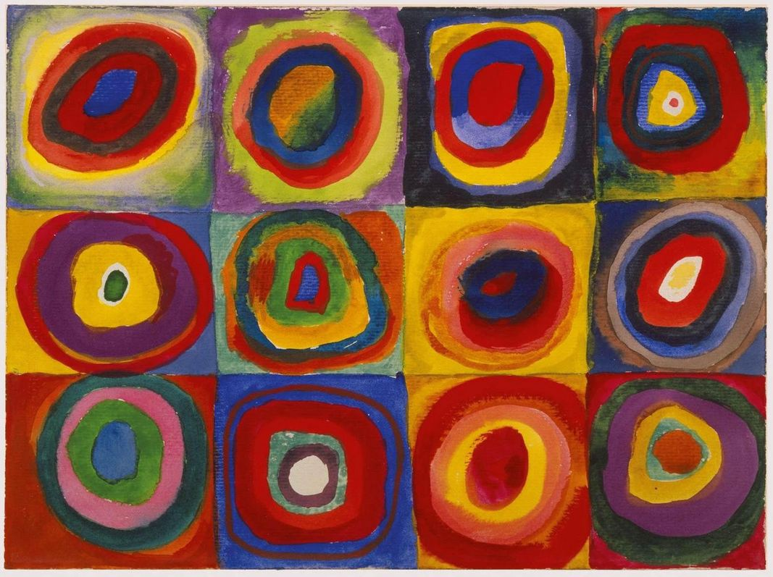
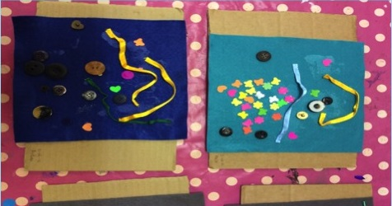
What the children can learn
-about all sorts of shapes
-about colours and how they relate
-about the meaning and message colours and shapes can evoke
Approach & Methods
-ask the children to look at the displayed picture carefully
-ask them for how many different colours and shapes they can find at the displayed picture
-ask for what they associate with, for instance, the colour green or a circle
-ask them to experiment with shapes/shapes, colours/colours and colours/shapes

Slide 6
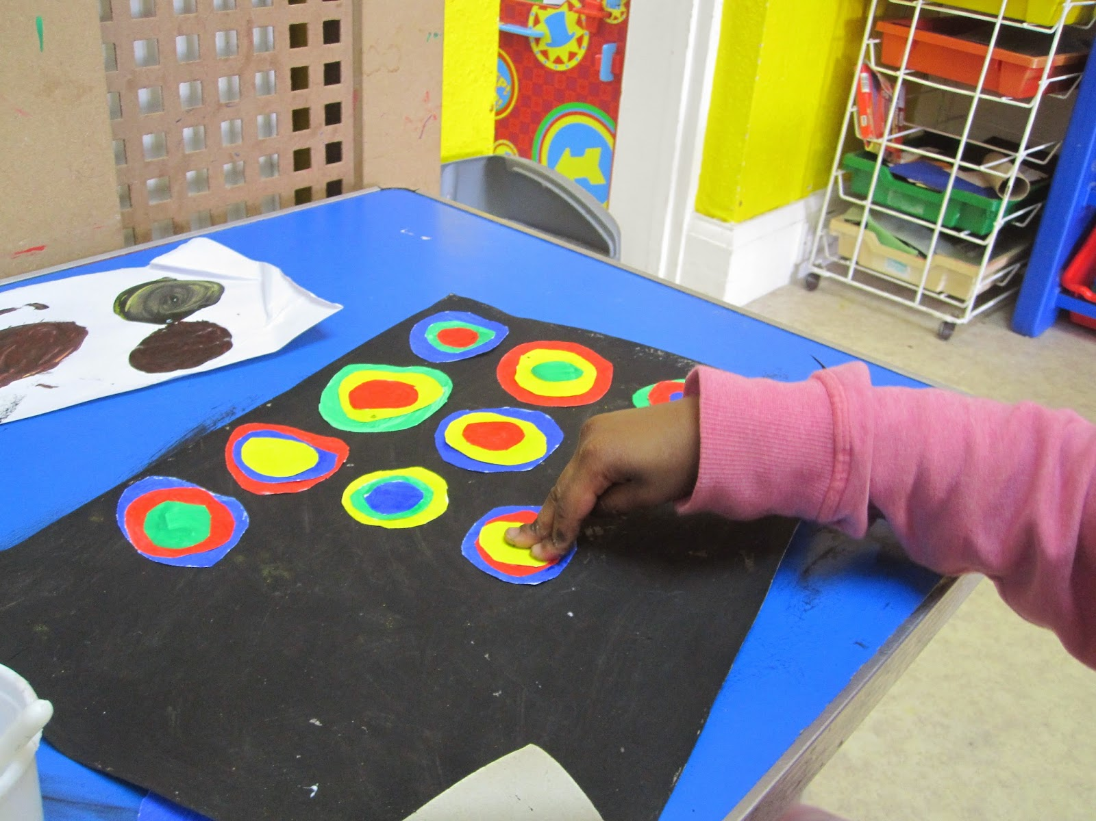
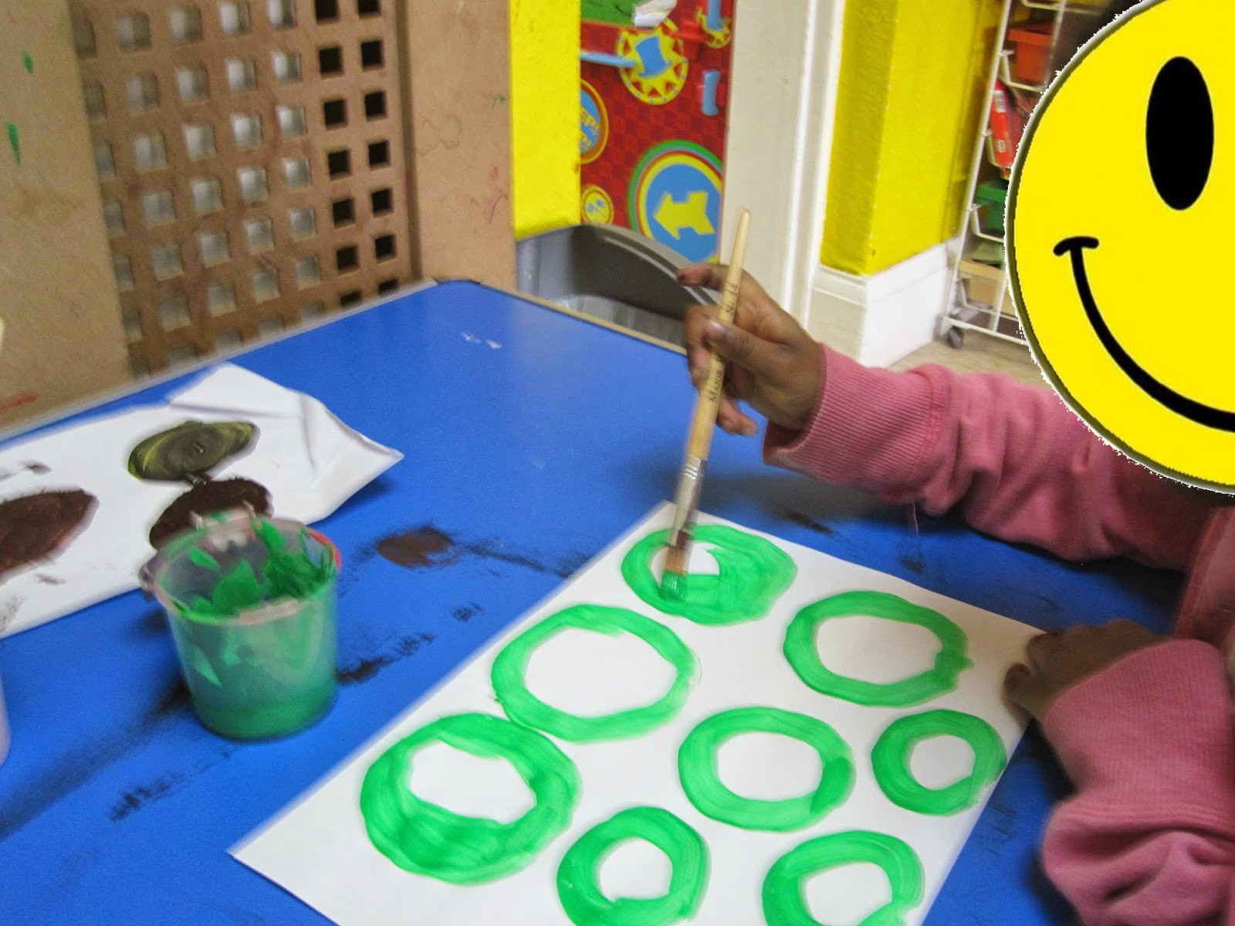
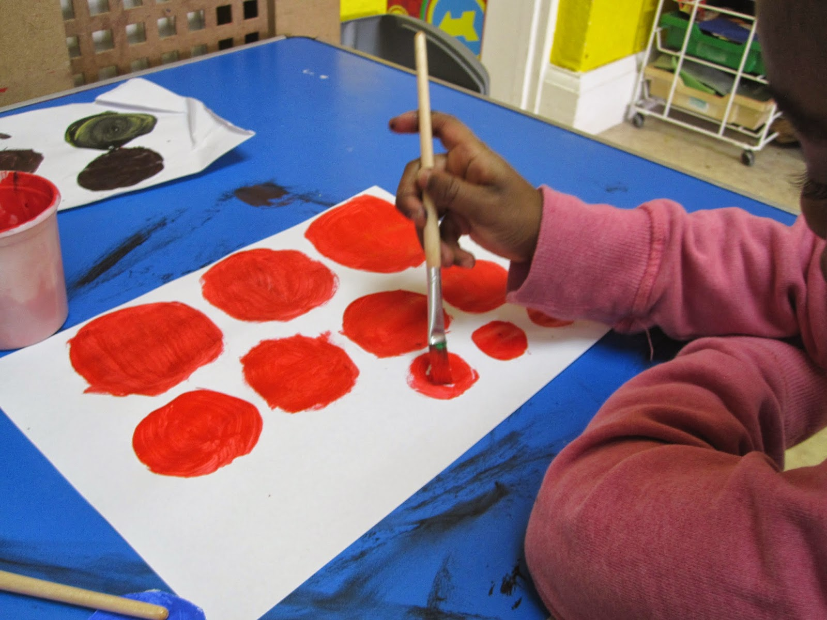
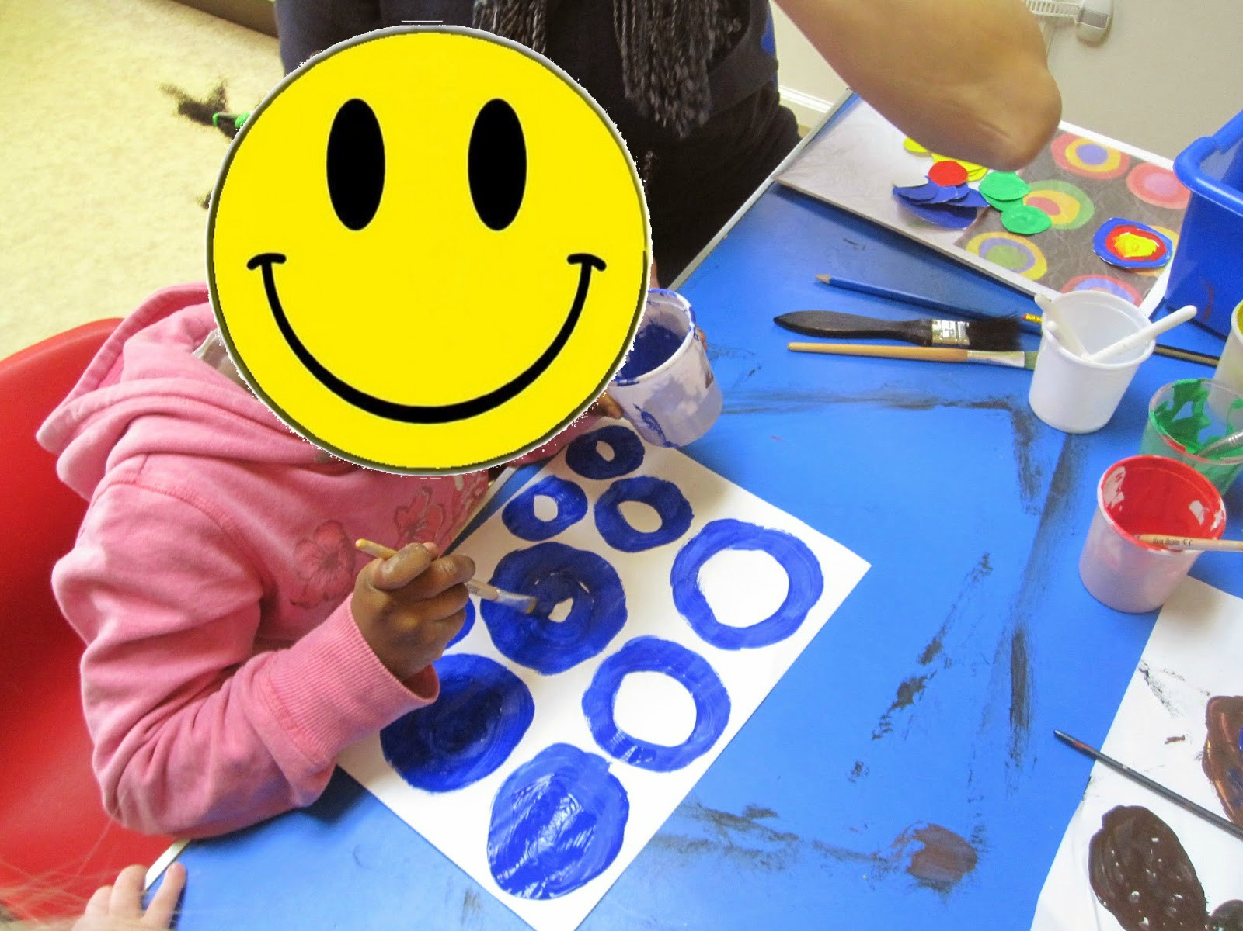

Slide 7
Pablo Picasso- Collages
Time period:
-25th October 1881- 08th April 1973
-first artist to use the collage technique in painting
-Collage: using different elements to form a bigger picture
-he used:
Different shapes
Different colours
Different kinds of paper
Different materials, such as newspapers, photographs or metal
Important & famous works:
-Still life with the advertisements
-Violin hanging on the wall
-Still-life with Chair Caning
http://www.pablo-ruiz-picasso.net/images/works/4004.jpg, http://www.pablo-ruiz-picasso.net/images/works/4008.jpg, http://www.pablo-ruiz-picasso.net/images/works/88.jpg

Slide 8
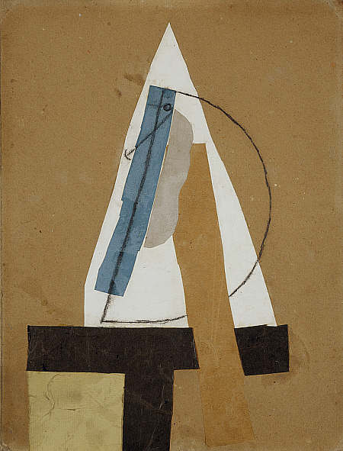
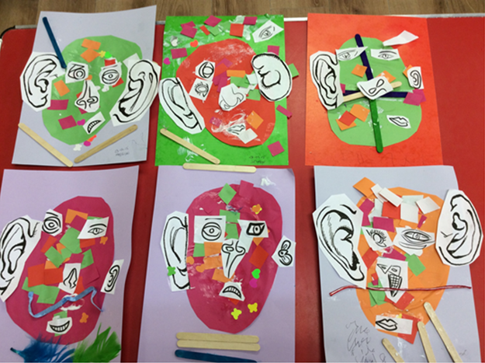
What the children can learn
-about how to create a shape, form or picture of smaller shapes, forms or pictures
-about using rather unconventional materials
Approach & Methods
-ask the children to outline any form they want to draw (E.g. trees, animals, buildings)
-ask them to fill it out with many different shapes and colours
-ask them to outline another form
-give them different unconventional materials (such as newspapers) and fill it in with shapes cut from these materials

Slide 9
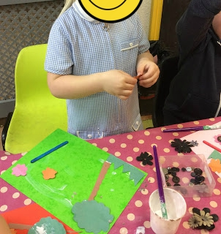
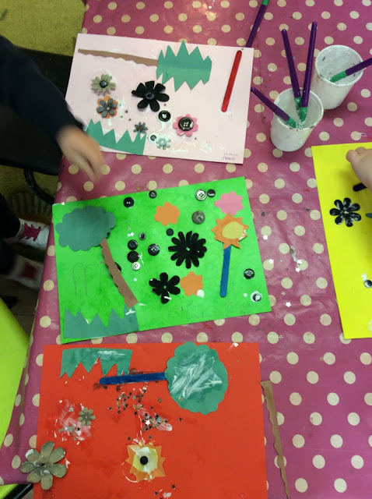
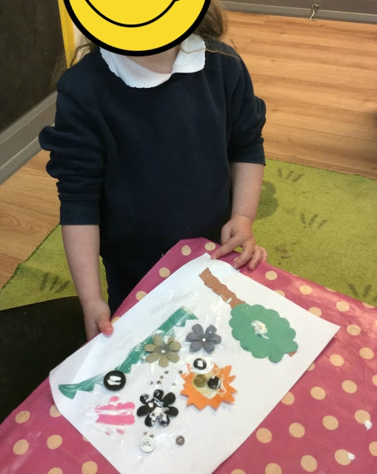
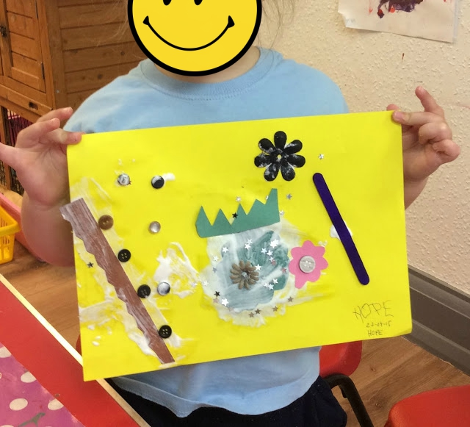

Slide 10
Romantic Painting
Time period:
-1800-1850
Characteristics & Facts:
-increasingly expressive and emotional
-focusing natural motives, such as the sunrise
-expressing the desire for the undiscovered, infinite and foreign
-rediscovering fairy tales and legends
Important Artists:
-Caspar David Friedrich
-William Turner
-John Constable
Important & famous works: https://en.wikipedia.org/wiki/Caspar_David_Friedrich#/media/File:Caspar_David_Friedrich_-_Wanderer_above_the_sea_of_fog.jpg

Slide 11
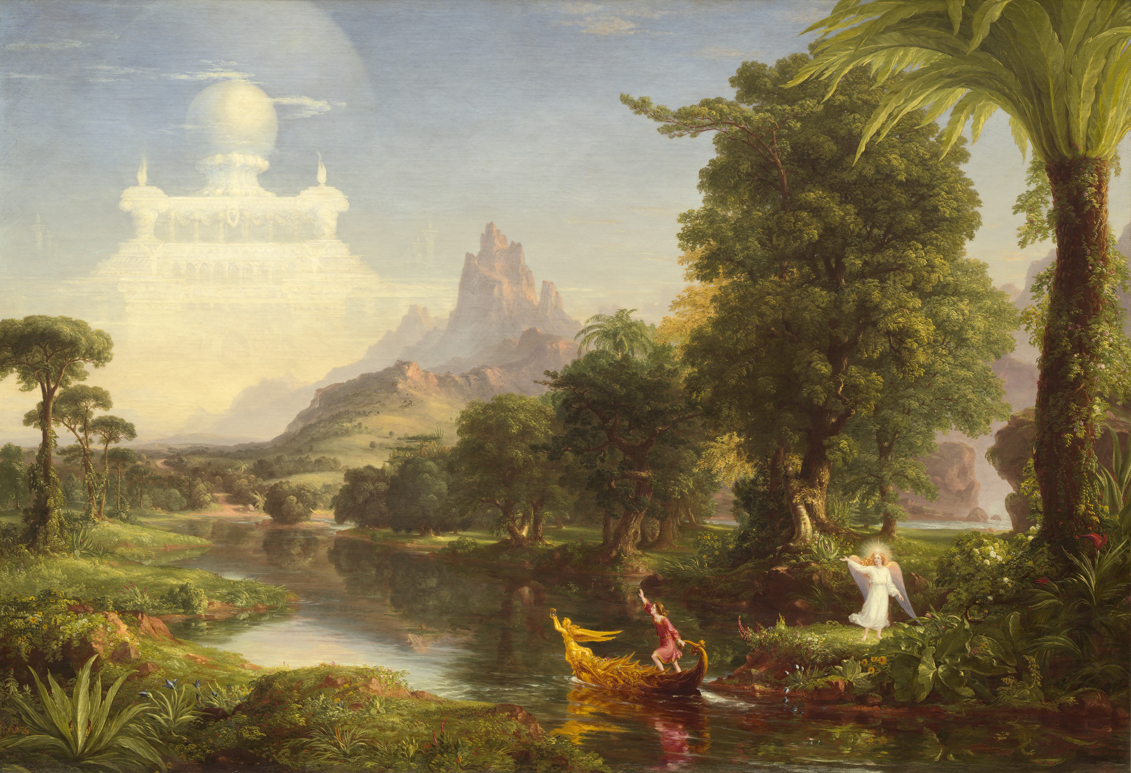
What the children can learn
-about nature motives, such as landscapes, plants and animals
-about elements of fairy tales and legends
-about symbols of infinity, such as the ocean, sky or a desert
-about the concept of beauty and romance and how to evoke those feelings
Approach & Methods
-show them the displayed picture and ask them how they feel about it
-ask them to find elements of nature, fairy tales, legends and infinity
-ask them to think of romantic elements of nature, fairy tales, legends and infinity
-ask them to paint those

Slide 12
Impressionism
Time Period:
-1867-1886
Characteristics & Facts:
-focus on depiction of the light, movement and atmosphere of a moment
-aims to capture the essence of an object
-rather light and thin brush strokes, abandoning strict forms and lines
Important Artists
-Claude Monet
-Camille Pissarro
-Edouard Manet
Important & famous works: https://en.wikipedia.org/wiki/Impressionism#/media/File:Claude_Monet,_Impression,_soleil_levant.jpg

Slide 13
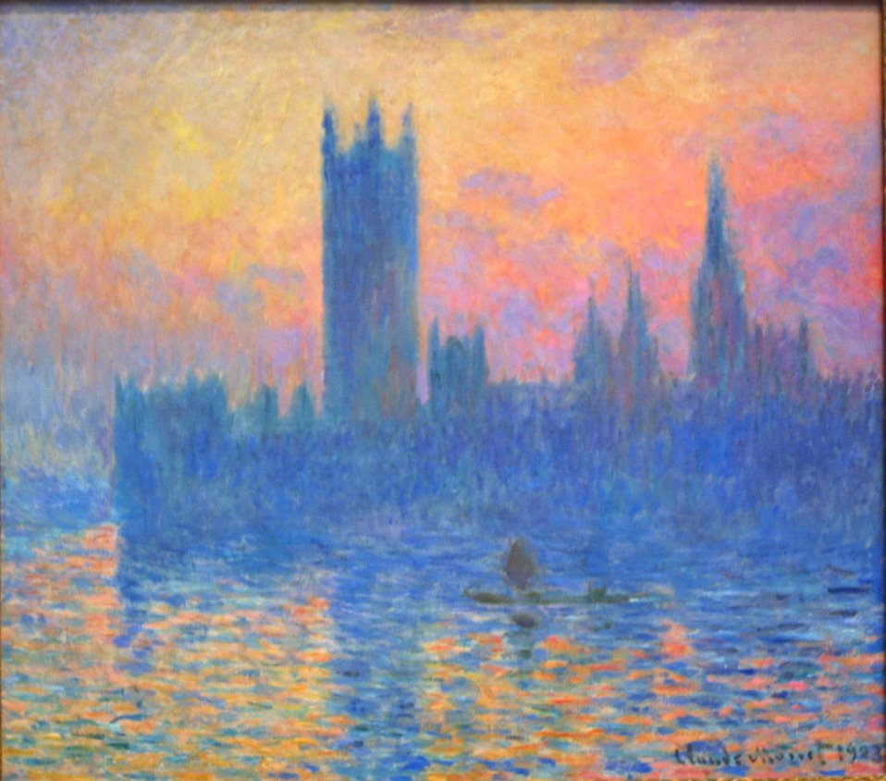
What the children can learn
-about the element of light & darkness
-about elements of movement
Approach & Methods
-show them the displayed picture
-ask them for what they can see
-ask them to search for how movement (water) and light is depicted
-ask them to try to add elements of light, darkness and movement to the picture they created previously

Slide 14
Pointillism
Time period:
-1889-1910
Characteristics & Facts:
-no continuous lines; many colour dots forming an image
-no mixture of pigments
-colours often appear to be brighter due to the white canvas in-between dots
-mainly done in oil paint
Important Artists:
-Georges Seurat
-Paul Signac
-Henri-Edmond Cross
Important & famous works: https://media.overstockart.com/optimized/cache/data/product_images/GS2840-1000x1000.jpg

Slide 15
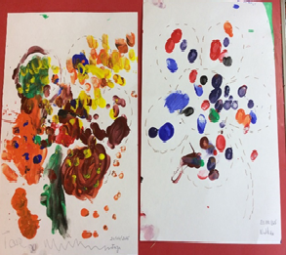
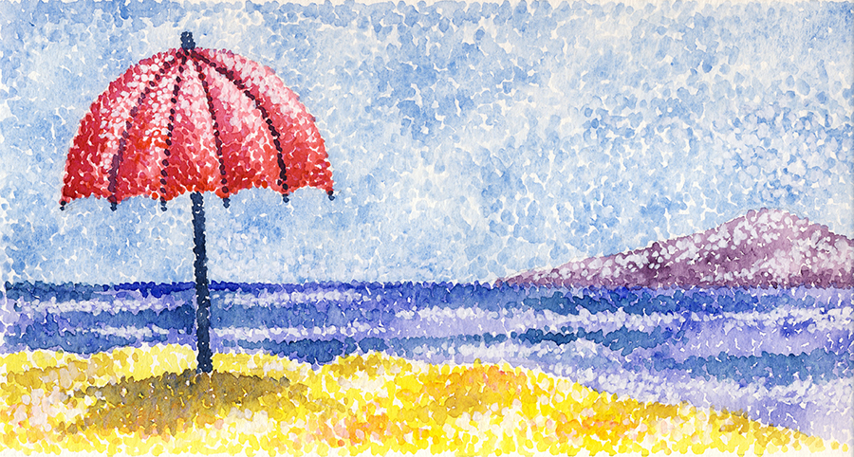
What the children can learn
-about creating shapes and images out of small points
-about how to make these images look brighter
-about pixels
Approach & Methods
-tell them about how a display works (everything you see consists of small points/pixels)
-ask them to look at the displayed picture carefully
-ask for the characteristics of this picture
-ask them to take one of these previous picture (nature, fairy tales, shapes) and try to paint it again using points instead of lines

Slide 16
