Slide 2
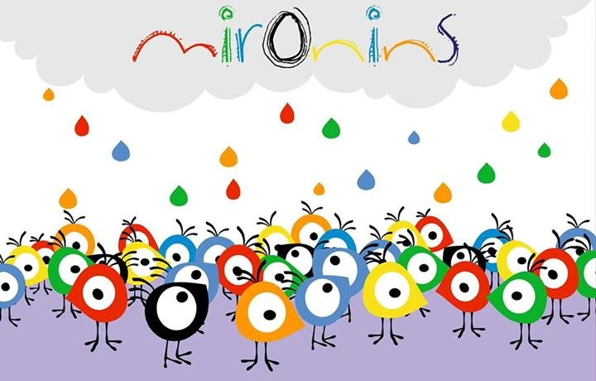
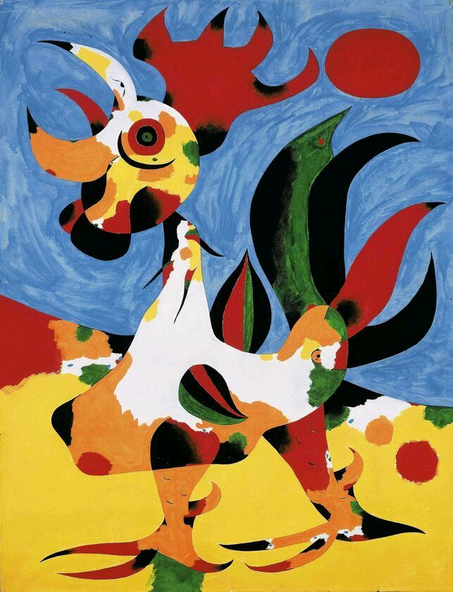
In Barcelona city, lived a boy called Joan. Joan liked to paint alot of animals like dogs, fishes, cats and birds.

Slide 3
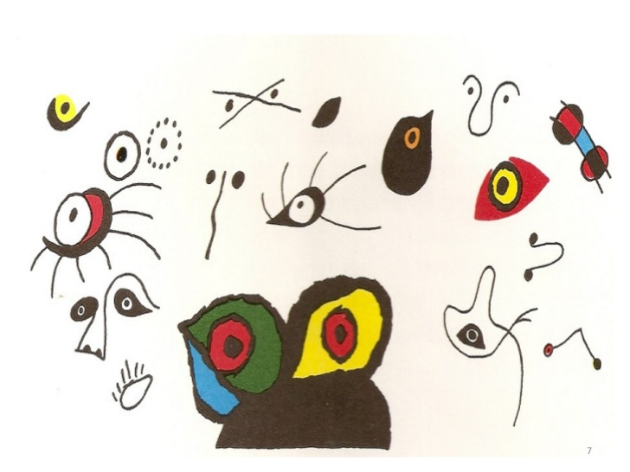
What he liked most was the animal´s eyes, because if he looked at them he knew wether they were happy or sad, if they were hungry or they were cold,… He painted them big, small, open, close, a lot of colours,…

Slide 5
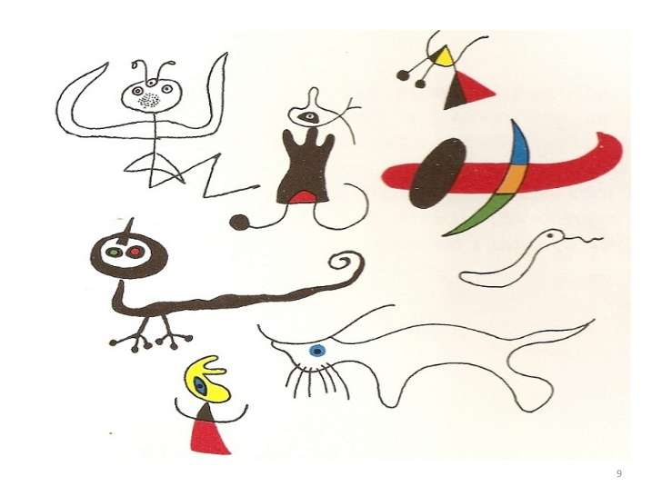
He even knew how to draw every animal, but he didn´t know what they were like, but a lot more beautiful!!! With 3 tails, 5 eyes, 2 noses, 7 legs, 8 hairs,… In this way they were more funnier and his paintings more happier and they were full of fantasy and hope.

Slide 7
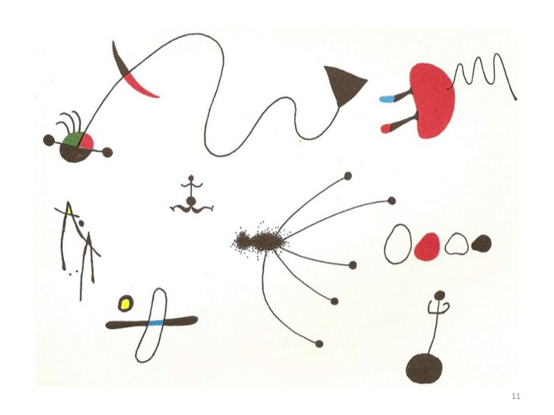
Joan loved nature, he painted leaves, trees, insects and stones!! They were heavy and grey colours, but he painted them big, small and of all colours like yellow, red, green, blue and orange. They had never been more beautiful!!

Slide 9
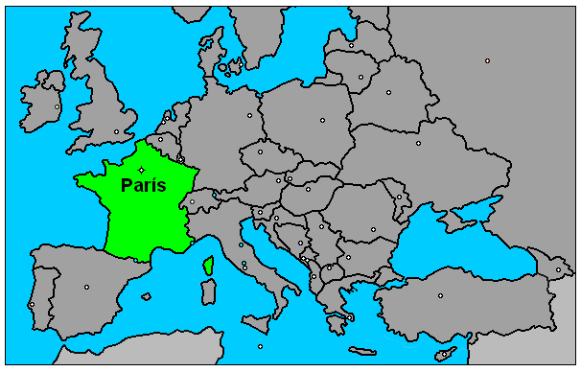
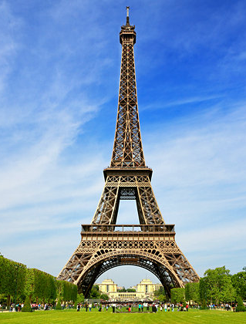
One day, Joan carried the animals and insects of his paintings to París. They went up a tower of iron and he showed them the immensity of the Universe.

Slide 10
He showed them the moon and sun too, the stars, planets and satellites, just like the constellations. He decided that they would be part of his world, all of them.

Slide 11
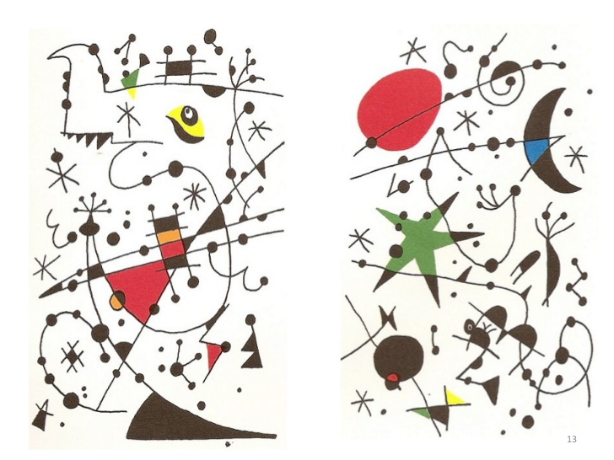

Slide 12
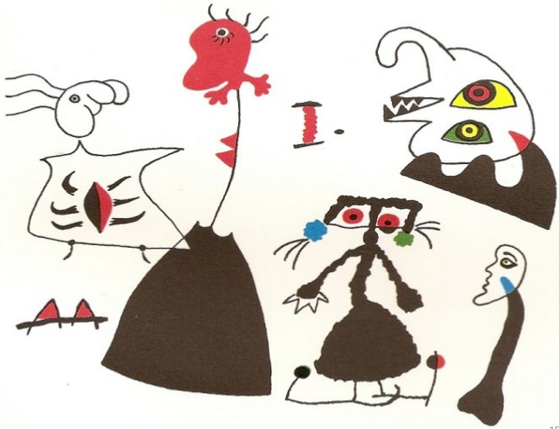
Another day, Joan travelled to Mallorca. It was a quiet place where there were men, women and children. Quickly, everybody was part of Joan´s magical world too.

Slide 13
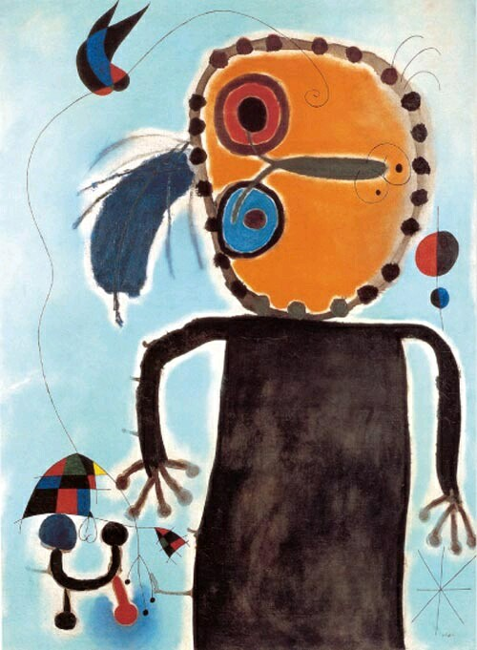

Slide 14
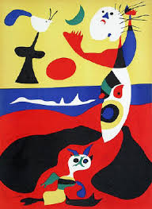

Slide 15
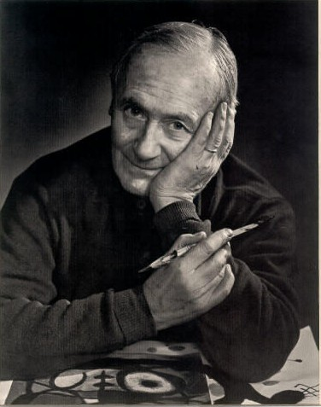
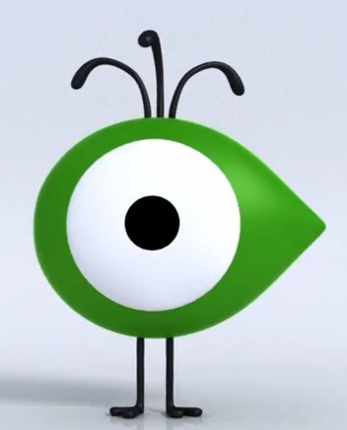
All elements were part of Miró´s life and his paintings. Where respect for freedom was the most important thing. This was a happy world for him.
THE END

Slide 16
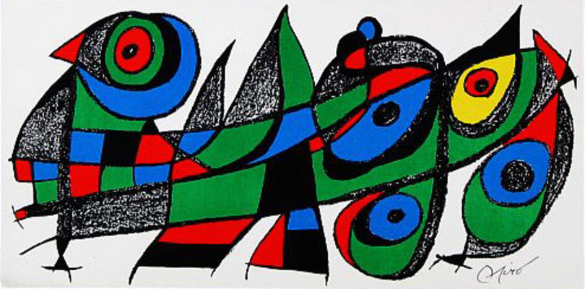
Where is the Miro eye?

Slide 17
Where is the Miroeye?

Slide 18
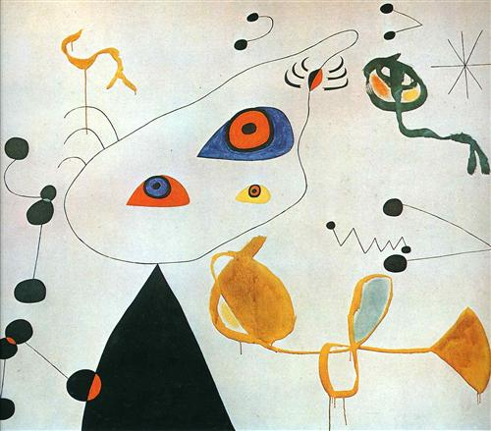
Where is the Miroeye?

Slide 19
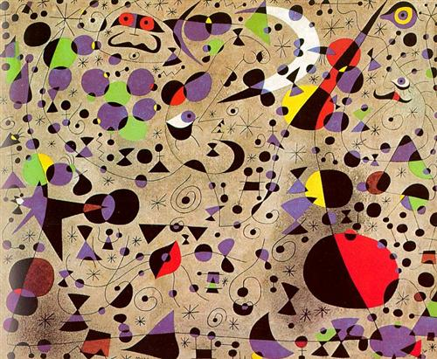
Where is the Miroeye?

Slide 20
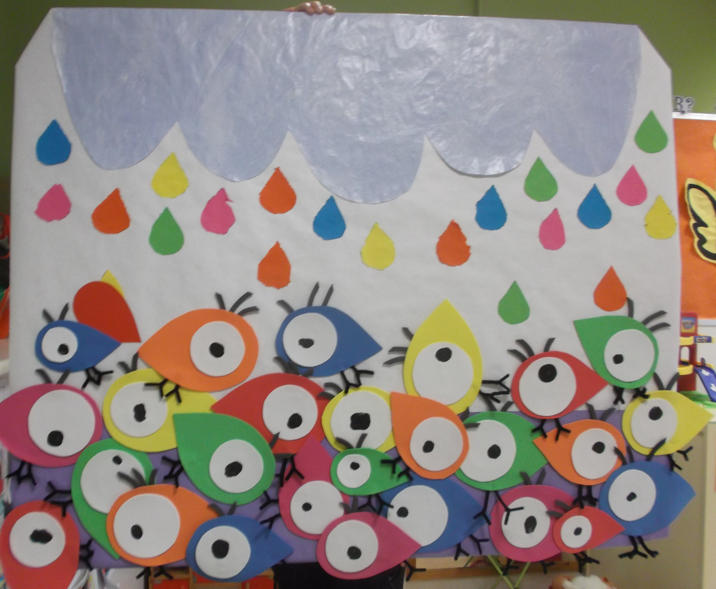
Now, we are going to draw Miroeyes, and later we will create a painting with them, like this…
Do you like it??

