Slide 1







The European Child:Learning by doing the 3 C’s - Connect, Construct And Create
Transnational project meeting
in Burgas, Bulgaria
28.11.2017.-02.12.2017.

Slide 2
The transnational project meeting
Bulgaria
Agenda
28.11.2017.
Get to know about the educational opportunities for adults and children in Bulgaria.
29.11.2017.
Attend lessons and watch teachers working with children, classes in nature, non-traditional activities.
Each country shows presentation about their school and about active teaching/learning activities used in their school.
Get to know about the results of the questionnaire.

Slide 3

The transnational project meeting
Bulgaria
30.11.2017.
Visit Burgas Municipality – meeting with the Major of Burgas.
Get to know about teaching policy in the country, priorities in the education, issues regarding teacher further training, the organization's activities, educational problems.
Active learning seminar/workshop with the participation of Associate Professor Dr. HrissulaNedyalkova. Theme: «Constructivist Teaching / Learning Method and its close relative theory «Active Learning»».

Slide 4
The transnational project meeting
Bulgaria
30.11.2017.
Discuss about International learning/training activities. We will work on clarification of responsibilities in order to teach activities 'CHILD OF NATURE’.
Discuss about responsibility during the project.
Discuss the Project website with the partners.
Discuss about budget and time management.
01.12.2017.
The theme "The Nature's Child". Learn how to use different environments, materials, methods….. Observations, discussions, studies.

Slide 5
main objectives of project
To develop children’s learning ability to construct knowledge by doing.
To prepare 21st century students for living in global society.
To develop teachers’ knowledge and skills.
To develop quality of education in the project organizations and others European countries.
To develop innovative didactic materials with the children participation.

Slide 6
The transnational project activities
Will take place on the dates:
October, 2017 Bulgaria (transnational project meeting)
Marth, 2018 Finland (learning/training seminar)
June, 2018 United Kingdom (learning/training seminar and transnational project meeting)
October, 2018 Turkey (learning/training seminar)
Mach, 2019 Italy (learning/training seminar)
June, 2019 Latvia (transnational project meeting)

Slide 7
Each organization also has some tasks that they are responsible for
Every institution is responsible:
for creating a good cooperation and communication in their institution and local regional municipality, as well as involving parents in activities;
for set up a work group and head of group is responsible for all activities and sharing results;
for creating innovative teaching methods to improve teachers and children skills, to share experience;
for preparing and planning international meeting and/or international learning /training seminar in their own countries.

Slide 8
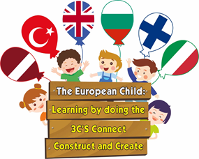
Responsibilities - bulgaria
Is responsible for taking photos, video films during the meetings.
Is responsible for creating and leading E-twinning project.
Bulgaria and Finland are responsible for creating the teaching material "CHILD OF NATURE".

Slide 9
Responsibilities-Finland
Is responsible for the training /learning seminar for the participants "CHILD OF NATURE"- (planning, management, evaluation, quality).
Is responsible for preparing project booklet (at the end of the project).
Bulgaria and Finland are responsible for creating the teaching material "CHILD OF NATURE".

Slide 10
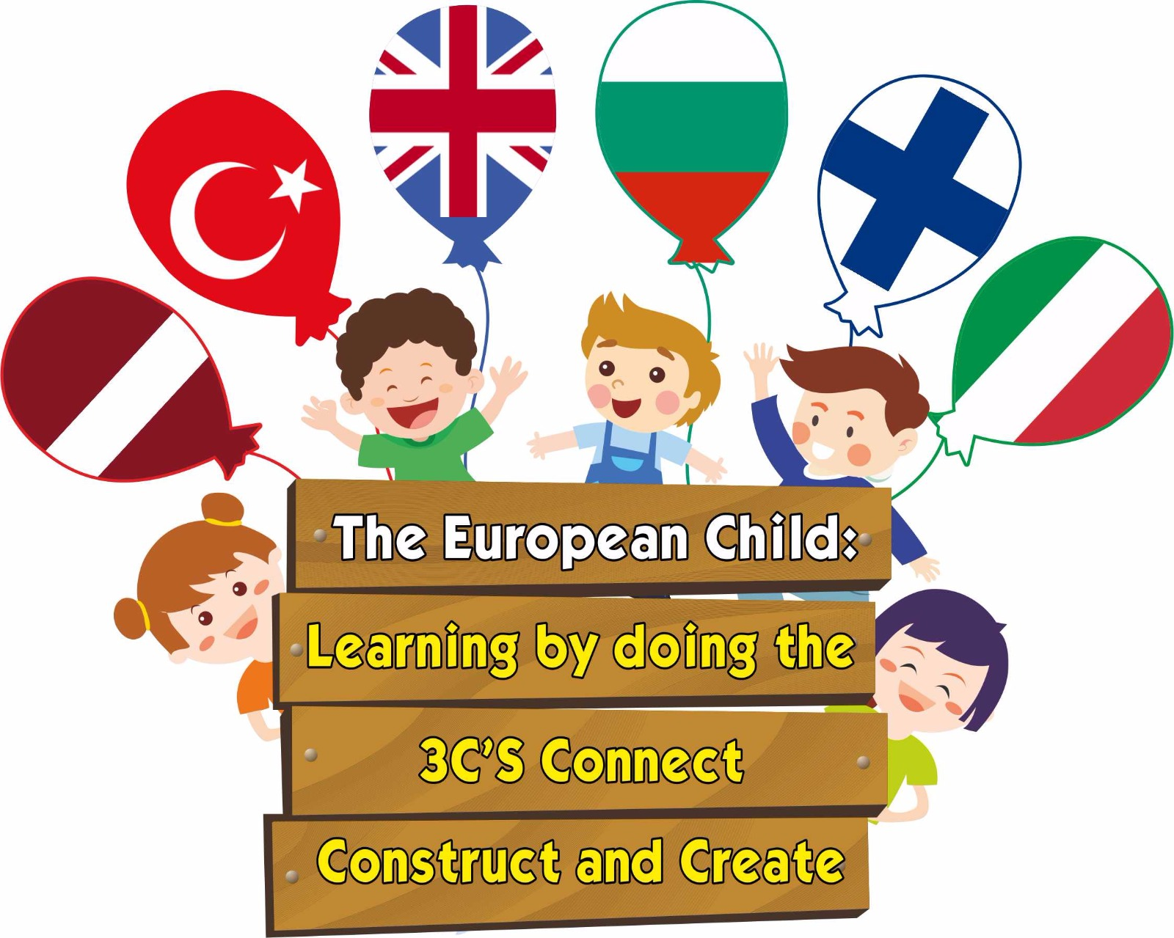

Responsibilities - United Kingdom
Is responsible for designing project logo and brochure
(at the beginning of the project).
Is responsible for training/learning seminar for the participants "I 'M AN ARTIST" (planning ,management, evaluation, quality).
Latvia and England are responsible for preparing the teaching material '' The Art Dvd'' and ''I'm an Artist'' training/learning seminar for the participants.

Slide 11
Responsibilities - turkey
Is responsible for preparing the teaching material ''ONE CHILD TWO LANGUAGES".
Is responsible for training/learning seminar for the participants "ONE CHILD TWO LANGUAGES"- (planning, management, evaluation, quality).
Is responsible for preparing surveys for the teachers and parents and the results of distribution.

Slide 12
Responsibilities - italy
Is responsible for preparing the teaching material "ROBOTING CODES".
Is responsible for training/learning seminar for the participants "ROBOTING CODES"- (planning, management, evaluation, quality).
Is responsible for taking protocol of all transnational seminars and meetings and sending them to all organizations (no later than one week after the activity).

Slide 13
Responsibilities - latvia
Is responsible for:
preparing the project WEB page (creating, following, popularization, maintenance in the long run);
sharing the material on a national /EU level, uploading information on EST database, project Web page;
(Go to Mobility Tool website at https://webgate.ec.europa.eu/eac/mobility)
transnational meetings (planning, management, evaluation, quality);
communication with partners during and after the project.

Slide 14
Activity calendar
October, 2017 –June, 2019
„Learning by doing the 3 C’s –Connect, Construct and Create”
Get the experience of the involved preschool, regional preschool and project partners in teaching/learning activities. Cooperation activities for Innovation and the Exchange of Good Practices. Four topics: Child of Nature I’m an Artist One Child Two Languages Robotics Coding Get the knowledge of the theme: "Constructivist Teaching / Learning Method and its close relative theory ''Active Learning‘’».

Slide 15
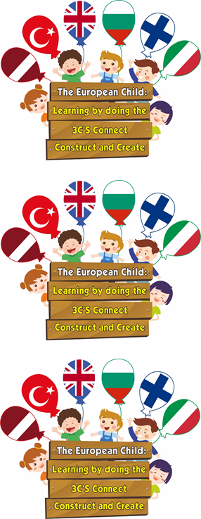
Activity calendar
October, 2017 – June, 2019
The meetings of the working group – once a month.
Teachers’ meetings – once a month (sharing the results).
Uploading materials on the Project WEB site (constant updates).
Communication with partner organizations through Facebook, e-mail, E-twinning.
Evaluation of results, monitoring, distribution (regularly).
Evaluation of benefit.

Slide 16
Activity calendar
October, 2017 – June, 2019
Constant co-operation with regional and local municipalities.
Constant communication with children’s parents.
Taking minutes of all meetings/ seminars.
Other Project management and activities.

Slide 17
September, 2017
Included project activities in the institution’s action plan. Each country created Project work groups. Met the local governments to introduce the project.

Slide 18
october, 2017
Created Project LOGO.
Created Project Brochure.
Set up the Project information board.
Created the Project WEB page.
Website will be key tool for sharing project results during the project implementation and in the long term

Slide 19
november, 2017
Created teachers’ questionnaires about their experience innovative teaching/learning methods.
Created parents’ questionnaires about their experience how they can help their children to develop their skills in their daily life.
Transnational Project meeting in Bulgaria.
A methodological ‘’Guide’’ about active learning will be prepared with the all partners during the meeting.
We should also share information on the projects in regional newspapers, and via country Internet links.

Slide 20
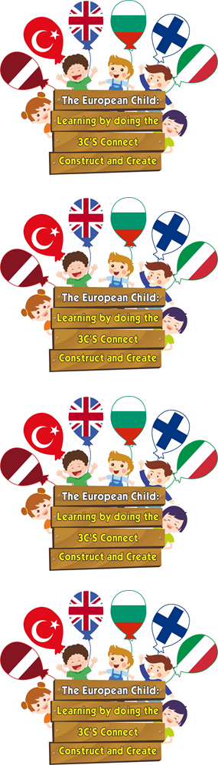
December, 2017 - january, 2018
Active learning seminar/workshop will be held for the school teachers and ‘’Active Learning Methodological Guide’’ will be introduced to the teachers.
Parents’ Days in pre-schools. Teachers will give information to the parents about the active learning activities which develop basic skills in their daily life.
To create E-twinning project on experiments, to share experience and get experience from partners in other countries.

Slide 21
February - March, 2018
International learning/ training seminar in Finland. Exchange of experience and good practices of professional development during the teachers’ workshop „Child of Nature”. Responsible (Bulgaria and Finland).

Slide 22
C 1 International learning/ training seminar in Finland
This activity aims to exchange of experience how to create 'Nature Awareness '' in children. Four nature trips. Each trip has specific tasks:
Autumn Trip: Orienteering games.
Winter Trip: Designing bird feeders and putting in natural environment.
Spring Trip: Planting tree.
Summer Trip: Recycling activities.
Children will prepare ‘’Nature Scrapbook’’ in these four season trips.
Discussions about the teaching techniques and materials.

Slide 23
BUDGET
Do you have any questions?
1. Project Management and Implementation
2. Transnational Project Meetings
3. Learning/Teaching/Training Activities
3.1. Travel
3.2. Individual Support

Slide 24
Thank you for your attention!
Questions!

